Slide 1


Molly Eckman,
Service Coordinator Supervisor
Notes:
Molly Eckman, County Connections SC Supervisor
A little history
Janitorial alongside individuals
Direct support
Team lead
Employment
Community skills coordinator
Service coordinator
SC & Quality Assurance
SC supervisor

Slide 2

My Life Course Journey…How it Started
Notes:
My boss chose 2 staff to join the LifeCourse Work Group. One choice being someone she knew would grab a hold of the tools and be all in! And the other… that was me! The one who shows resistance, uncertainty, and the one who takes a tad longer to convince.
We started to pilot the LC Tools with individuals & families on our caseload who were just the same as my coworker & I…. Families we thought who would grab tools and run with them and explore and somewhat “do the work for us”.. And other families who I thought would closet the tools, put them up on the top shelf, never to think of them again. What I found out was, I wasn’t right. Those families who I thought would embrace them often didn’t and visa versa.
I also found out that giving someone a folder with resources listed & and pockets full of tools was not at all successful. Charting the LC Success is having the right conversations. Charting the LC Success is mapping out ways to make those big dreams we all have- reality.
What really made the tools start making sense for me was when County Connections experienced a little bit of staff turnover
I used the tools as a means to develop new relationships and a quick snapshot of what’s really important to the person

Slide 3
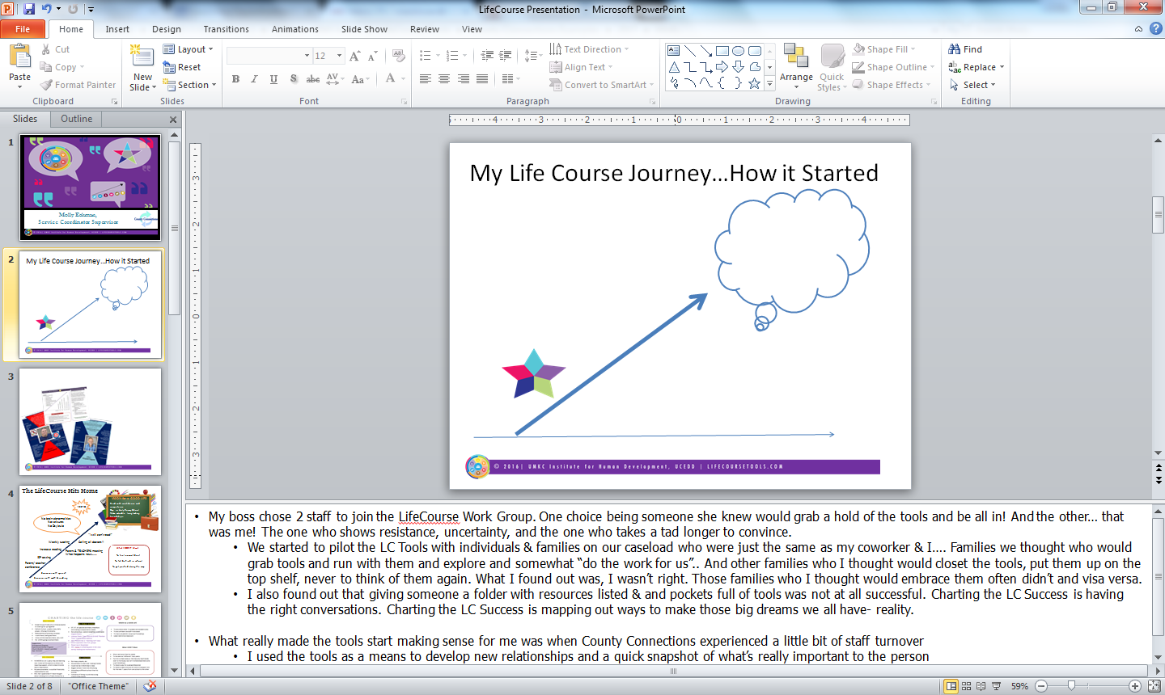



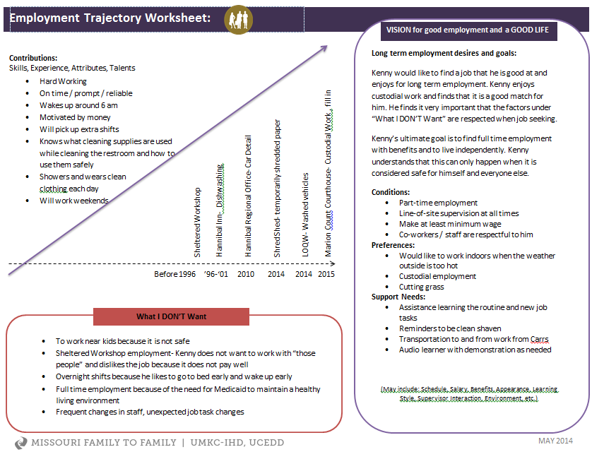

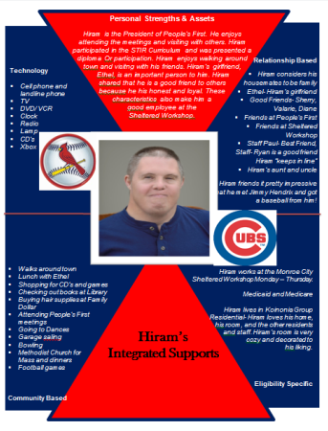
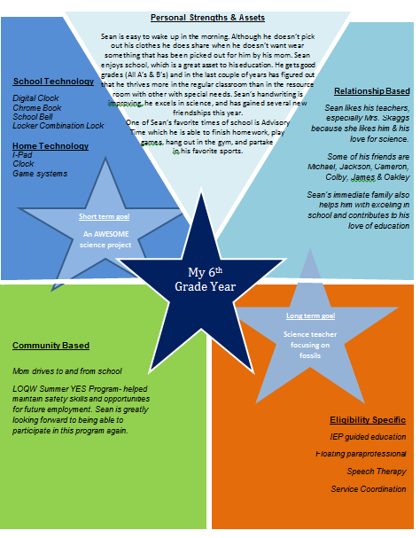
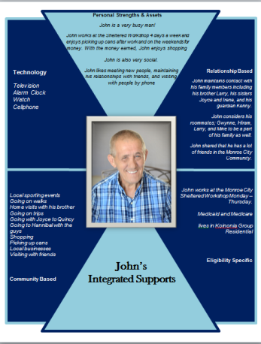


Building relationships
Notes:
For me, I’m quite competitive, so I had to use the tools the most! I had to hit the most families with it and I had to get them done! At that point, I was all about the doing and sharing! I had to dive right in and start using tools and figuring out what they were all about through trial and error. (I found out, there’s no real error- aside from the lack of trying).
So that’s what I did… I dove in easily
Asking questions- what do/ don’t you like, whose important to you, where do you go in your community
Moved on to- do you like your job? Why or why not
As an organization we began sticking LC sprinkles everywhere- our team meeting, our ISPs, QR, SM’s (Kim’s presentation)
So I found out that while I was COLLECTING information from people… I was just collecting it and making it look pretty… Well that was leading me more toward “what I don’t want” out of the LC tools. Then came the Aha moment… Those conversations I had about employment made the perfect trajectory I just had to think about it differently. So through the layout of the trajectory I was able to track what his employment history was, what successes and failures he’s had, and where he sees himself. This became much more than a piece of paper, it became a guide.
It made a valuable impact when I saw what the tools meant for others. Through conversation navigated by the tools, I feel like I gave people a voice. People were hanging the tools on their walls, using them to guide their own IEPs and ISPs, taking them to school and educating their new teachers about themselves and their support needs, fostering empowerment through VR by taking the tool and sharing about their successes and support needs with employment .

Slide 4

The Life Course Hits Home
VISION for a GOOD LIFE
100-IQ
Read with confidence and competence
Stay in Holy Rosary School
Make valuable long lasting friendships
Read with confidence and competence
Stay in Holy Rosary School
Make valuable long lasting friendships
No brain abnormalities
No seizures
No Dsylexia
“I still can’t read!”
Weekly tutoring
Calling all doctors!!
Increase reading
What I DON’T Want
Parent & TEACHERS meeting
What happens next…….
IEP testing
To feel unconfident
To fall behind in school
To get pushed along the way
Parent/ teacher conference
Concerns with speech
Concerns with math & reading
Notes:
My little guy; has fallen way behind in reading, math and learning in general. He has a lisp & if he wasn’t so cool- he’d likely get made fun of for that
Parent teacher conferences were held showing some concerns IEP testing was completed
Like all moms, I thought about worst case scenario, but I wasn’t concerned about that “labeling” and what developmental delay he might have… I felt like if the test came back saying that then I was blessed to have so much background knowledge in the field…. However, the IEP testing came back with an IQ of 100 (ata boy!)
I was thrilled….. But the problem continued to remain. He’s behind in math, reading & learning in general.
So we increased reading at home, added on a tutor, I take him to the public school 4 hours a week for his special services
Then I got a call about another P/T meeting… This one was the big one.. Hold him back? Send him to public

Slide 5
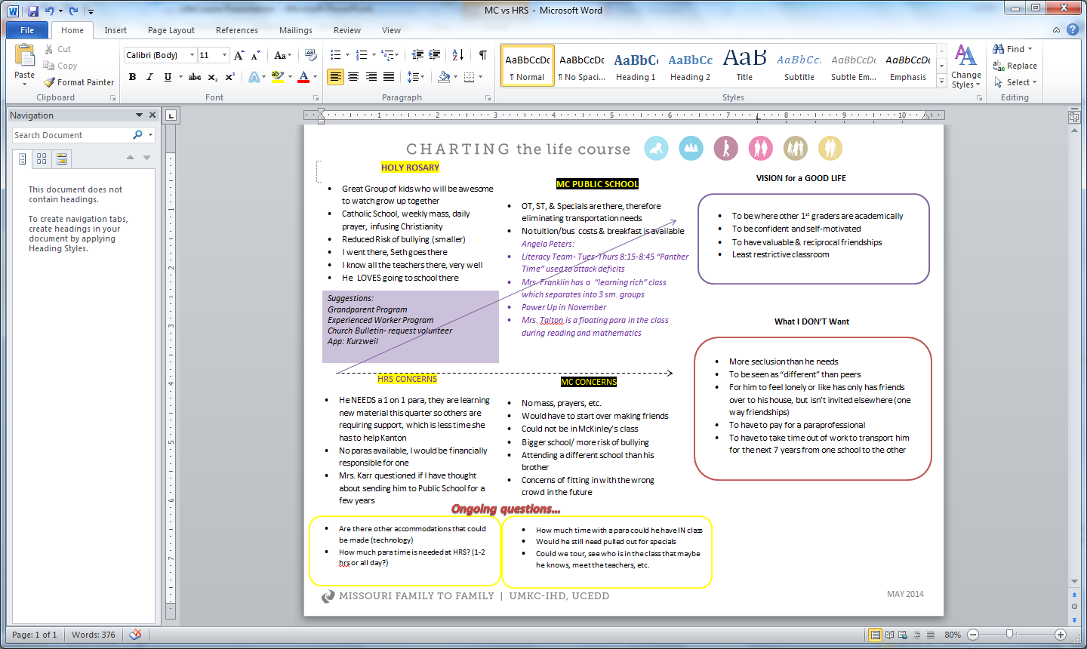
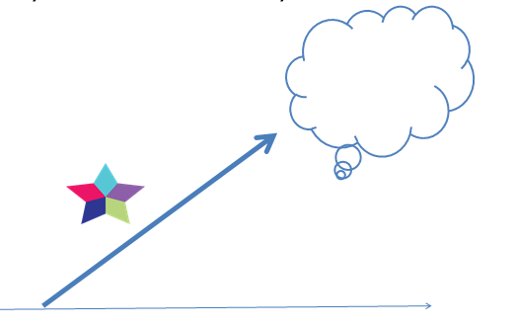
Notes:
What do I do… - a trajectory (kind of). So I brought this tool to the school. I guided the discussion. I encouraged the teachers to give me suggestions and ideas, but I was not going to let them choose his fait, his school, what services he received, etc. so I followed up on their suggestions
There were no founding’s from an eye exam, brain scan, sleep study, or a dyslexia screening, nootttthinnngg but a major disconnect.
From then on, I ALWAYS use Life Course Tools to mediate my sons school meetings
I haven’t come up with any answers, but I have a stack of life course tools to track my journey with him.

Slide 6

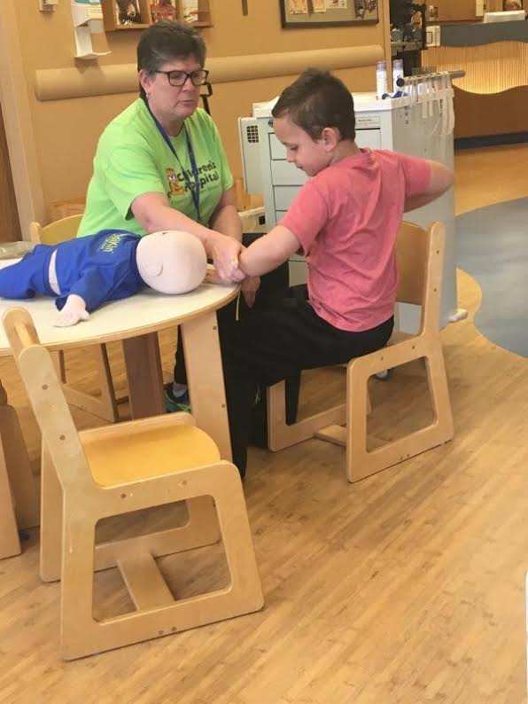
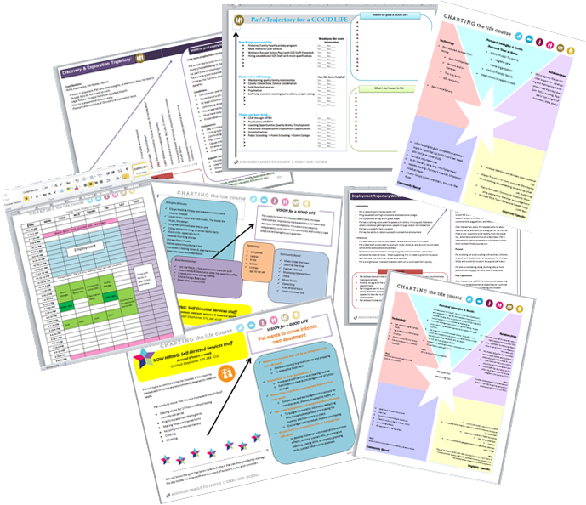
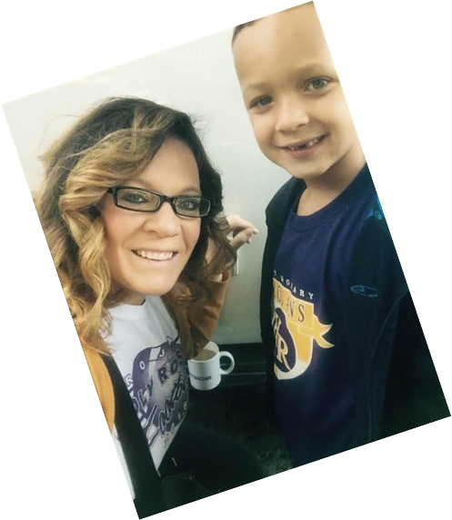
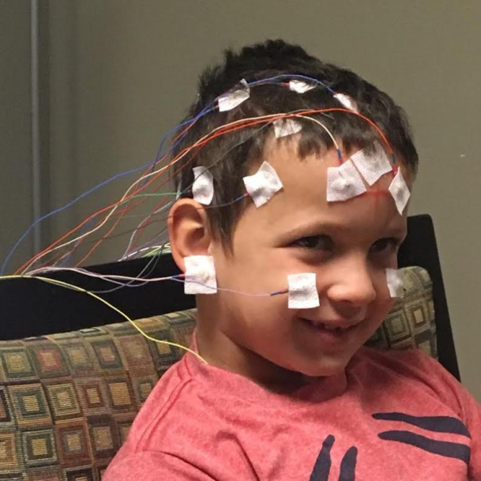
Notes:
But the LC framework didn’t really hit home until it actually HIT HOME.
I find myself to be a pretty good SC. I like to hear about others lives, I like to advocate for others, and this is the field that I grew up in- I’m passionate about it (and believe me- im not passionate about much!) But I never knew I would have to use the tools for me. For my family. To troubleshoot my own problems.

Slide 7
Notes:
So I figured out…. If I can use Life Course Tools for working with individuals, my children, schools providers, employers, etc. then why can’t I just use it for everything! So I am…..
Thinking about a new job, check
My goal of quitting smoking, check check!
My better health journey– ohhh still there! Day 17 of Whole 30 (thumbs up)
Even for my house hunting adventures. It was such an easy lay out. What I really wanted, what I don’t want, and how the house ranked on my lists.
To map out my job skills and tasks

Slide 8
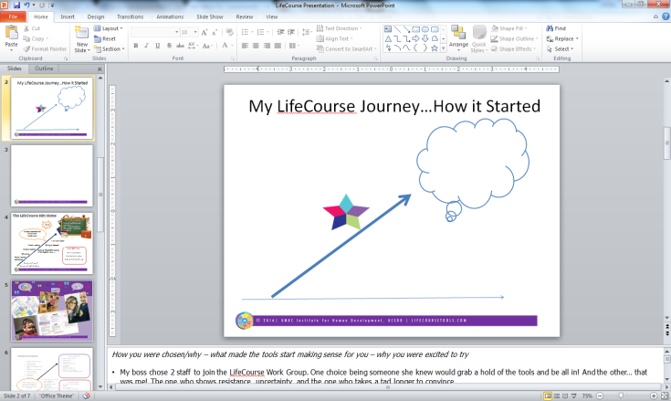
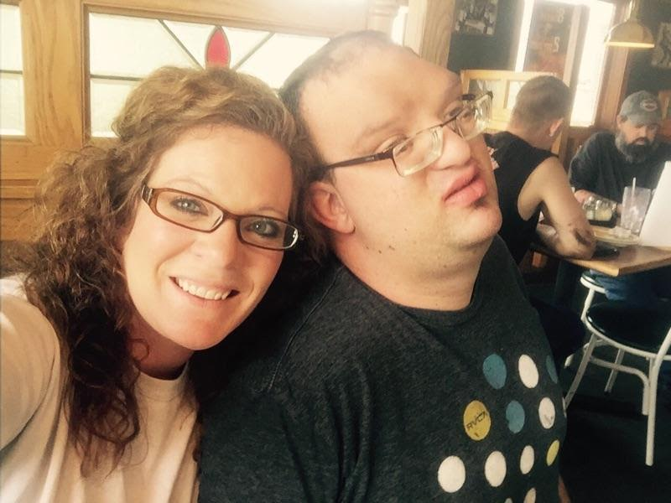
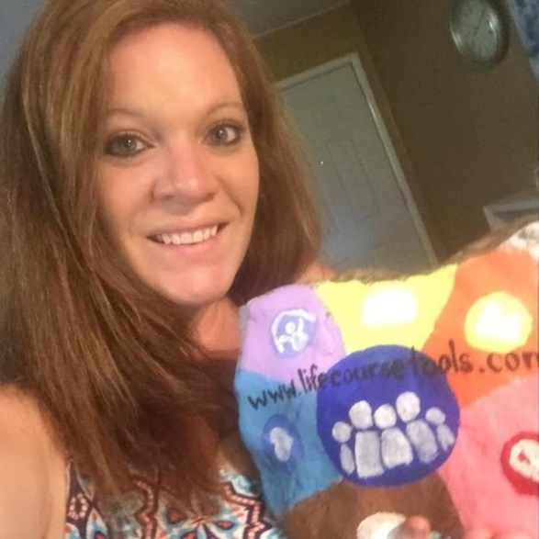
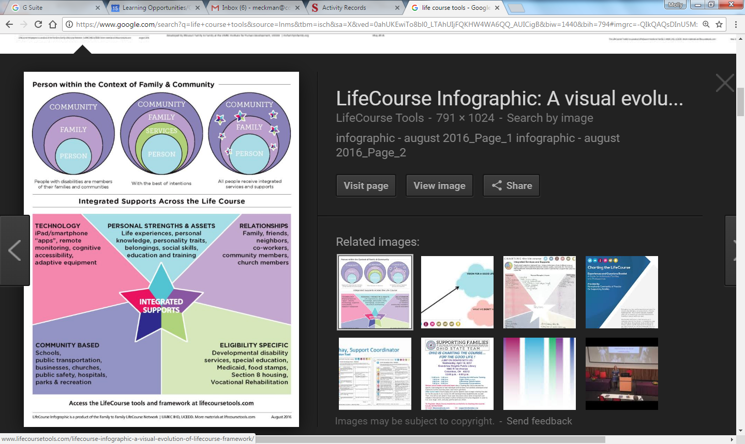
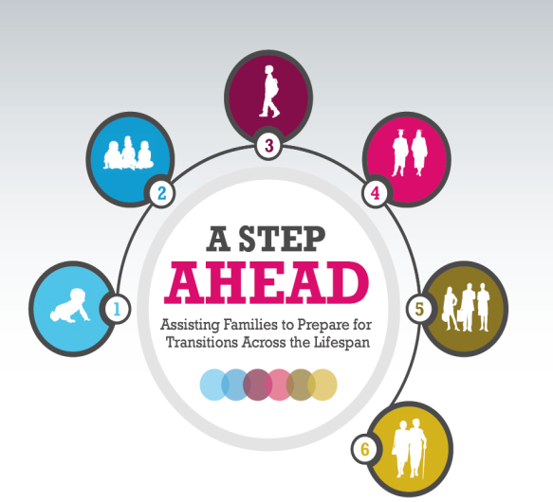
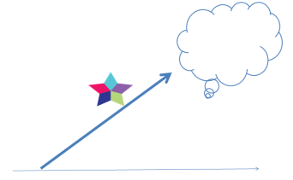
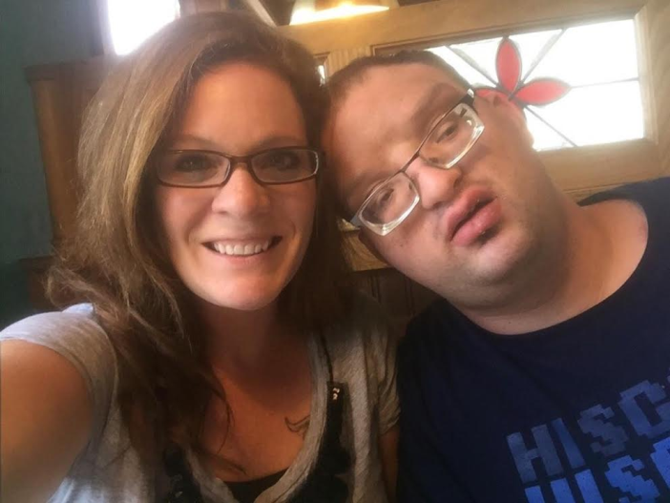
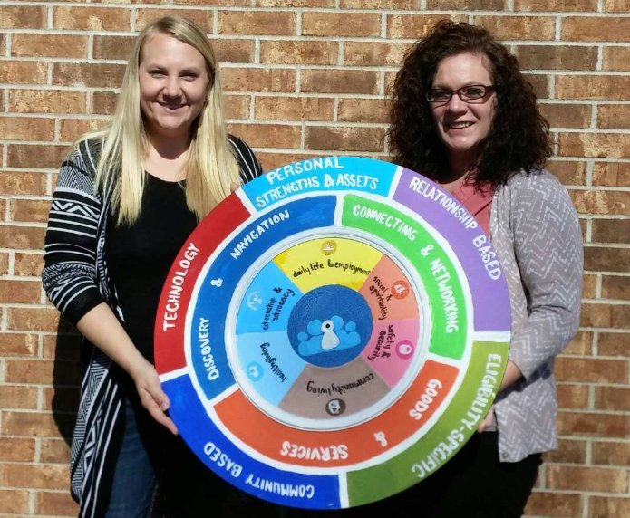
The Life Course leaves It’s Mark
Notes:
So for me, the LC framework leaves its mark. And not only through the sprinkle its left on our forms… but I use it in my everyday life for work. As a Service Coordinator, my job is to support individuals with developmental and intellectual diagnosis reach their goals. What better way to reach your goals than to use the trajectory to map out what your goals are, what steps you should take to get there, and what things to avoid. Coupled with the Integrated Supports Star to look at those goals and assure you are using variety of resources, not exhausting just one. Through the use of the LC we found that not every goal needs to be reached by Eligibility Specific / paid supports; sometimes, people just need to explore their communities.
My Journey’s not over…what I anticipate for the future I don’t know….This evolves with us as we grow personally and professionally…I just want to impact people as they come through our door, which is why I’m starting right off using the LC tools & philosophy with our intakes.

