Slide 1


Missouri
Self-Directed Supports:
Charting a LifeCourse
Charting LifeCourse Showcase
May 17 & 18, 2017

Slide 2
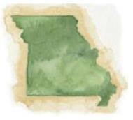
Missouri Division of Developmental Disabilities
Kyla Mundwiller
Missouri Division of DD
Director of Self-Determination
kyla.mundwiller@dmh.mo.gov

Slide 3
Building Program Integrity
If you have seen one self-directed support program you have seen one self-directed supports program.
If you have seen one state structure for home and community based supports you have seen one state's structure.

Slide 4

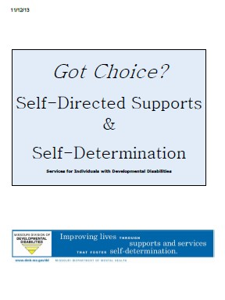

What is Self-Directed Supports?
Self-directed supports (SDS) is an option for service delivery for individuals, who live in their own private residence or that of their family member & who wish to exercise more choice, control and authority over their waiver supports. SDS is firmly grounded in the principles of self- determination.

Slide 5
Where did this all begin?
1993 Original Proposal to the Robert
Wood Johnson Foundation.
“If individuals and families have control of the resources, quality will go up and cost will go down.”

Slide 6
Self-Directed Supports
SDS is based on the premise that the individual and their representative know best about their needs and how to address those needs.
The individual must be empowered to make decisions about the services they receive, including having choice and control over the type of supports they receive, who provides the supports and when and where the supports are delivered.

Slide 7
Shifting Power
From
Professionals planning for individuals
Reliance on paid professions who are only temporarily part of an individuals life
A view that only professional can be responsible
Support Coordination as a means to let people into existing services
To
Individuals and families planning for themselves
Reliance on the lifelong commitment of individuals and families to manage their own lives
Respect for the fact that individuals and families have a vested interest in acting responsible on their own behalf
Support Coordination & Support Brokerage as a means for individuals and families to create services in response to their needs and dreams

Slide 8

A Brief Missouri History
1998 Missouri’s State Planning Council(MPC) “Show Me Change: Building A Participant-Driven System For Missourians With Developmental Disabilities.” The report concluded:
“Resources for supports in Missouri must be allocated and expended from a person-centered rather than a provider centered perspective.”
“Individuals must be in control of their allocated resources for services and supports and how they are delivered.”
2003 “DMH Practice Guidelines for Consumer
Directed Supports and Services”
2003 Independence Plus Grant

Slide 9

A Brief Missouri History
2009 Self-directed Support Coordinators in 12 Regions
2009 SDSC Monthly Reports
& Goals
2009 Consultation from National Experts Sue Flannigan and Robin Cooper
2010 “Got Choice?”
Handbook finalized

Slide 10

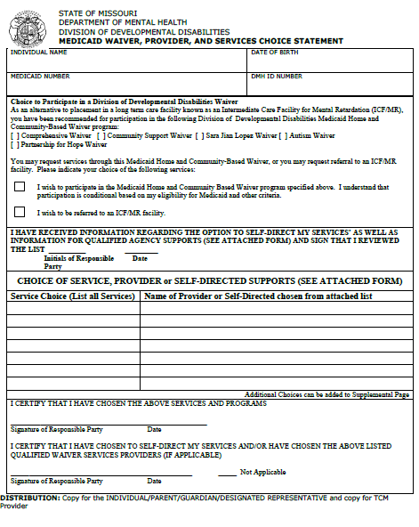
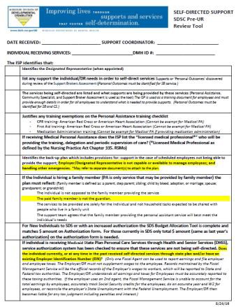
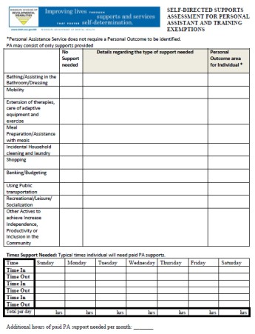
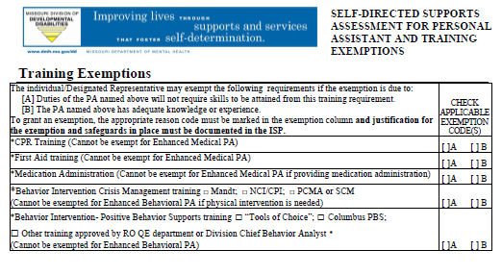
A Brief Missouri History
2010 Service Coordinator
training.
Service Monitoring Guidelines Created tools for SC
A tool for ensuring that the ISP is meeting waiver requirements and helps to determine goals and outcomes.
ISP Checklist
PA Assessment
Medicaid Waiver, Provider and Services Choice Statement

Slide 11
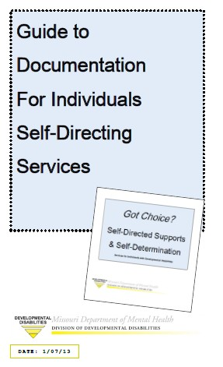

A Brief Missouri History
2013 “Guide to Documentation for Individuals Self-Directing Supports”
2013 “Guide to Creating your own ISP when Self-Directing Supports”
Will be revising based on the LifeCourse Tools

Slide 12
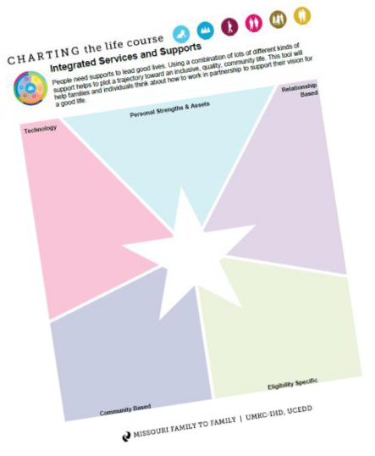

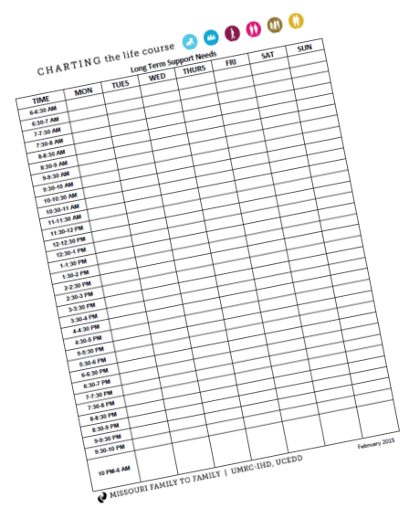
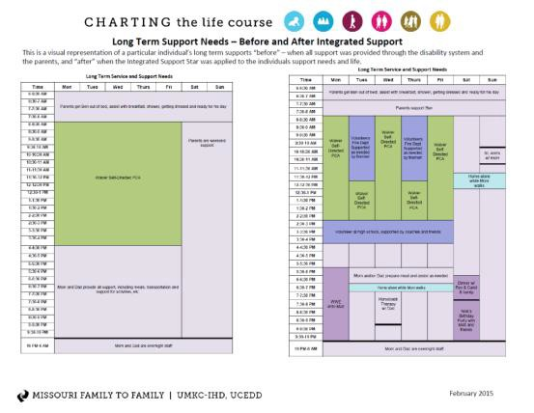
A Brief Missouri History
2015 Statewide Individual Budget allocation process. 2015 Began to incorporate
LifeCourse tools into
training
LifeCourse tools for individuals, families, and professionals. Are helpful in having conversations with individuals and families about a vision for a good life and how to achieve it.
“Personal Supports Budgets as a Means for Promoting Self Direction: Balancing Ideology with Fiscal Discipline Within a LifeCourse Framework “ Tomorrow at 1:00!
www.lifecoursetools.com

Slide 13

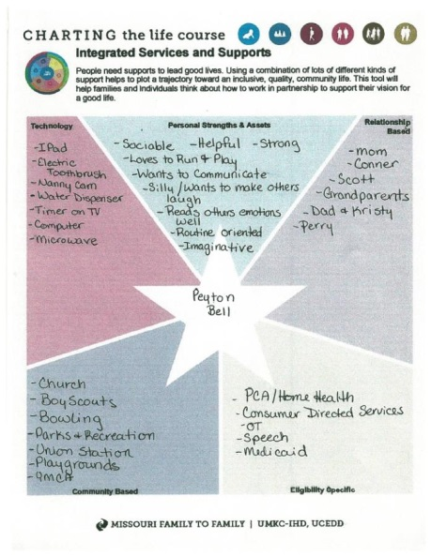
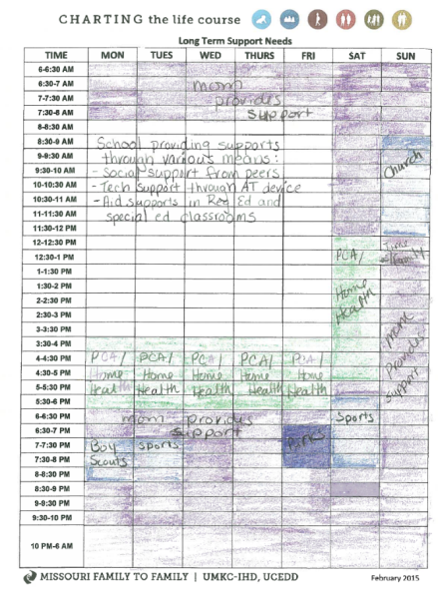
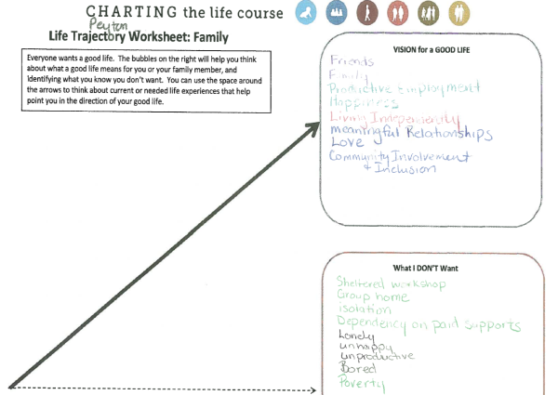
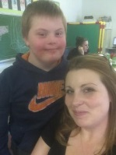
A Brief Missouri History
2016 LifeCourse Community Wide Events
  Included examples of families using Life Course when self-directing supports

Slide 14






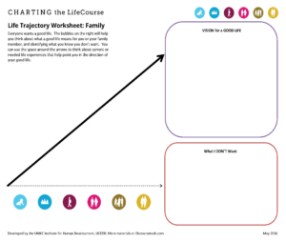
A Brief Missouri History
2016 ISP Guide Revision
Organized around the MOQO/LifeCourse Domains
Use LifeCourse Language
  Trajectory (Dreams)
  Integrated Services and Supports (Natural Supports): Technology, Personal Strength/Assets, Relationship based, Community Based, Eligibility Specific
Increased skills of using LifeCourse Framework
  Workgroup included Mo COP team and LifeCourse Tools Practice Group
Notes:
Use to say that you must exhausted all other supports before use of waiver.

Slide 15
A Brief Missouri History
2017 SDS and FMS Advisory Group
Includes: Individuals, Designated Representatives, family members, Support Brokers, FMS, Support Coordination, MO Family to Family Representative and State agency.
What is working/what is not working in order to create a work plan.
Creating informed stakeholders.

Slide 16



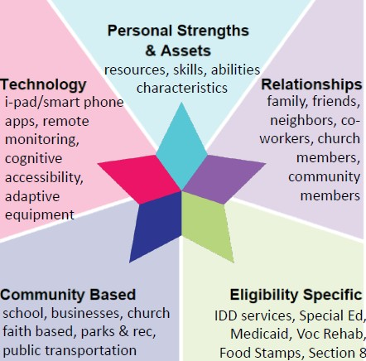
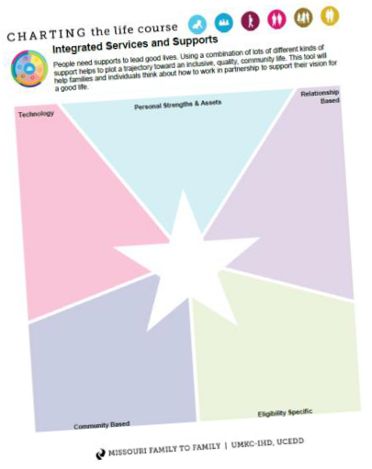
A Brief Missouri History
2017 Regional Training Events Informational Events: Self-Directed Supports & Integrated Supports and Services

Slide 17
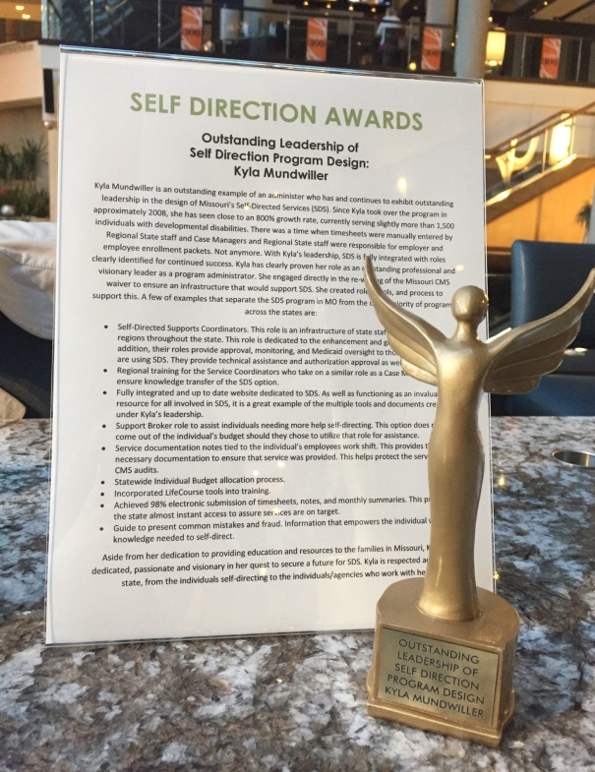

A Brief Missouri History
2017 Missouri receives:
National Applied Self Direction award for ‘Outstanding Leadership in Program Design’.
www.appliedselfdirection.com

Slide 18
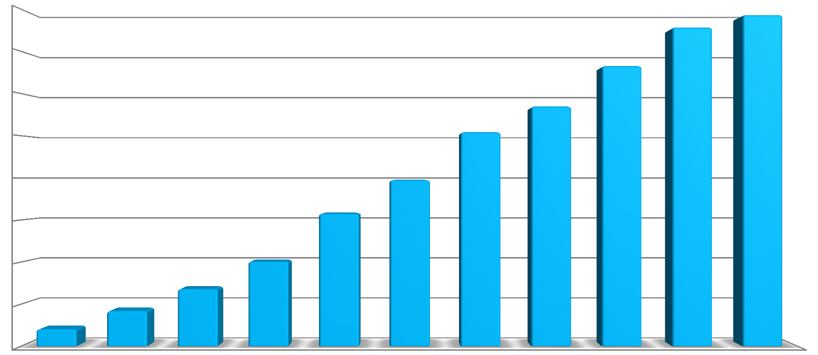


Missouri Growth in
Self Directed Supports by Year
Growth in Self-Directed Supports Number of Participants by Fiscal Year
_{1,516} 1,575
1,600
1,400
1,332
1,200
1,140
1,018
1,000
791
800
631
600
403
400
272
168
200
81
-

Slide 19
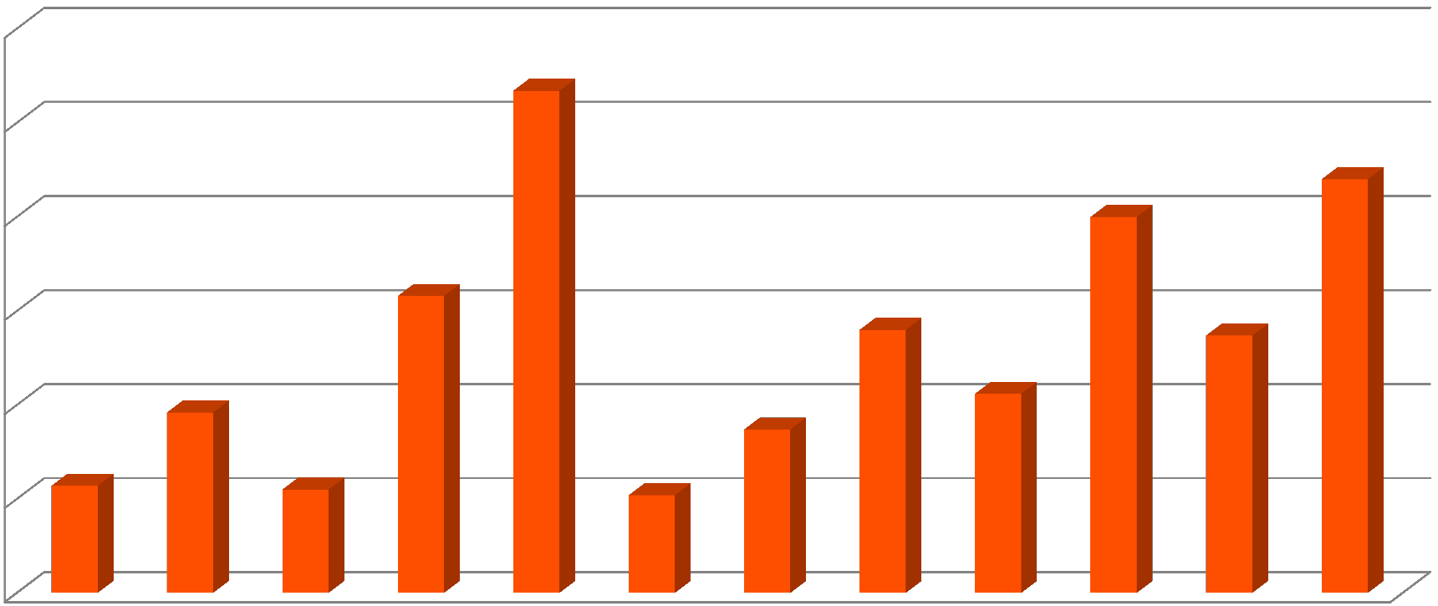




Missouri SDS # by Region
Total # of Individuals Enrolled in SDS By Region
(Statewide 1575 individuals )
300
267
250
220
200
200
158
140
137
150
106
96
87
100
57
55
52
50
0
Notes:
I may leave this in to show how KC has the largest number and related to MOF2F

Slide 20
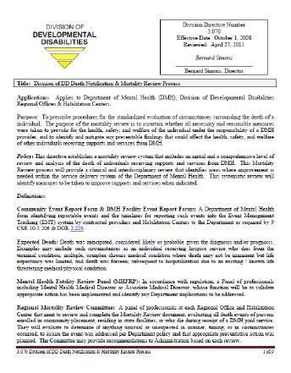
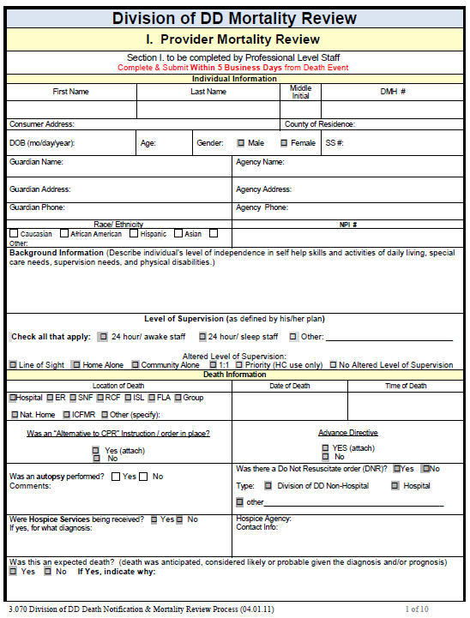
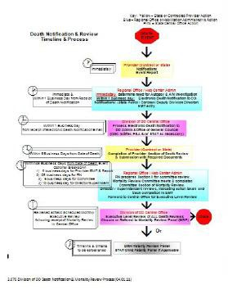
SDS in a Changing Environment
- Mortality Reviews
Families Changing the System by providing stakeholder feedback.
Death Notification and Mortality Review
Non-Hospital Do Not Resuscitate Orders

Slide 21
Rules Rights Responsibilities
In Missouri rights for people who receive services can be found in the following of laws, rules and regulations:
Missouri Revised Statue 630.115.1
Patient's entitlements
Missouri Code of State Regulations
Rules of the Department of Mental Health Division of Developmental Disabilities 9 CSR 45-3.030 Individual Rights
Code of Federal Regulations 42CFR 441.301(c)(1) Home and Community-Based Waiver Services (HCBS)
Authority for each right and protection
can be found in a blue box like this.
For more information about your rights at dmh.mo.gov/constituentservices/rights.html
Notes:
Rules help us to understand the things that we need to do in order to keep our rights.
Everyone follows rules. Some types of rules are laws. Can you think of other places that we use rules. Wait for answers. Some answers may be (schools, classrooms, cities, towns, countries, home, work, etc.)

Slide 22
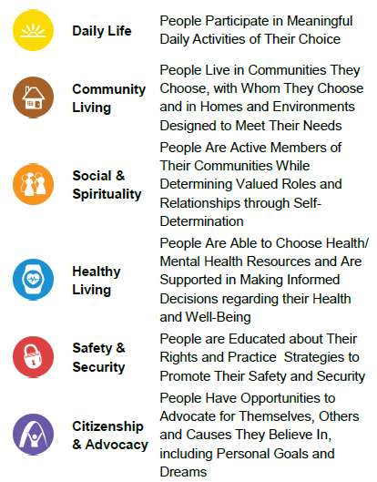
Rules Rights Responsibilities
Rules
Having 3 sources for rights was confusing because not all rights are covered in one authority and sometimes that different authorities overlapped. So rights have been organized by the MOQO/LifeCourse Domains

Slide 23
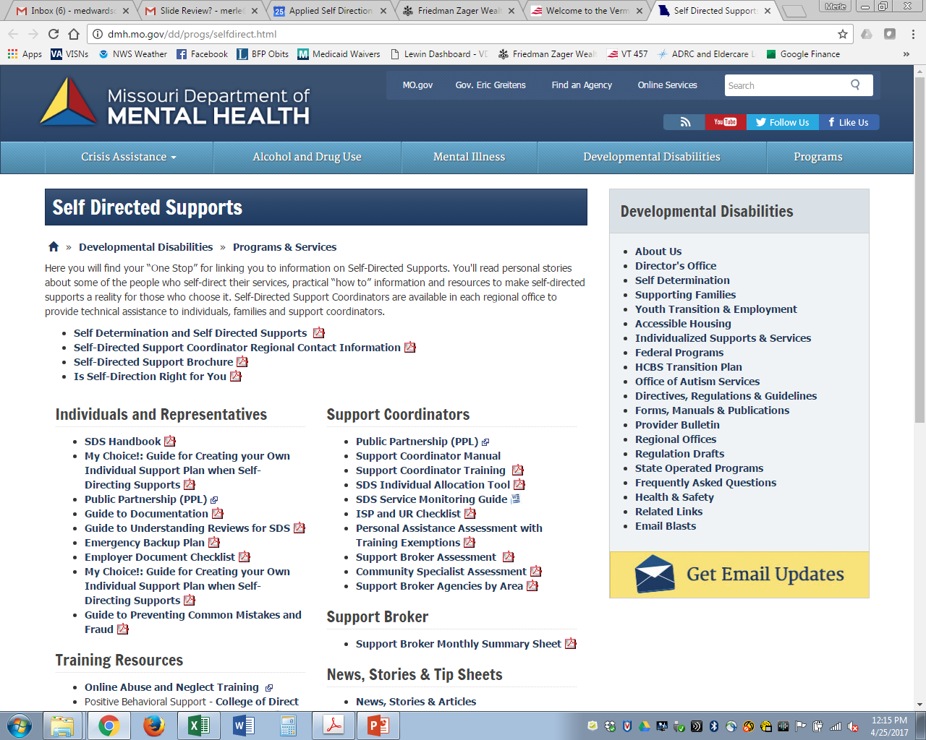
dmh.mo.gov/dd/progs/selfdirect.html

