Slide 1
ACTIVITIES IN EDUCATION

Slide 2
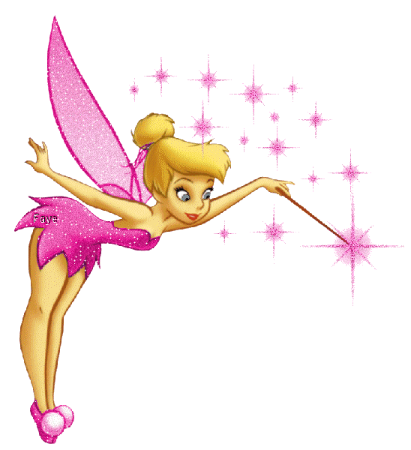
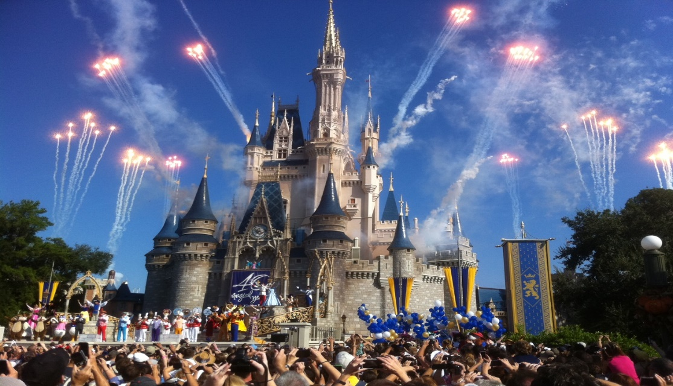
Meet Aly
She is 6 years old
She likes music, dancing and anything Disney
Her favorite color is pink sparkles
Her favorite food is tomatoes
What she wants most is to visit Disney World!

Slide 4
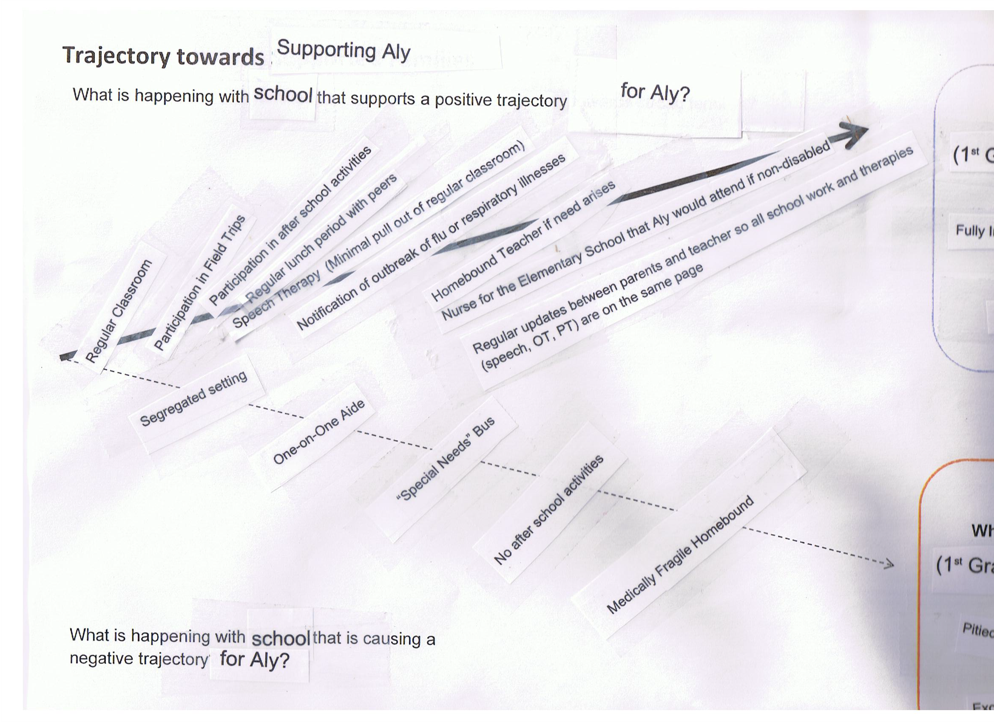

Slide 5
Preparing for Aly’s IEP

