Slide 1
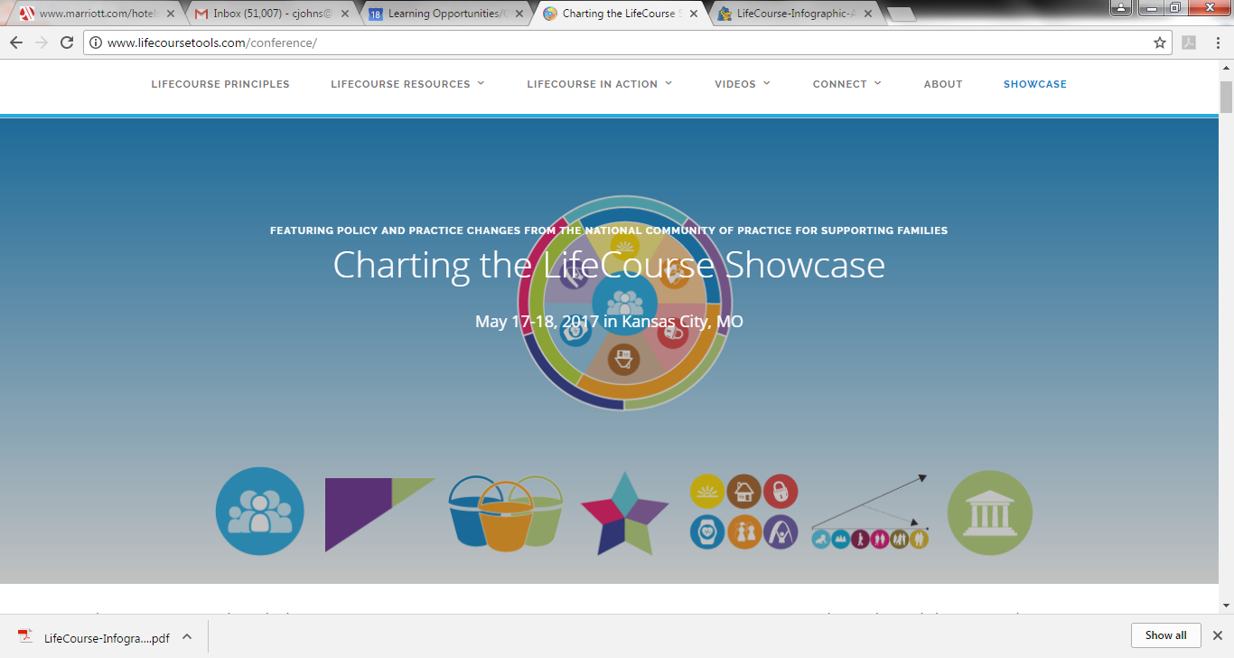
Charting the LifeCourse Showcase
Kansas City, Missouri
May 18, 2017
LifeCourse & Adult Employment Outcomes:
Focusing on Provider’s Journey
Notes:
Welcome! Thanks for joining us today!
Give really short intro of ourselves here if not done by a session facilitator.
Mention handouts and give brief information on them.

Slide 2
Notes:
As I thought about this conversation on the way here this week…. I kept thinking about the snow ball effect…. You start small and build momentum….

Slide 3
Benefits of Family Involvement on Employment Outcomes
Family Involvement
Advocate for and advise on policy & practice improvements
Influence on other families and community members
Person
Community
Policy & Practices
Can bring citizens, employers, etc. to the table
Notes:
Sheli Cyndi
We are really here today to talk about:
--What are the benefits of Family Involvement and
--How can we better involve families in Missouri to support Employment Outcomes

Slide 4
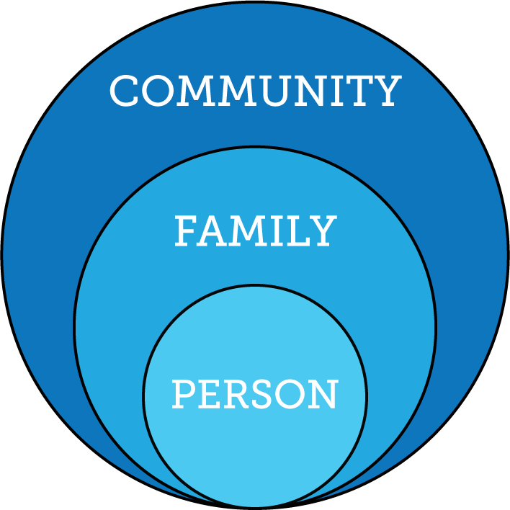
Individuals Exist Within the Context of Family and Community
Notes:
Cyndi
It is important for us all to remember that Individuals exist within the context of their family and then within the larger context of their Community.
There are a few organizations in Missouri working closely with Family to Family to think about this…. And not only just the individual in the context of the family but also in terms of our organizations, our organizational change, and our Community Initiatives.

Slide 5
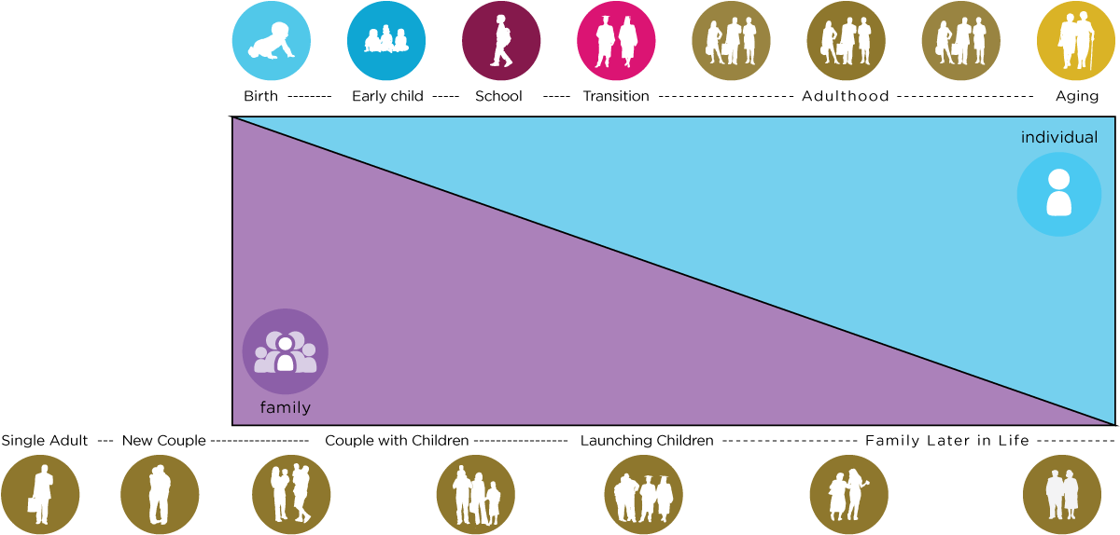
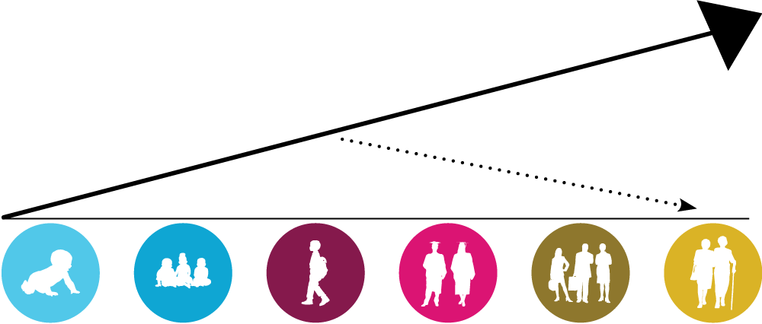
Lifelong Impact of Family Impact on Career Planning
Family Cycle Impacts Member Life Cycle
Family Life Experience Impacts Trajectory
Biology: Likes, dislikes, skills, abilities
Social: Family and friend network, connection with community members
Environment:
Neighborhood,
socio-economic, education
Policy:
Dreams, aspirations,
house rules, cultural rules, expectations
Family Unit Impacts Individual Level Characteristics
Notes:
Cyndi
Just use visual to reinforce previous slide discussion.

Slide 6
Where Adults with I/DD Live
89% of People I/DD are Supported
Outside of Formal Residential Supports
Larson, S. A., Lakin, K. C., Anderson, L., Kwak, N., Lee, J. H., & Anderson, D. (2000).
Notes:
Cyndi
Just use visual to reinforce previous slide discussion.

Slide 7
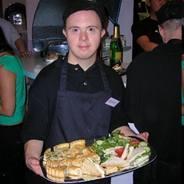
!
The focus is on the “person with a disability”
this does NOT mean that “Family Involvement” supersedes the INDIVIDUAL
It is not…….
family involvement VS person centered
Family Involvement is a component of a holistic approach to person centered supports (focusing on employment outcomes) that recognizes the context and impact of the family in practice and policy implementation.
Notes:
Sheli Cyndi
The other thing we just want to remember as we are having these discussions today is that the focus is on the individual… but that doesn’t mean that we are talking about allowing the family to supersede the rights and self determination of the individual…
… but rather how does it COMPLIMENT the person centered practices and cool work everyone here is already doing.

Slide 8
UCP’s Case for Inclusion, 2015
Notes:
Cyndi
The OTHER parts of the LifeCourse

Slide 9
UCP’s Case for Inclusion, 2015
Families have a tremendous impact on the successful transition of their children into a full and rich adulthood.
Most importantly, parents must:
Expect employment for their child
Expect postsecondary education for their child
Ensure high functional academic skills are realized by their child
Ensure their child completes high school
Notes:
Cyndi

Slide 10
Why do Families Need to be Involved?
DISCOVERY AND NAVIGATION Knowledge & Skills | CONNECTING & NETWEORKING Mental Health & Self-Efficacy | GOODS & SERVICES Day-to-Day & Caregiving/Supports
Notes:
Kim
One of the things we always want to remember…. Is whether it’s the individual or the family we are having conversations with – that there is a recognition that there is a need for goods and services to really help them improve their lives, but also we cannot forget the nee to really help them get connected to resources that would increased their knowledge and skills about topics, specifically employment in this regard.
The 3 buckets conversation that Sheli has all the time with people.

Slide 11
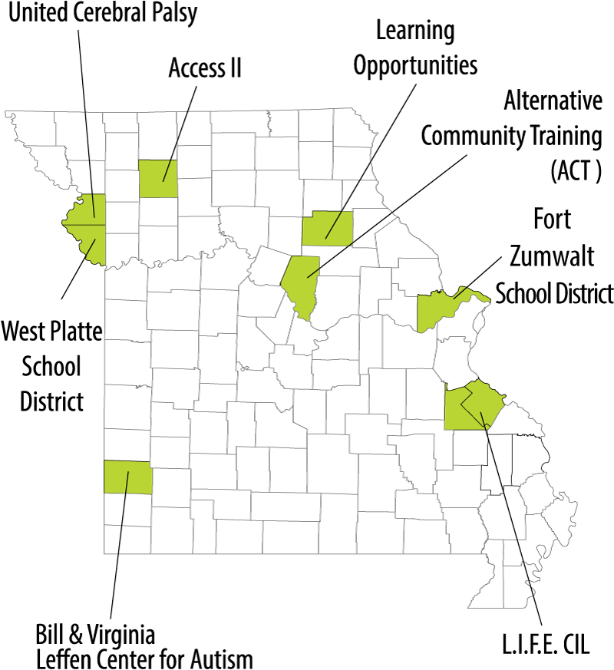
Map of project regions
Family Involvement Outcomes
Notes:
Cyndi
The work discussed here today is all a great partnership of many projects…. But in particular the resources of Family to Family and the connections of Show Me Careers have really allowed us to make some of these connections here around all the things were trying to do.

Slide 12
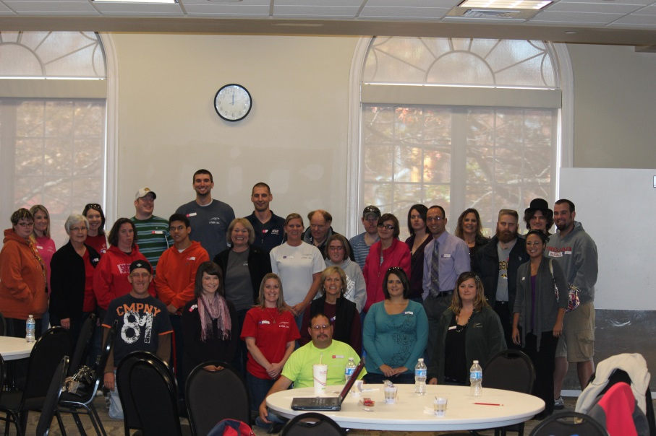
Learning Opportunities/ Quality Works
Putting the LifeCourse Framework into Action
Notes:
Cyndi

Slide 13
Overview of LOQW
Support, Advocacy, and Connection to Resources
Employment | Community Life Engagement
Employment Services support individuals in their career planning and other employment needs. Supporting job seekers and businesses to find the best match to meet the needs of both customers. | Community Skills Program focuses on skill development supporting individuals to become valued members of their communities and live the life they see for themselves.
Employment is woven in the fabric of our lives, all of us…. so this is a piece of all the products and services we deliver as an organization
Notes:
Cyndi
Just to give you a little idea of where we are coming from…
Serve 14 counties rural area in Northeast Missouri (north of St. Louis)
Began in early 1980’s as a result of a small group of concerned community members (Seed money from local manufacture)
Employment has always been the a focus with formal funding starting 1987 (Seed money to start employment program from Missouri DD Council)
Our workforce is made up of people that live and are rooted in the communities they serve and share the philosophy of the organization and have a passion for it!
Also elaborate here… employment is woven in the fabric of our lives, all of us… in our world everyone works…. so this is a piece of all the products and services we deliver as an organization.

Slide 14
Employment First Policy
Important to put this in policy
It had always been our practice but policy matters.

Slide 15
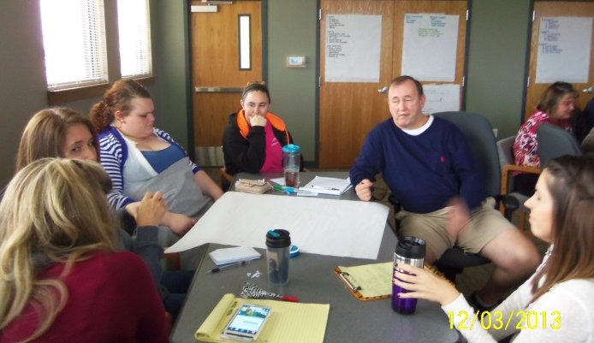
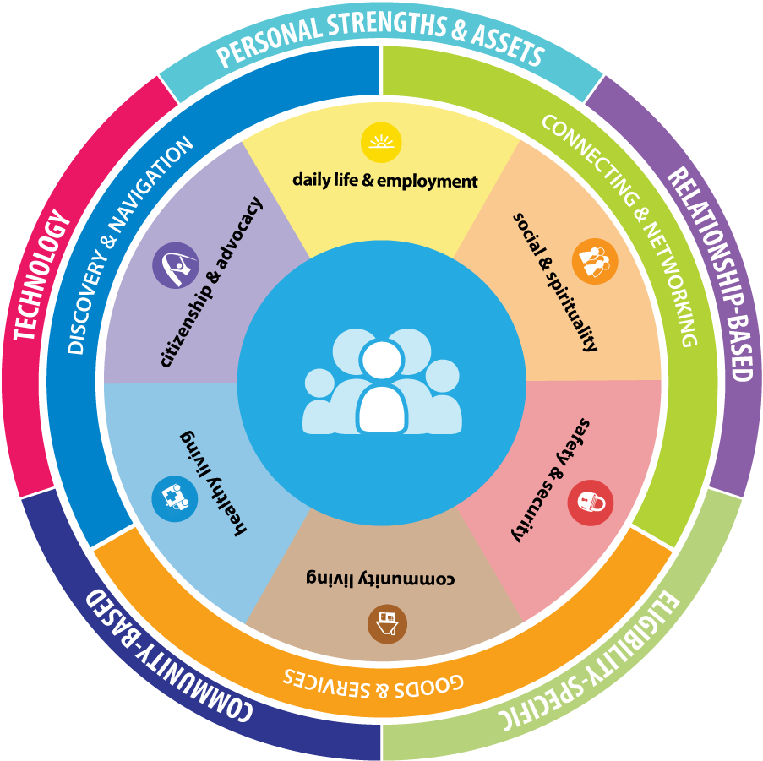
Our Perfect Storm
Setting the Stage for Change
Notes:
Cyndi

Slide 16
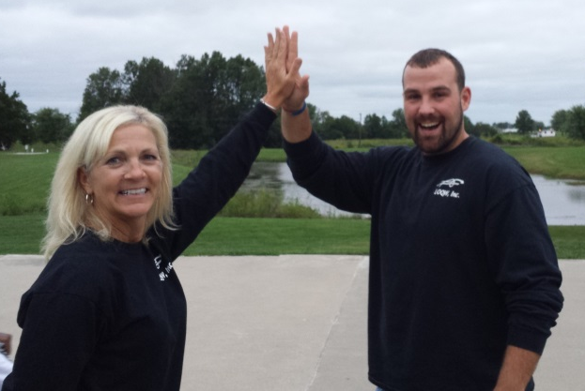
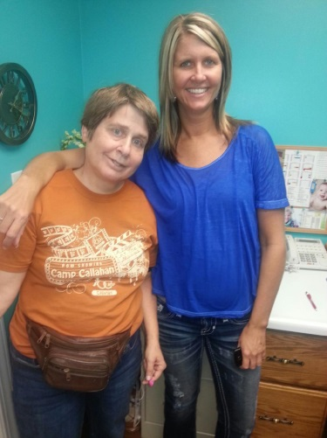
The Big Motivational Spark
The Big Spark: Remembering Why We Do What We Do!
Attended Future is Now Conference in 2013
Variety of staff and customers attended (administration, direct support professionals, and customers from various parts of the region)
Light bulb moment! Excitement! Motivation!
Notes:
Cyndi
Tell the beginning of the story of your journey like you would tell your best friend…. Make this feel more conversational to the audience.
We were good, but we had a LIGHT bulb moment at the Future is Now Conference…..we had leadership, self-advocates and staff attend and we just “remembered why we did what we did”……..we could be so much better at it and truly include people in our planning and the big picture stuff.
We had been doing some things but hadn’t really full embraced inclusion in organizational change at ALL levels… strategic planning, policy and procedures, etc.

Slide 17
Embracing External Opportunities
Project Stir for Self-Advocates
Show Me Careers Projects awarded in MO
Partnering with F2F, UMKC-IHD
Support Broker Training Through DMH for Self-Direction
WIOA
Capitalized on Joining Circles and other local events in NEMO for Community Change
Notes:
Kim
This slide is where you will explain all of the many and cool initiatives that LOQW got involved with….. (explaining them as separate activities)……..(the image in this slide is just a place holder of the types of things but we can make this visually look however you want with what ever content you want……) I am envisioning “bubbles” with the different initiatives individually placed all over the slide.
Remember: Even though we have many of these initiatives and projects categorized here… they really cross program lines. Transition Packets for example go out to all transition age youth, not just those in our employment or community skills programs.
Perfect storm…… sparks of motivation, opportunities, partnerships, and the drive that comes from challenges.

Slide 18
Recognizing Our Current Realities
Pressures & Challenges
Medicaid assurances
System redesign & restructure
Pressures on staff that pulls focus from the individual
Recognizing the challenges individuals and families were facing around crisis, unemployment, and overcoming these challenges.
Workforce Shortages
Notes:
Kim

Slide 19
Our Storm: Opportunities for Improvement
Not just be reactionary – plan ahead.
Pride ourselves on being a progressive organization… the challenge is to continually evolve as the needs of our customers change and as their family changes.
Supporting people to have the kind of life they want to have in the times we are living in with the resources we have available.
Notes:
We are tired of crisis driving what we do….
Customers drive or evolution…

Slide 20
Why LifeCourse Framework?
Had partnered with UMKC IHD and F2F before
Framework Useful for Organization and Professionals
Crosses the entire life span, short term and long term issues
Builds on person centered planning and self-determination values
Connects and integrates across life domains
Tools were Useful for Supporting Individuals with Disabilities
Allow us to look forward and plan for the future, not just be reactionary
Promote valuable conversations which allow anticipatory guidance
Encourages us to encompass the whole family unit
Can use some or all of tools, depending on what makes sense for individual and their family
Participate in the National CoP
Notes:
Kim
One minute elevator speech of what would appeal to an organization if you were “selling” LifeCourse thinking and tools to them
Be honest and say that you didn’t know these things at first but had to learn along the way…. Partly because it was new to you but also because it was newly being developed and continues to evolve.

Slide 21
Connecting the Dots
 | Overall Thinking | TCM Partners | Employment | Community Skills
Person with Disability | Hosted Youth Leadership Academy using LifeCourse | Asset Development Training LifeCourse for Person Centered Planning | Job Clubs in Schools Youth Leadership Academy in Summer | Hosted Project Stir classes Joining Circles
Family | Regional Conference Breakout Session on LifeCourse Framework | Revising Guardianship Letters Sent out from Schools at 18 | Participate in Youth Leadership Academy in Summer | Youth Transition Point in Time Packet
LOQW Staff | Attended Future is Now Statewide Conference National CoP | Participate in LifeCourse Tools workgroup | LifeCourse Tools for Planning Paid Work Experiences | Trained Support Brokers DSP Events
Organization | Policy and CARF Standards Review Strategic Plan | Updated ISP Document Revising Service Monitoring | SDCDM Research Project | DMH Support Broker Partnership for Hope Waiver
Connect to Other Initiatives | F2F Stakeholders LifeCourse Framework | TCM-ISP Format Committee | Pilot Community for Show Me Careers grant | Joined MoSDA
Notes:
Cyndi
Tell a story about this………… how we had a lot going on and we had to connect these projects and see how they all fit together.
So as we started to embrace the framework and we worked with it and really began to understand it more… we had lots of cool things going on…. Refer to the slide….
……. Lots of things that we felt like this was affecting in a positive way…. But we began to feel a little disjointed really…. We had things going on everywhere.
We needed to make sure that we could reflect on it and begin to connect those dots a little bit….. And see how all things fit together.
Not only does that help the individuals and their families from their standpoint with making their own vision, but it helps us as an organization to do that as well.
So taking a little time to do that and begin to reflect a little bit helped us as we continued to move forward.

Slide 22
LifeCourse Framework and Tools
Real Life Examples
LifeCourseTools.com
Notes:
Cyndi
http://www.lifecoursetools.com/
I know many of you guys have begun to look at the tools, start to use them, begin to adopt them into your work and your organizations…. You have some base knowledge of them at least and are starting to get a feel for them.
We are going to talk a little bit about how we went about that process…. We all know that when you begin to embark on any kind of significant change like this…. You have to have a game plan for it. Well initially…. Guess what …. We weren’t that organized… lol
But Kim’s going to talk to a little bit about how we began to embrace this so you can hopefully learn from our experiences…

Slide 23
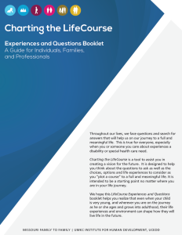
Charting the LifeCourse: Daily Life & Employment Guide
Charting the LifeCourse: Experiences & Questions Booklet
Notes:
Cyndi
http://www.lifecoursetools.com/
We cant live without these…. We use them in tons of ways!

Slide 24
LifeCourse Tools for Planning
When and How we use Tools
Integrated Support Star, Life Trajectory Worksheet, Tool for Developing a Vision, Charting the Life Course Experiences and Questions Booklet
Use at various stages, as planning tools at planning meetings, as tools to promote real better conversations.
Use with both youth and adults.
Support and trajectory we are using them as profiles for people’s plans
Next Steps… How to move things forward?
Notes:
Kim
What tools are using and when do you use them? (list them and we can put the pictures of them) but tell us when, with who and for what purpose

Slide 25
LifeCourse Tools for Planning
How we are building capacity of staff and organization:
TCM partners chose 2 or 3 service coordinators participate in LifeCourse Tools Workgroup and pilot in different situations – one embraced employment uses
Chose staff …. Some because they were early adopters….had a strong understanding of the guidelines and requirements so that as we were stepping outside the norm we could ensure we were still maintaining compliancy.
Chose families &individuals…. some with a lot of natural supports and strong networks also early adopters and some more resistant. Also delivered it to them in different ways… some with direct visits and some by mailing ahead to let them review…. Play with this… See what works!
Then began rolling out to other staff and had attend YLA for training
Then began to adapt tools to employment conversations and engage our employment consultants and employment consultants around the region.
DSP Month LifeCourse event to begin to better engage Direct Support Professionals
Notes:
Kim/Cyndi (at the end on the last 2 bullets)
How did you get buy in and build capacity of staff to use? How do you provide on-going coaching to learn how to use the tools?
-Chose 2 or 3 service coordinators to participate in the workgroups and be a part of the development and evolution of the tools. Had them pilot the tools in a variety of settings and situation with a variety of people to get a feel for how they would work…. And begin to share with staff. Once we had a better feel for framework and the tools we then began to role it out to other staff in other roles and… we also had all staff then begin to participate in YLA to get training and a better comfort level with the tools.
-Chose staff …. Some because they were early adopters… very progressive easy to get on board with new things. Chose Molly because she is very detailed… knew she would give a lot of feedback… both positive and negative.. Both were more veteran staff and already wrote excellent plans with people but also had a strong understanding of the guidelines and requirements so that as we were stepping outside the norm we could ensure we were still maintaining compliancy.
-Choosing families and individuals…. Chose some with a lot of natural supports and strong networks also early adopters and some more resistant. Also delivered it to them in different ways… some with direct visits and some by mailing ahead to let them review.
-Didn’t get a clear cut answers on this… it didn’t seem to matter if they already had strong networks or not…. It really depends on the person.

Slide 26
LifeCourse Tools for Planning
Organizational Policy or Procedural Changes
Updated our annual assessment tools and ISP format to utilize this framework. These are required things…. Made LifeCourse Portolio our own to help individuals plan and have better conversations around what they want leading up to planning meetings
Talk about at every staff meeting, team meeting, etc. It is just part of what we do now.
Self-Determination committee…. Reviewed policies, handbooks, forms and tools, giving feedback on understanding it ….grievance vs. resolution…..
Began using tools in employment conversations!
Notes:
Kim
What organizational policy or procedures did you put into place to implement using the tools (such as ISP form, expectations for use?, built into training requirement, etc.)
updated our assessment tools and ISP format to utilize this framework. These are required things…. So we were still able
We talk about this at every staff meeting, team meeting, etc. It is just part of what we do now.
Self-Determination committee…. Reviewed policies, handbooks, forms and tools, giving feedback on understanding it ….grievance vs. resolution…..
How do you check to see if they are making a difference at different levels (person with disability, family, direct care/VR staff, service coordinators)
constantly looking out for feedback…. Feedback from DMH regional offices, utilization teams…. Feedback from family members and guardians feel like it really reflects the person…. Funders easier to read and follow and find the information….while also seeming more detailed.
Kim getting a couple of quotes stories here…. “I didn’t realize this was even important to my son/daughter till we talked about this.”

Slide 27
Updated Annual Assessment & Utilize new LifeCourse Portfolio
Notes:
Kim

Slide 28
Utilize new LifeCourse Portfolio

Slide 29
Tools for Employment Conversations
Notes:
Cyndi
Refer to Handouts | Don’t forget: lifecoursetools.com & supportstofamilies.org
Tell Kenny’s story here….
Tell Molly’s stories on these 2 tools….
Support Star = She met with someone in a local ISL…. Meeting and planning with someone that wanted to look for a competitive job outside the sheltered workshop…. Yada yada yada….. Contacted by roommates about looking for competitive employment…. When she came back to have conversations with roommate she stopped in to say hi to the first guy…. When she came back it was framed and displayed with his family photos….
Employment Trajectory - this was really our first break in getting this out to our employment staff…. This completed tool can be taken to a vr meeting… to meet with a new employment consultant… maybe to a guardian…. It was quickly embraced by Employment Consultants… it utilized the conditions, preferences, and contributions they were knew were valuable in employment planning… it was clear and concise… easy for them to use too.

Slide 30
Elementary School Trajectory
Notes:
Another example from another organization…. But shows how you can begin to with these tools at all ages…. Remember that anticipatory guidance we talk about all the time…

Slide 31
LifeCourse Tools for Planning
Initial Outcomes and On-going Quality Improvements
“I didn’t realize this was even important to my son/daughter till we talked about this.”
Feedback from DMH regional offices, utilization teams
Feedback from family members and guardians feel like it really reflects the person
Funders easier to read and follow and find the information, while also seeming more detailed.
Individuals report being able to use the tools to have conversations with employment consultants, DVR counselors, guardians and other in their lives that are a part of their teams or decision making process.
Notes:
Kim/Cyndi
How do you check to see if they are making a difference at different levels (person with disability, family, direct care/VR staff, service coordinators)
constantly looking out for feedback…. Feedback from DMH regional offices, utilization teams…. Feedback from family members and guardians feel like it really reflects the person…. Funders easier to read and follow and find the information….while also seeming more detailed.
Kim getting a couple of quotes stories here…. “I didn’t realize this was even important to my son/daughter till we talked about this.”
Tell stories from Molly here…. Story about guys at the ISL all wanting competitive employment now…. Also story about Support Star being framed in one guys room if I didn’t earlier?????
What is really cool is that they can be so individualized!!!
Ask for some feedback here. Give them a break from the sound of our voices… lol. Ask the audience how they are using some of these tools in their own organizations? How are they beginning to play around with them??

Slide 32
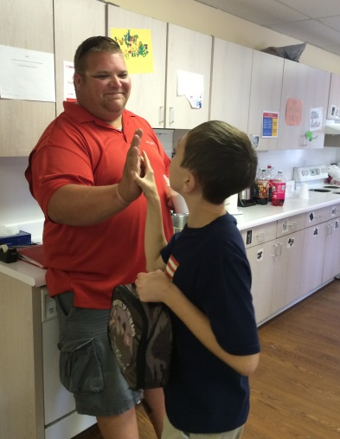
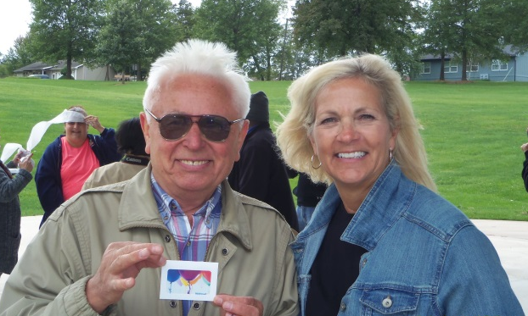
LifeCourse Tools in Action
http://www.lifecoursetools.com/
Notes:
http://www.lifecoursetools.com/
Kim

Slide 33
YLA and LifeCourse
Different Marketing Strategies
Materials focused less on “employment” and more
on adult life outcomes
Included family members and other supporters to attend with you
Use LifeCourse Framework for Content
Adapted the tools and activities to be youth-focused, interactive and fun
Developed concrete “take home” tools with vision and plans
Notes:
Cyndi
Start by explaining how it was before…………so you can explain what you did different this time.
Reached out to a whole new audience, not just individuals, but also natural supports, also seemed to open up doors to new people when it didn’t look so hard core all about employment/// its like we snuck it in on them…lol
Pic of flyer from Rachel pics from event.

Slide 34
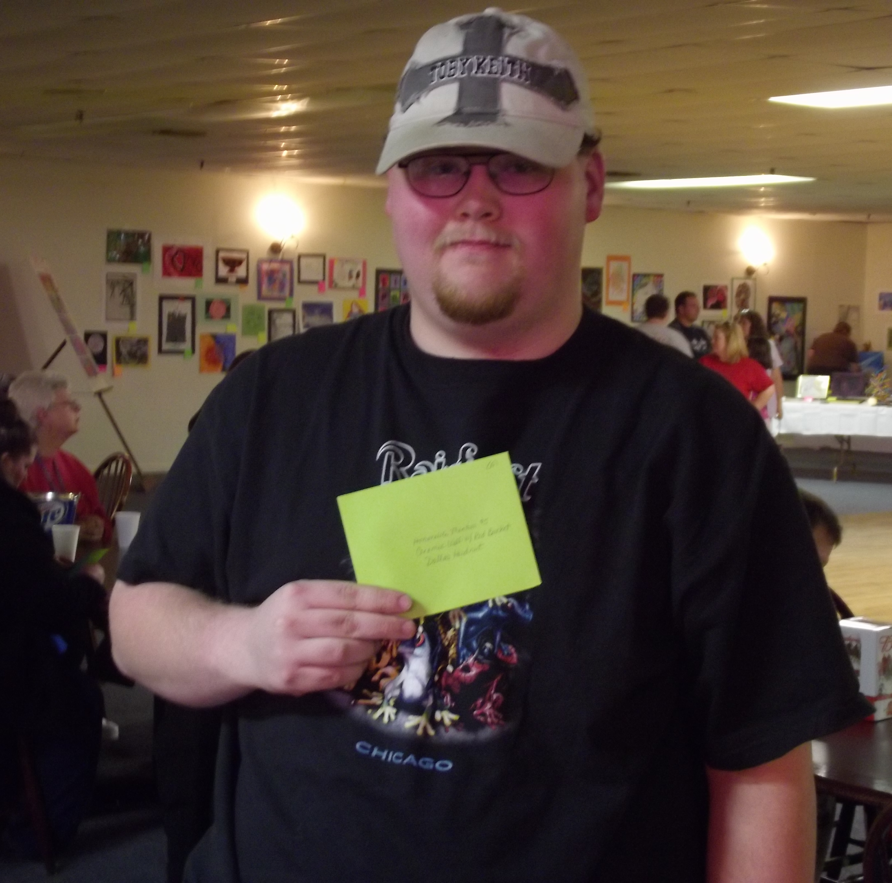
Outcomes of YLA and LifeCourse
Youth: Bobby and Rachel connecting with one another and building confidence to make connections and make a difference in their own lives
Family: Dad feels like he had some direction for the future
Notes:
Cyndi
Youth – Liked seeing old friends and making new friends …. Great environment for socialization…. Example: Bobby and Rachel… Bobby walked away with her phone number! That’s pretty cool in itself…. But the real beauty of it in terms of employment is that Bobby has a great story …. When we first met Bobby he was so shy he couldn’t talk to anyone /… he was paired with the right support coach (Kody from the Future is now conference with us….. Remember that spark with talked about earlier at the conference…. ) and began working on networking and making friends. He then got a job… which is great…. But as he met more people and got more experience he used his connections to get a better job at a local university where he had some friends. He used his own connections… he got his job… not someone else or an agency… he did it. He is also the best person to spread this message to another youth like Rachel or others. What a great way to share or spread the message! Youth talking directly to youth about these things in a real way that resonates with them! Rachel lives in a different small town but suddenly began thinking about things and taking some action.
Dad – Great information. Well educated man, a teacher himself in fact…. But he was not prepared…. he said He walked away from YLA feeling like he had some direction. Got to have conversations with local vocational counselor even while at event. You could visibly see his comfort level change after these 2 days. Comforting for parent to know even if they haven’t thought about this that there are people out there who have… is response reported by parent to local vocational counselor as well.
I can really sell these stories. Kim and pulled up these stories and actually called and spoke with people too to get at this feedback and the stories were great… especially on Bobby ….. And also the Dad and the DVR counselor.

Slide 35
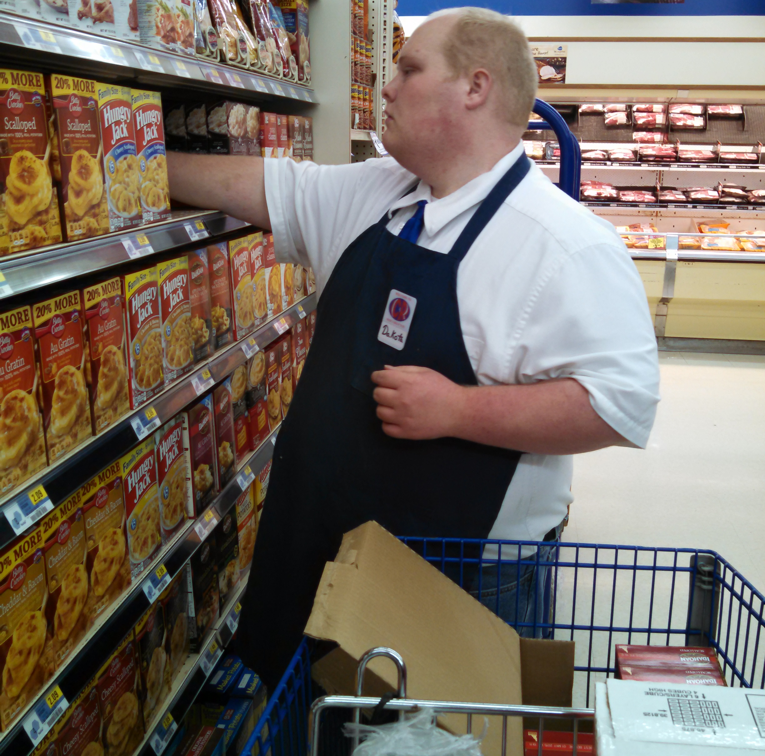
Outcomes of YLA and LifeCourse
Service Coordinator: Watching the framework put into action by self-advocates and families
Division of Voc Rehab – Jill said “with our focus on motivational interviewing…. The Youth Leadership Academy fits in perfectly! The LifeCourse framework and model of thinking about things and the tools really helped people drill down to what their interests were and why…”
Notes:
Cyndi
Service Coordinator – Really liked seeing the framework applied, spending time with the families and walking through that planning and those conversations with the families over these couple of days.
DVR – Jill (DVR counselor) said “with our focus on motivational interviewing…. Working with people to get to why they want to do what they want to do…. They Youth Leadership Academy fits in perfectly! The LifeCourse framework and model of thinking about things and the tools really helped people drill down to what there interests were and why…” She has noticed this with several youth since the YLA that attended or with people that she knows have been using some of these tools in their own planning. She really feels like it goes hand in hand with motivational interviewing. (This will likely really speak to VR type people in the audience.)
I can really sell these stories. Kim and pulled up these stories and actually called and spoke with people too to get at this feedback and the stories were great… especially on Bobby ….. And also the Dad and the DVR counselor.
Hopefully this will resonate with those of you that are VR folks in here today.

Slide 36
Focusing on Guardianship Letter Sent by High Schools
Need: The “guardianship letter” gave people a negative impression about options and possibilities
Solution: Work with schools to improve the “Guardianship Letter” and provide good information and alternate options for safety and security concerns AND also provide anticipatory guidance on adult life domains (EMPLOYMENT)
Notes:
Kim
Working with schools on the “Guardianship Letter” to develop materials that provide good information and provide alternate options for safety and security concerns AND also provide anticipatory guidance on adult life
-why is this important to employment, how did you get others to understand the importance of this, how are others involved in making change around this
Our goal with this guardianship letter was to really help people understand that there were more options out there…. and that if there are more options around guardianship there are also more options around other things as well for their child.
This was actually a pretty simple thing… we really just shared this resource that UMKC-IHD and F2F put out there for us… but we got it out directly in the hands of youth and their families at the grassroots level. This was a great partnership of Show Me Careers pilot community members working together on an issue important to them and youth and families in their area.

Slide 37
Partnering to Change “The Letter”
Show Me Pilot Community organizations all recognized this as something important to them
Partnered with F2F to use Alternative to Guardianship materials
Getting the right materials into the hands of the people on the front line who could get them to families
Notes:
we really just shared this resource that UMKC-IHD and F2F put out there for us… but we got it out directly in the hands of youth and their families at the grassroots level. This was a great partnership of Show Me Careers pilot community members working together on an issue important to them and youth and families in their area.

Slide 38
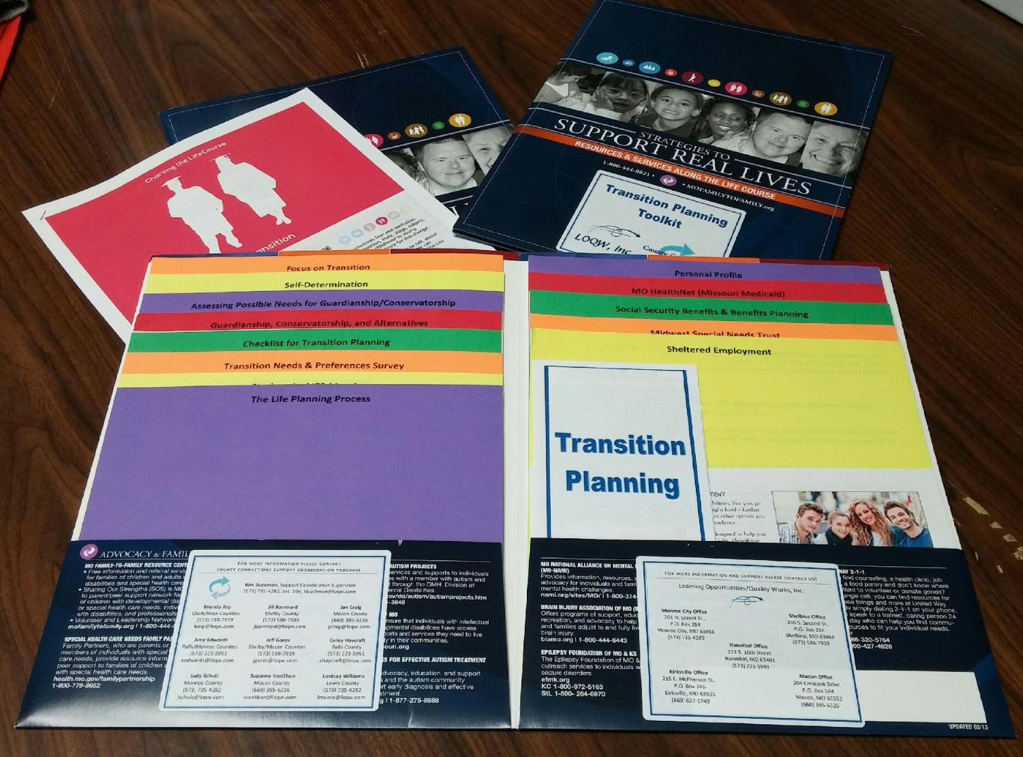
Youth Transition Packet
Identified the Need to get information into the hands of self-advocates and families transitioning from High School
Committee of people who have experience with Transition Age developed a draft packet
Used LifeCourse network and Show Me Career group for further review and suggestions
Once developed in traditional form (folders) then moved to making it available electronically on school websites and parent portals
Notes:
Cyndi
Developing a Transition Packet for…
(give examples of what would be in it)
.
(how you have gone about the process of deciding what should be in it and getting feedback)
Experience over time of what issues arise during this time, feedback from those that have gone through this transition themselves, feedback from families on what they used, what they feared most during this time, etc. We are now in the process of getting feedback and support from others…. Nancy with SELN…. Shelly and her team at F2F…. Local partners and stakeholders…. Planning to work with one local school district/pilot community to pilot these packets and gather data on usefulness and tweak from there (what we discussed on our last phone call with Sheli and Jane and Megon to try in Macon area….)
(who is going to give out, who is going to pay for it, who is going to sustain it?)
Dissemination of will have to happen in a variety of ways I’m sure… directly to students in Job Club and other ways at local high schools… but lets be honest… things don’t usually make it home to the parents… so setting up at open house nights…. Through Service Coordinators with County Connections and other TCM entities…. Great idea from conversation just this week with Nancy and Show Me Careers consultation and are working with tech staff at local schools to post this information on the Parent Portals of the school district websites…. Basically going to try variety of methods to get information out there and in the hands of people that need it.
We consider this a part of marketing and outreach efforts so will be funded through our program efforts…. Will likely pool funds from LOQW and SB40 or other grant or project funds.
Marketing and outreach is crucial and needs to be built in to organizational operation…. If successful and useful they will be sustained. No special project is necessarily paying for them now so wont’ be an issue of what happens when the project ends kind of thing for example.

Slide 39
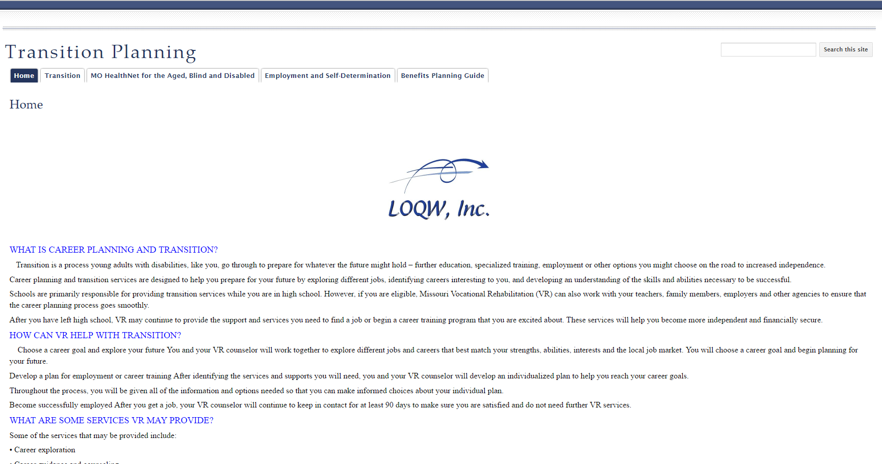
Transition Packet
Information on WIOA
Student led IEP meetings
Guardianship conservatorship and alternatives,
Self determination and employment, job accommodations,
Social Security and Benefits planning, special needs trusts,
Vocational Rehabilitation, information on local organizations
Notes:
Cyndi | Show a couple of the packets and pass around
We have used our Show Me Careers partnerships to help gain feedback from schools on information like this. Response all seems positive… need to continue to partner with schools and parents to find better ways to get this information into the hands of students and parents that need it.
Here’s the thing… all the cool stuff people like IHD and F2F is great… but people on the ground have to get it into practice and into the hands of people that can use them or its just cools stuff on slick paper…. AND hard working well intentioned people on the ground can work themselves silly but without the right tools and focus can’t move things forward in the right direction….. Something about the beauty of these two things working together or something…. I don’t know… see what you think…

Slide 40
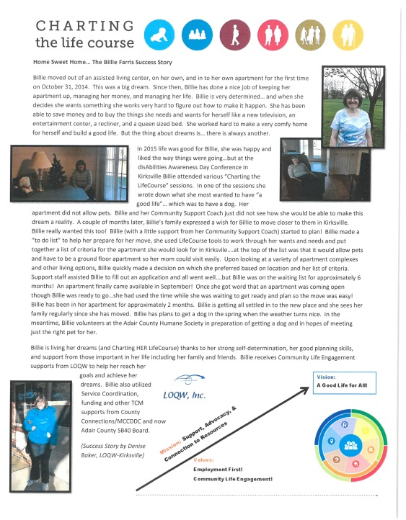
Next Steps with Toolkits
Dissemination:
Directly to students in Job Club
Work with local high schools to us their dissemination strategies (open house nights and district wide Parent Portals)
Service Coordinators with County Connections
Directly to parents at school fairs and events
Sustainability:
No special project is necessarily paying for them now, built into part of marketing and outreach efforts so will be funded through our program efforts of LOQW and SB40, etc.
What needs to change???
Marketing and outreach is crucial and needs to be built in to organizational operation…. If successful and useful they will be sustained.
Notes:
Cyndi
(how you have gone about the process of deciding what should be in it and getting feedback)
Experience over time of what issues arise during this time, feedback from those that have gone through this transition themselves, feedback from families on what they used, what they feared most during this time, etc. We are now in the process of getting feedback and support from others…. Nancy with SELN…. Shelly and her team at F2F…. Local partners and stakeholders…. Planning to work with one local school district/pilot community to pilot these packets and gather data on usefulness and tweak from there (what we discussed on our last phone call with
(who is going to give out, who is going to pay for it, who is going to sustain it?)
Dissemination of will have to happen in a variety of ways I’m sure… directly to students in Job Club and other ways at local high schools… but lets be honest… things don’t usually make it home to the parents… so setting up at open house nights…. Through Service Coordinators with County Connections and other TCM entities…. Great idea from conversation just this week with Nancy and Show Me Careers consultation and are working with tech staff at local schools to post this information on the Parent Portals of the school district websites…. Basically going to try variety of methods to get information out there and in the hands of people that need it.
We consider this a part of marketing and outreach efforts so will be funded through our program efforts…. Will likely pool funds from LOQW and SB40 or other grant or project funds.
Marketing and outreach is crucial and needs to be built in to organizational operation…. If successful and useful they will be sustained. No special project is necessarily paying for them now so wont’ be an issue of what happens when the project ends kind of thing for example.

Slide 41
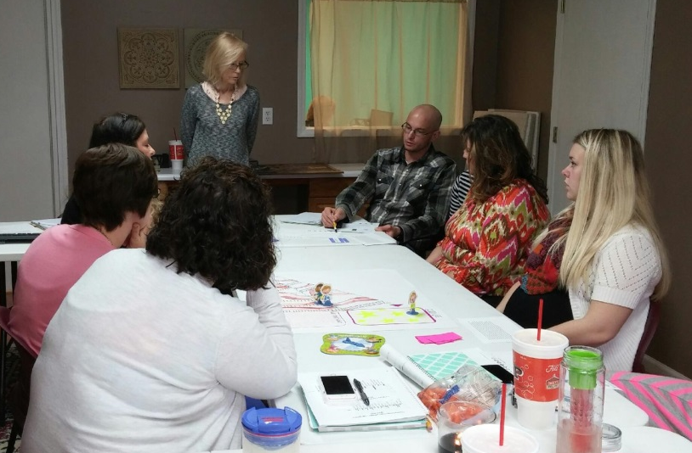
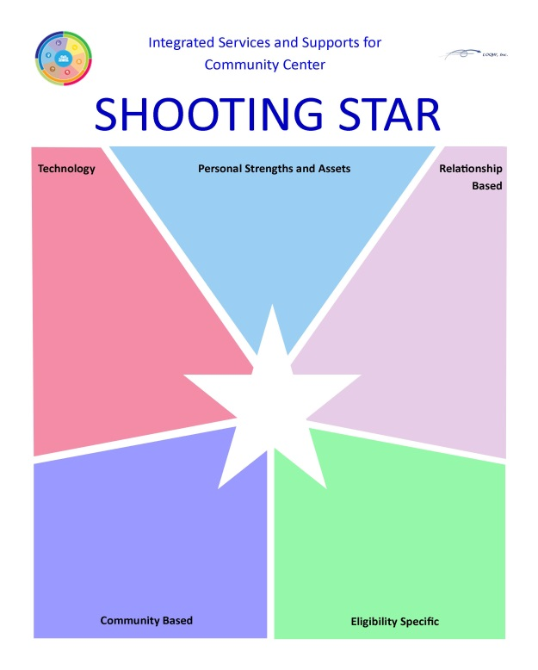
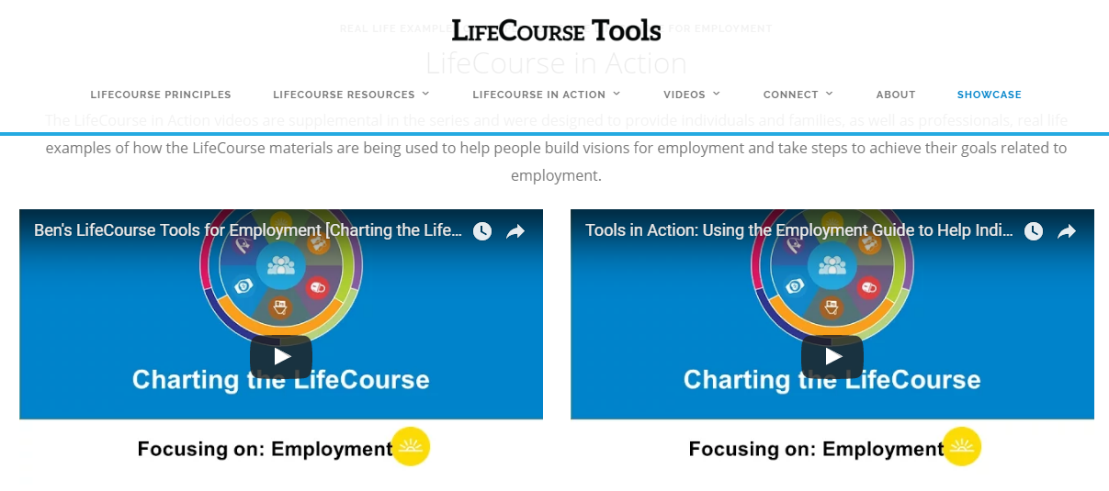
Learning & Games
Games & Learning
DSP Events
Staff Training
Outreach meetings (DVR & Career Centers)
Boards & Community
Notes:
Just to show that you don’t need to have the actual ‘tools’ to use the framework

Slide 42
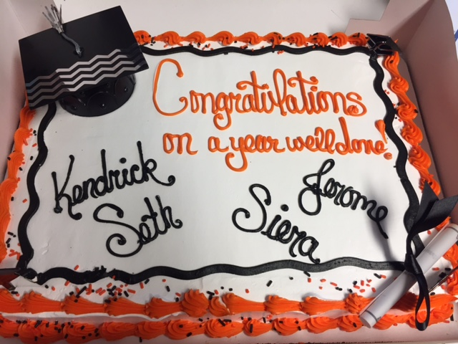
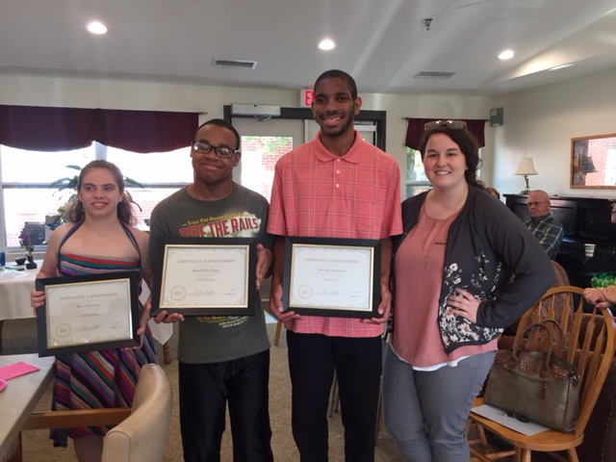
High School Work Experience Programs
Partnership between local business, high school, LOQW, SB40
Paid Work Experience
Started in 1 community
Expanded to next town
Experience is great….but job offers are even better!
Notes:
Early Work Experience… Early and Often!

Slide 43
Career Planning Events for Young Adults
Unmet need for Career Planning conversations with this age group
Met with local DVR offices
Events hosted at local Missouri Job Centers
Targeted youth at different stages in their career planning
Targeted LOQW Employment Consultants and Retention Specialists
Notes:
Addressing the gap….

Slide 44
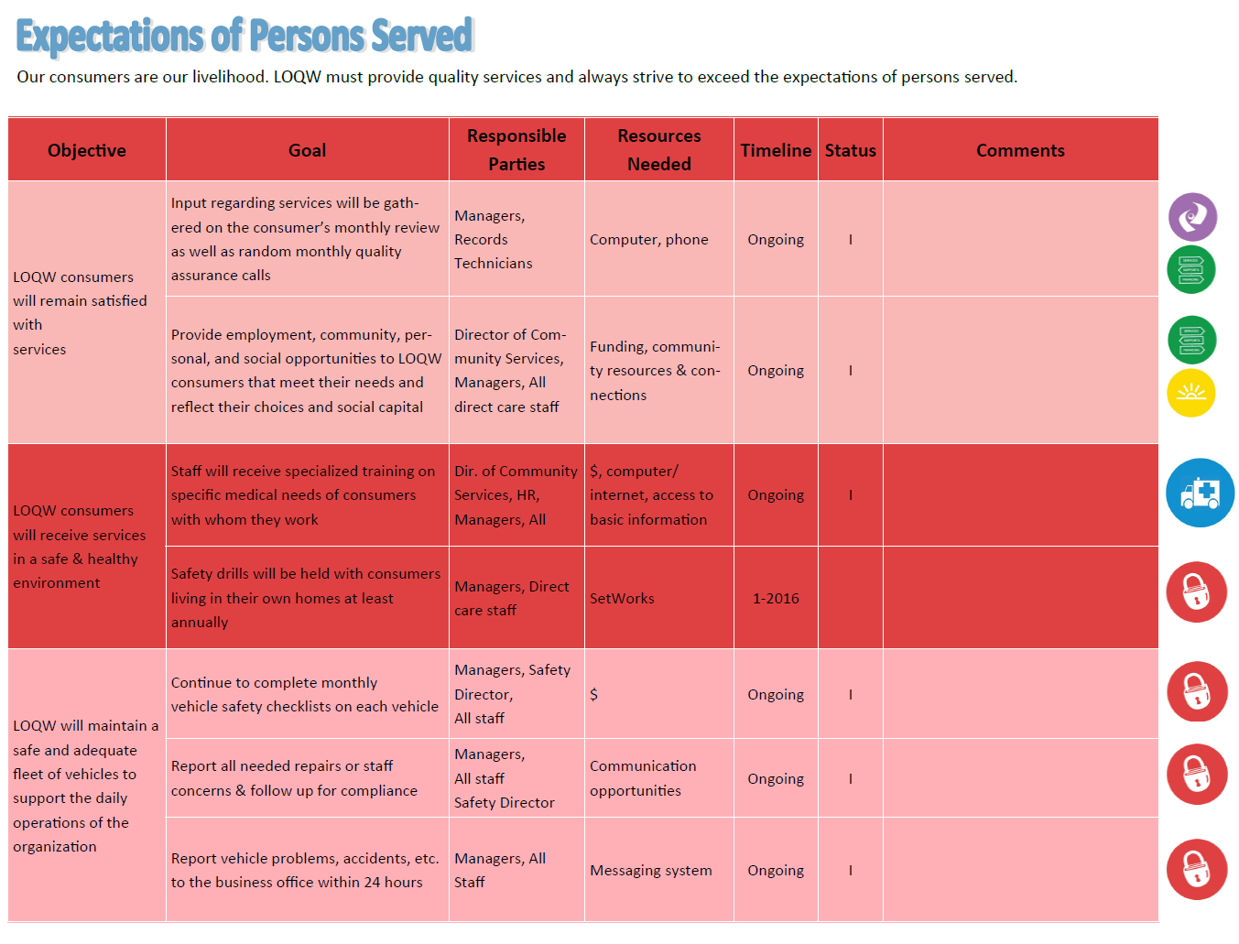
LifeCourse Framework Guiding Organizational Strategic Thinking
LifeCourse Foundation:
Life is a Journey – Our lives are not static, they change everyday.
Its all about Vision – Anything is possible with the right vision and focus.
Everything is connected – What you do today affects your life in the future.
Our overall compass for people and their families is “Quality of Life”
Notes:
Cyndi
Why did you use the life domains? What do they mean? What do they help you understand or organize?
Its back to our light bulb moment…. We became comfortable with the framework…. It just naturally made sense to us… that hey… we could use this same idea and apply it to any type of planning…. Not just individuals.
So we did! We used the life domains and the guiding principles of the Charting the LifeCourse framework to ensure we were “Remembering Why We Do What We Do”…. Back to that lightbulb moment.
Life is a Journey – Our lives are not static, they change everyday.
Its all about Vision – Anything is possible with the right vision and focus.
Everything is connected – What you do today affects your life in the future.
Our overall compass for people and their families is “Quality of Life”.
(I don’t have those little icons handy… but they should really go with these if you actually put those things in the slides.)
It isn’t much of a stretch to make those things apply to an organization right???
So keeps us on point… etc. The little icons actually being added in are really just visual reminders…… we tend to be pretty visual people and something about having those right there helps us focus.

Slide 45
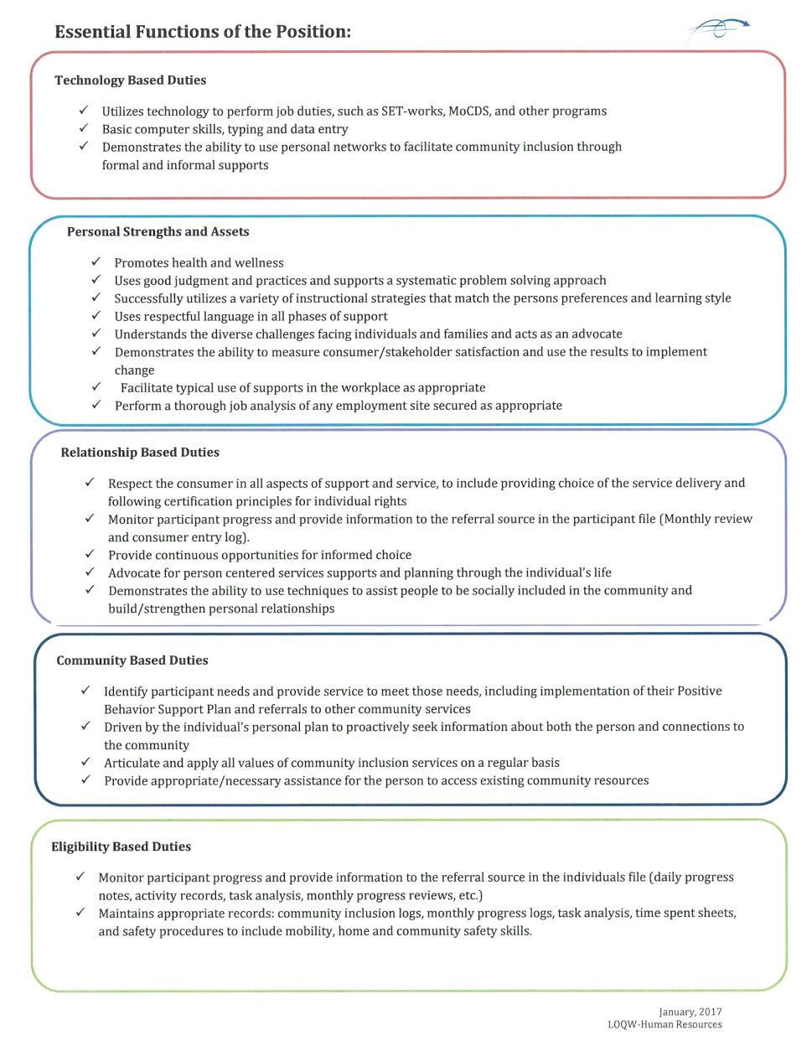
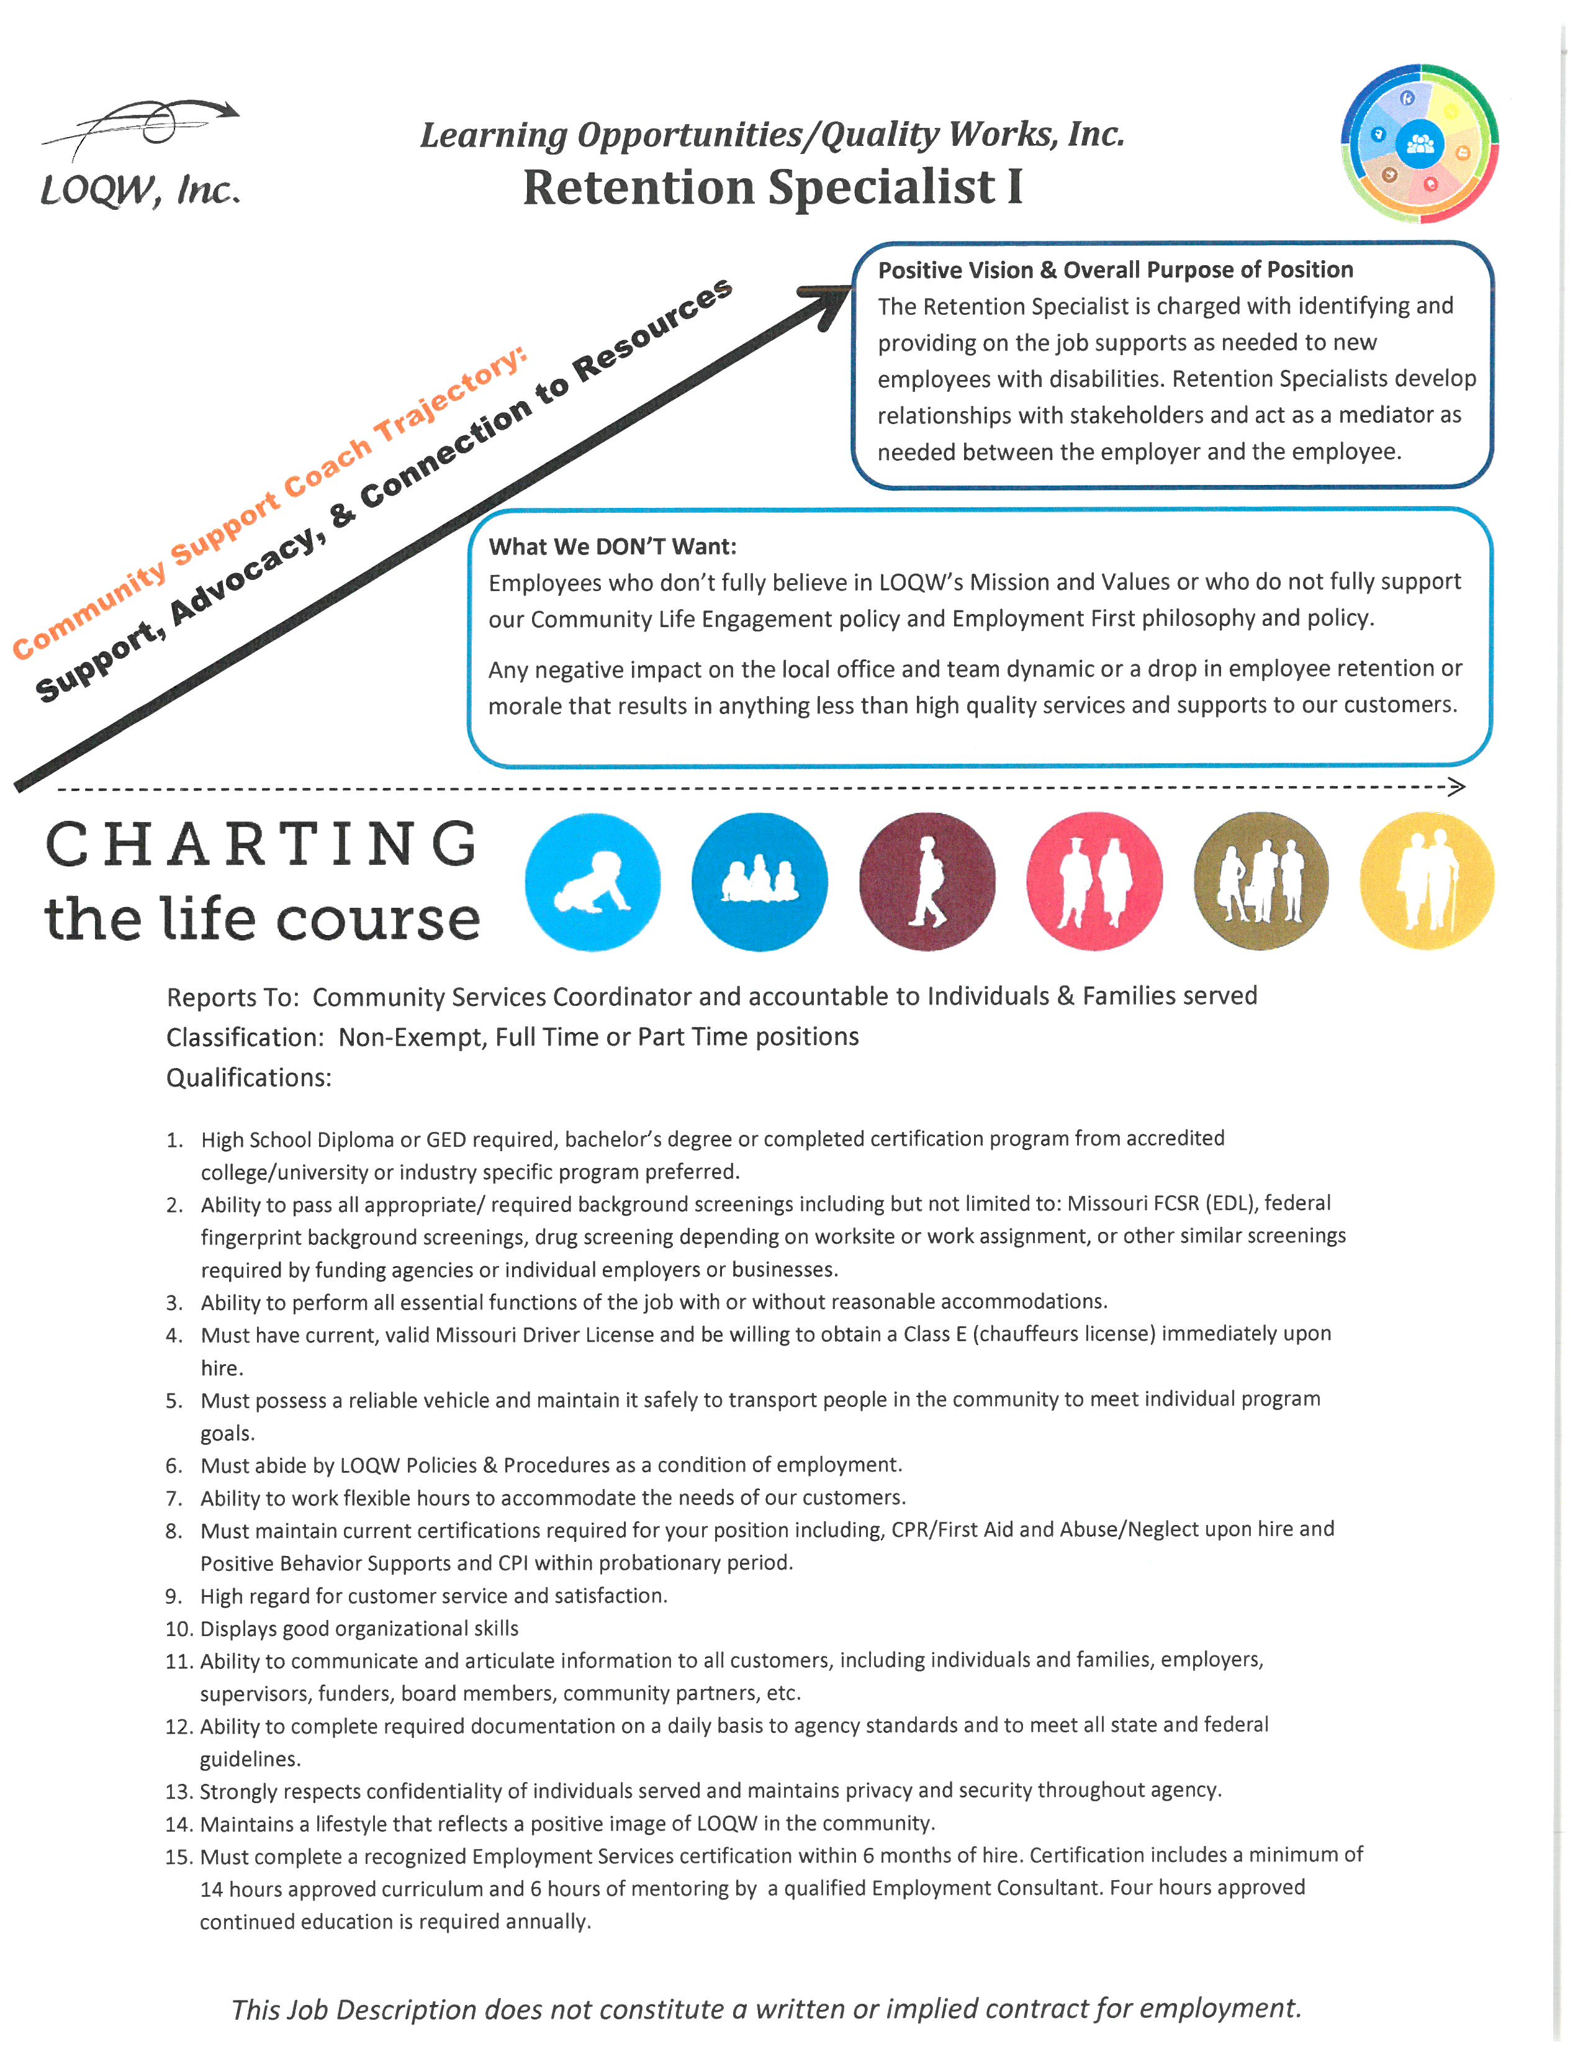
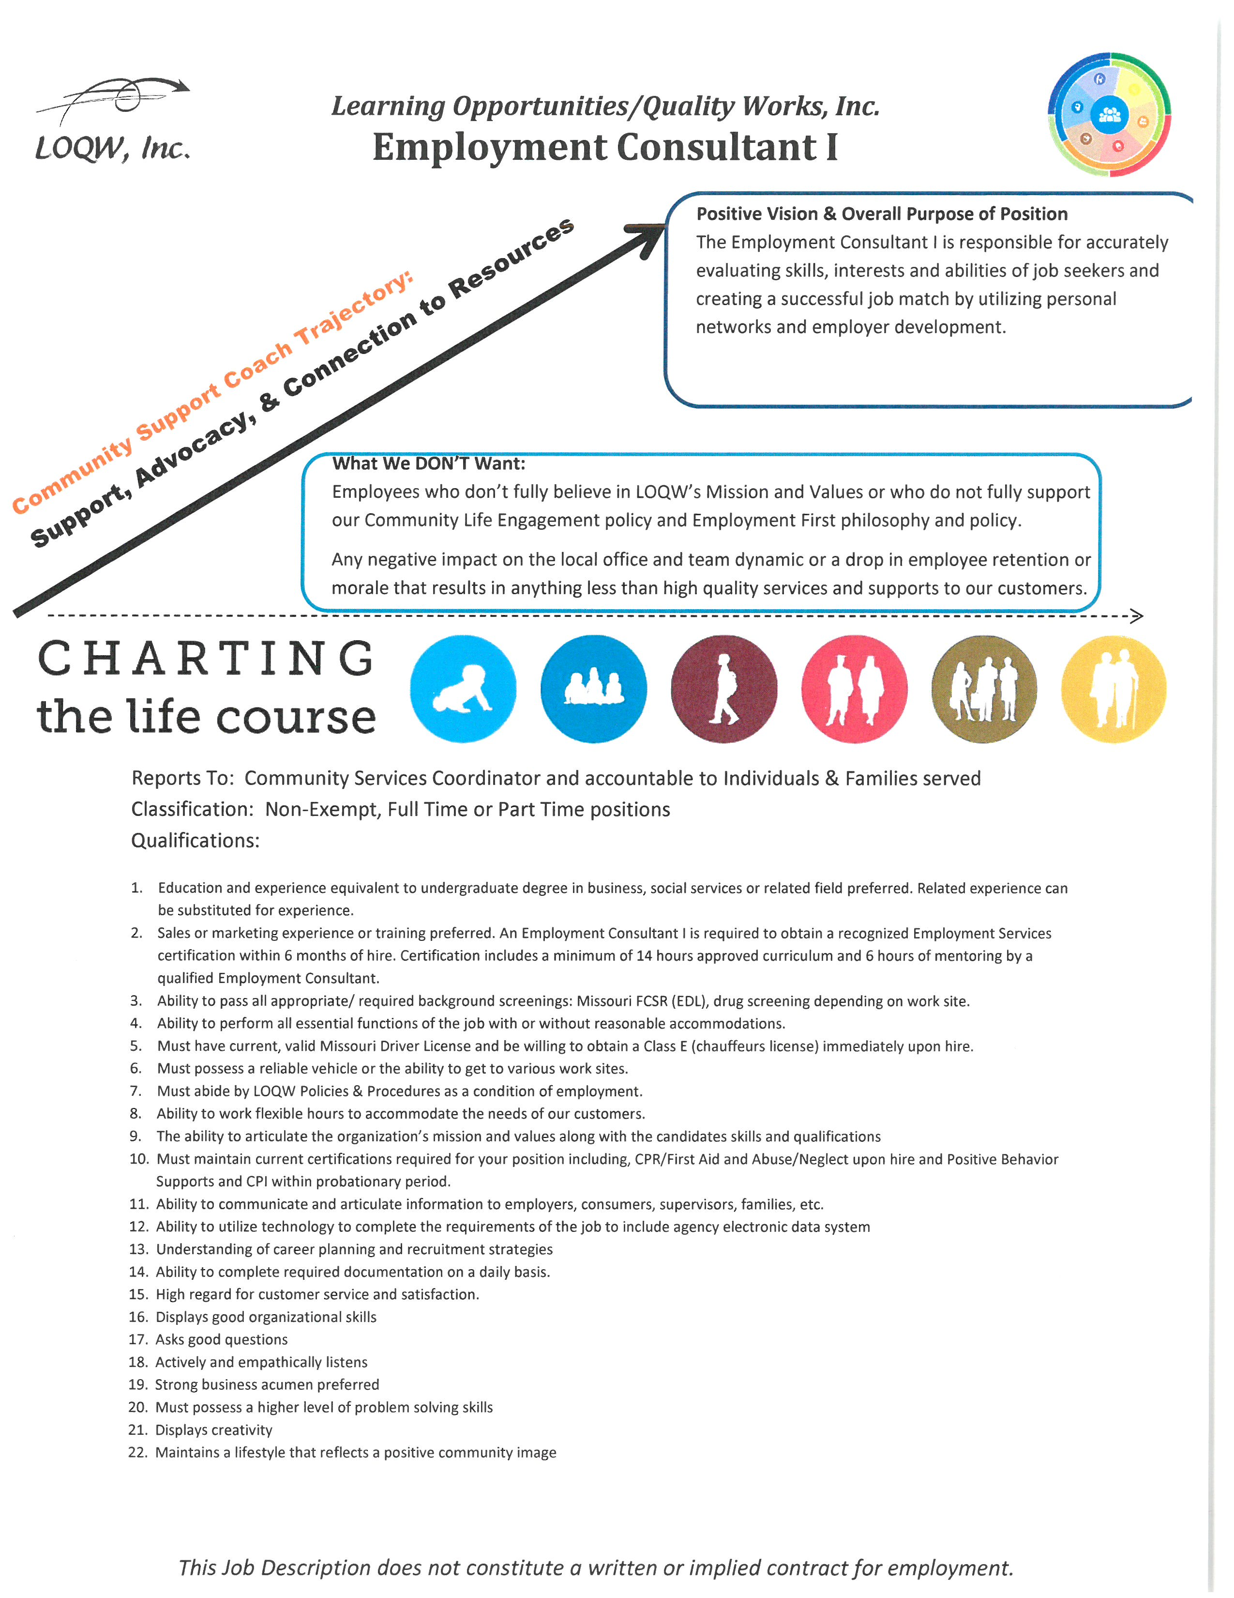
Reframing the conversation
Notes:
Job Descriptions for Employment Staff
Performance Trajectories

Slide 46
Organizational Strategic Thinking: Evolving Job Clubs and Other Products and Services

Slide 47
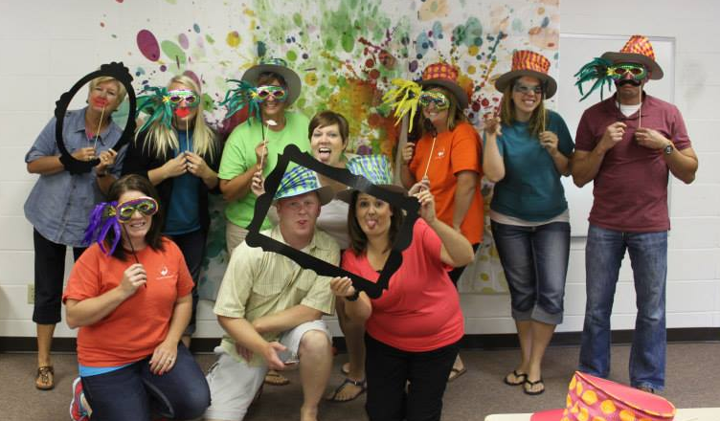
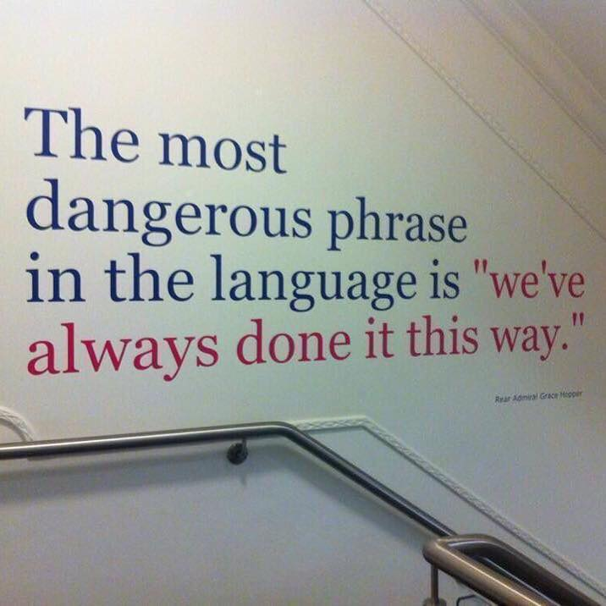
Where are We Now??

Slide 48
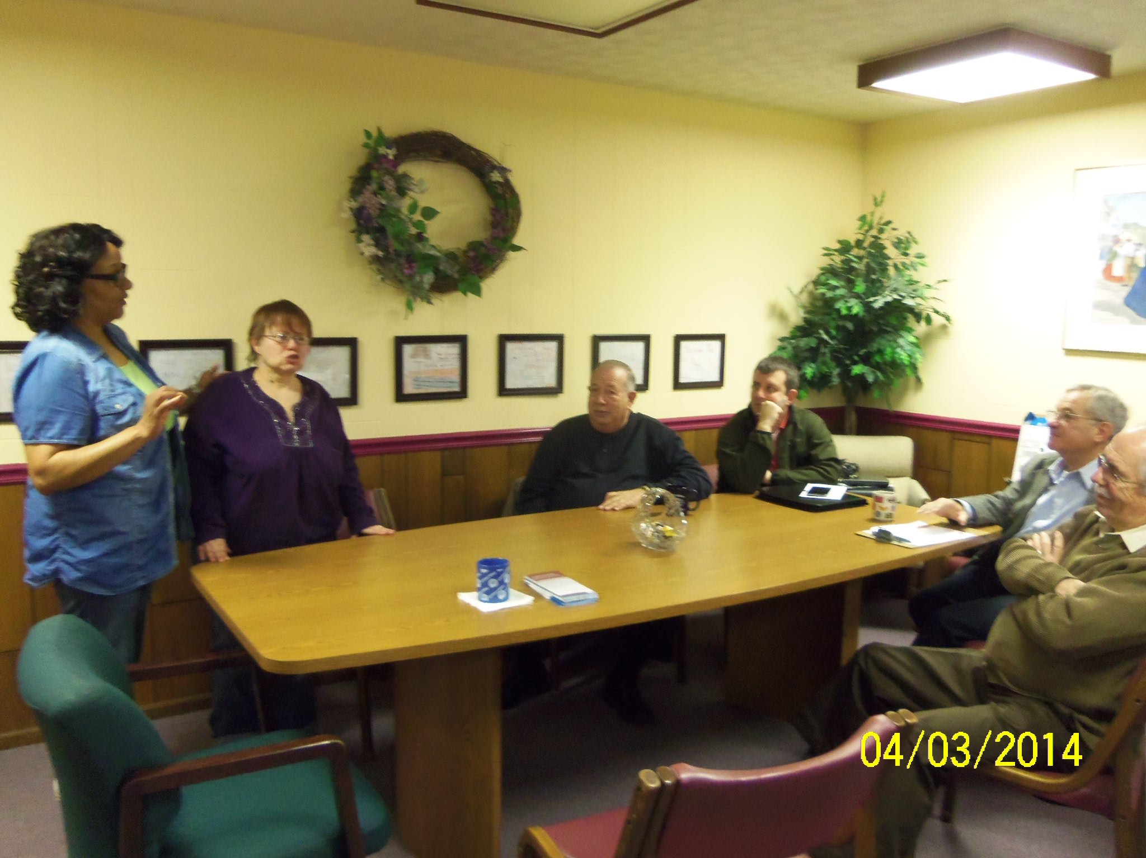
We Reserve the Right to Get Smarter: Looking Back While Moving Forward
Notes:
Cyndi
This recognizes that we are on a journey……that we need to take pause and see what we are doing and where are headed….. Remember those guiding principle! They apply here!

Slide 49
Staying Involved in Evolution of the LifeCourse Framework and Tools
External networking around LifeCourse (Tools Workgroup and F2F stakeholders meeting)
LOQW Internal Meetings to continue learning and making thinking and using tools second nature
Pilot Community Show-Me Career Group continues to learn about and integrate LifeCourse tools thinking and materials into other organizations – these partners continue to engage
Internal Staff Engagement needs to continually be fostered
Notes:
Kim/Cyndi | Stories of how we talk about it internally…..within teams, across the teams, refer to the LC framework fits into it….or we use a tool and talk about it to familiarize them with them…..make it a way of our life….to become second nature so everyone thinks like this. (life planning, planning a head, moving beyond paid services…….identifying like valued people to keep moving forward).
Staff Participate in Statewide External Groups
Quarterly Family to Family Stakeholders meeting to network with other organizations and systems using framework
LifeCourse Tools Workgroup for ongoing coaching and quality improvement of tools and facilitation
These external groups allow us to not only stay involved with the development and evolution of LifeCourse framework but also let us stay connected to others involved in other parts of the state… share cool things that are being done other places… motivate each other.
Staff have internal meetings at LOQW to learn about tools, refocus on guiding principles, always talk about it… it eventually becomes second nature…
Show Me Careers Project shares tools with other community stakeholders to not only skill up those involved but build capacity in our communities. This is a really well connected framework of communities…. Lots of cross pollination of ideas.
Continue to promote Staff Engagement to keep the evolution going…. Work in layers to continue to engage all parts of the organization…. Leadership…. TCM…. Community skills…. Employment…. Direct support coaches…. Etc. Remember that DSPs will likely use or be involved in these tools differently than Service Coordinators so we need to roll that out to them in a way that makes sense to them. Also they need to be reminded that everything they do influences so much in people’s lives… both positively and negatively!!!
Note some of the cool stuff Lynn and other organizations are doing…. Budget, strategic plan, etc.

Slide 50
Biggest “A-Ha” Moments LifeCourse and Organization
“Moving beyond satisfaction surveys to partnering with those that receive our services for real organizational change”
Notes:
Cyndi
Obtain direct input from people we support to review policies, participate in committees, and in strategic planning.
We have always done a great job of looking at feedback from customers and really analyzing it and putting it in to practices, but until recently we hadn’t really utilized customers of our services, people receiving supports, to help us look at internal policies and materials.
Why weren’t we getting more direct input from customers?
We thought we were great at this…. But we were really only getting feedback on the back end of things (feedback on satisfaction surveys etc.) and we truly used this information… but why weren’t we getting it on the front end during development (policies, etc.)…. So we did… we began structuring our committees to work on these things and included customers on those committees.
Also geography was an issue…. For example it was easy for us to include customers from the community where our main office is located but the logistics just became tough because we have an hour to and hour and a half drive between some locations. Technology has really helped us here. After initial face to face meetings we have begun utilizing technology like we are using here today to allow people to join in committee meetings from any location (video chat, conference call programs, etc.)

Slide 51
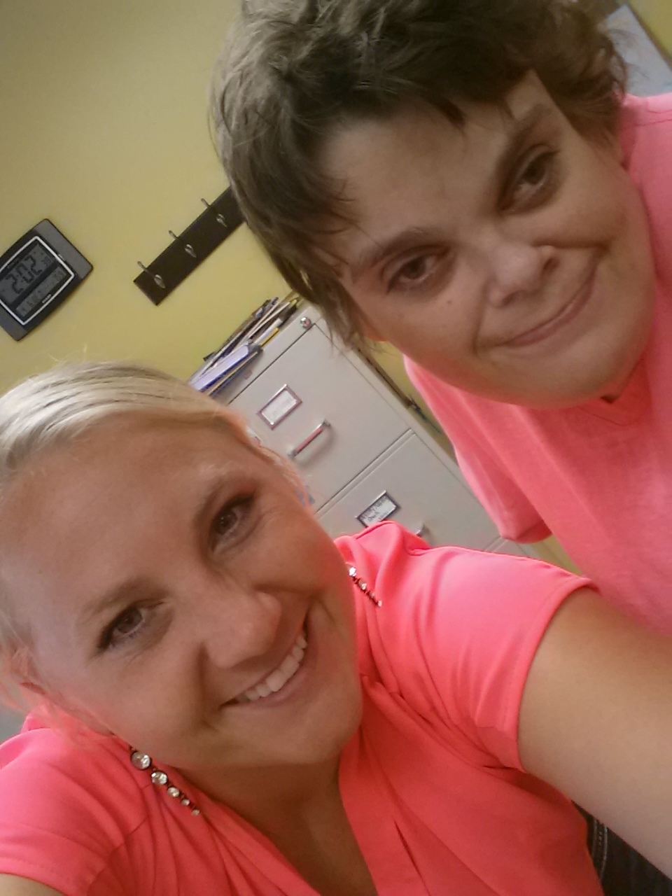
Biggest “A-Ha” Moments LifeCourse and Self-Advocates
“I'm not sure I realized how big my dreams can be!”
Notes:
Cyndi
The framework really helped open things up and help people realize they can dream big. We heard this type of thing a lot around post secondary ed, and home ownership and things like that especially….

Slide 52
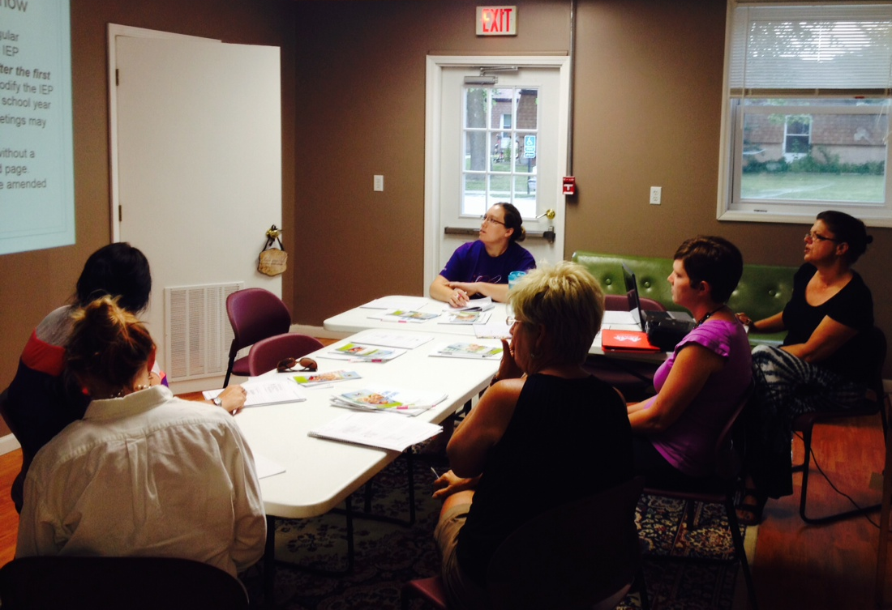
Biggest “A-Ha” Moments LifeCourse and Staff
“You can’t really plan for an individual without planning for the entire family unit!”
“Career Planning never really ends!”
Notes:
Kim
You work so hard to be person center…. That we lost this somehow… its not just one or the other… you don’t focus on the person first OR support the family… they work together.
Kim working on a couple of examples or stories here.
one example of a story that can be used as far as using the planning tools or maybe even not realizing what the individual wanted. Young man wanted to move out. SC utilized Developing a vision tool and LFC Experience and questions booklet to help facilitate discussions about this. The individual is now living independently with some supports.

Slide 53
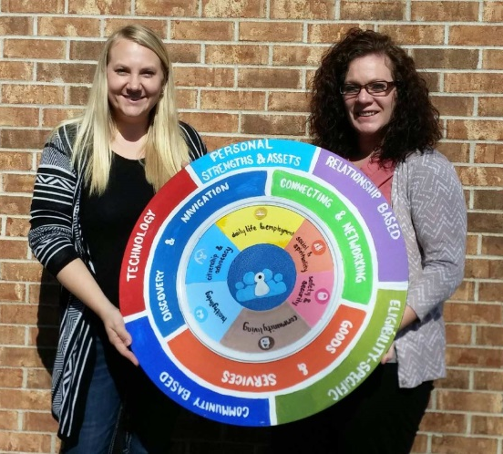
What Advice do you have for people just getting introduced to LifeCourse framework? To Employment?
Over whelming at first, use what makes sense for you.
Relax
Have someone look at what you are doing with fresh eyes. Get feedback!
Don’t box yourself in. Don’t assume that the way something played out in the past is how it will always play out.
Be creative!
“We reserve the right to get smarter!”
Notes:
Kim/Cyndi
If you were a brand new state starting off in this CoP, what do you wish you would have known at the beginning that you know now? Discuss the lessons you have learned, What factors were enabling, or presented challenges or barriers? What would you do differently or have you changed to meet the challenge?
We reserve the right to get smarter…
Use what makes sense for you.
This is all very cool and exciting, but it can be quite overwhelming. Remember the LifeCourse products are really just Tools for Conversations and you can pull them out and use one or all of them if that is what makes sense for the person or the situation.
Have someone look at what you are doing with fresh eyes.
Sometimes there are very simple things that you are doing that if looked at in a fresh way can make a huge difference. For example, we feel like we do a great job of supporting individuals in developing their plans, goals for the future, and strategies to achieve those goals…. But during a recent review it was noted by someone from outside the agency that we were writing goals “James will….” as opposed to “I will…”.
Don’t box yourself in. Don’t assume that the way something played out in the past is how it will always play out.
For example: When planning for the Youth Leadership Academy this past summer and planning to have not just the youth attend but their families… honestly we all thought “no way… families will never come” and Sheli and her team said “oh yes they will!”… and with the LifeCourse Framework and the right outreach… they did!
Reinforce that point from Mary Lee about “What we do influences so much in people’s lives… both positively and negatively.”

Slide 54
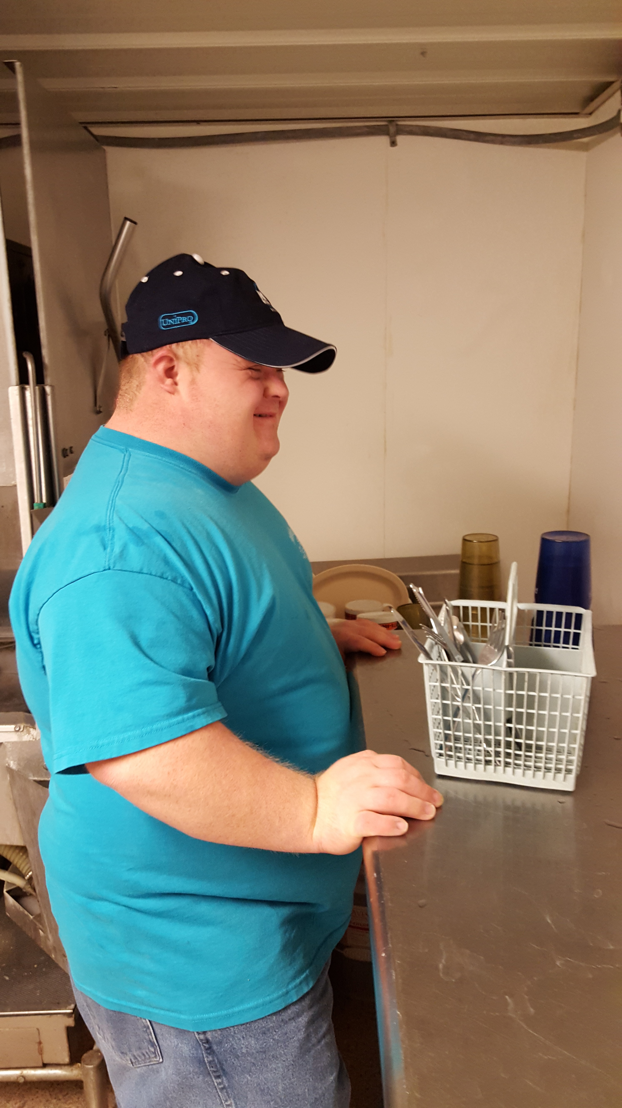
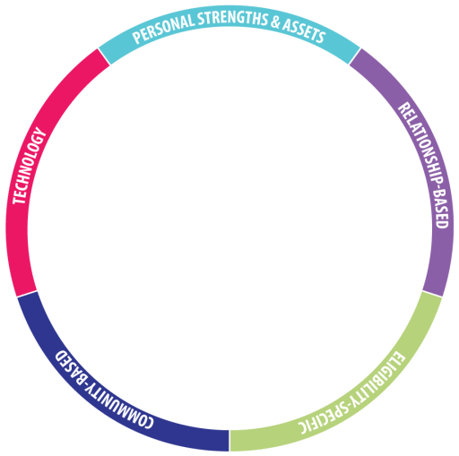
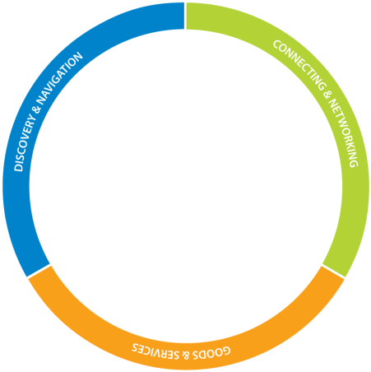
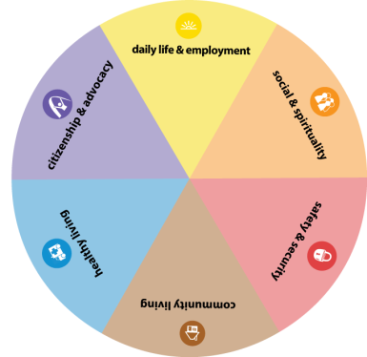
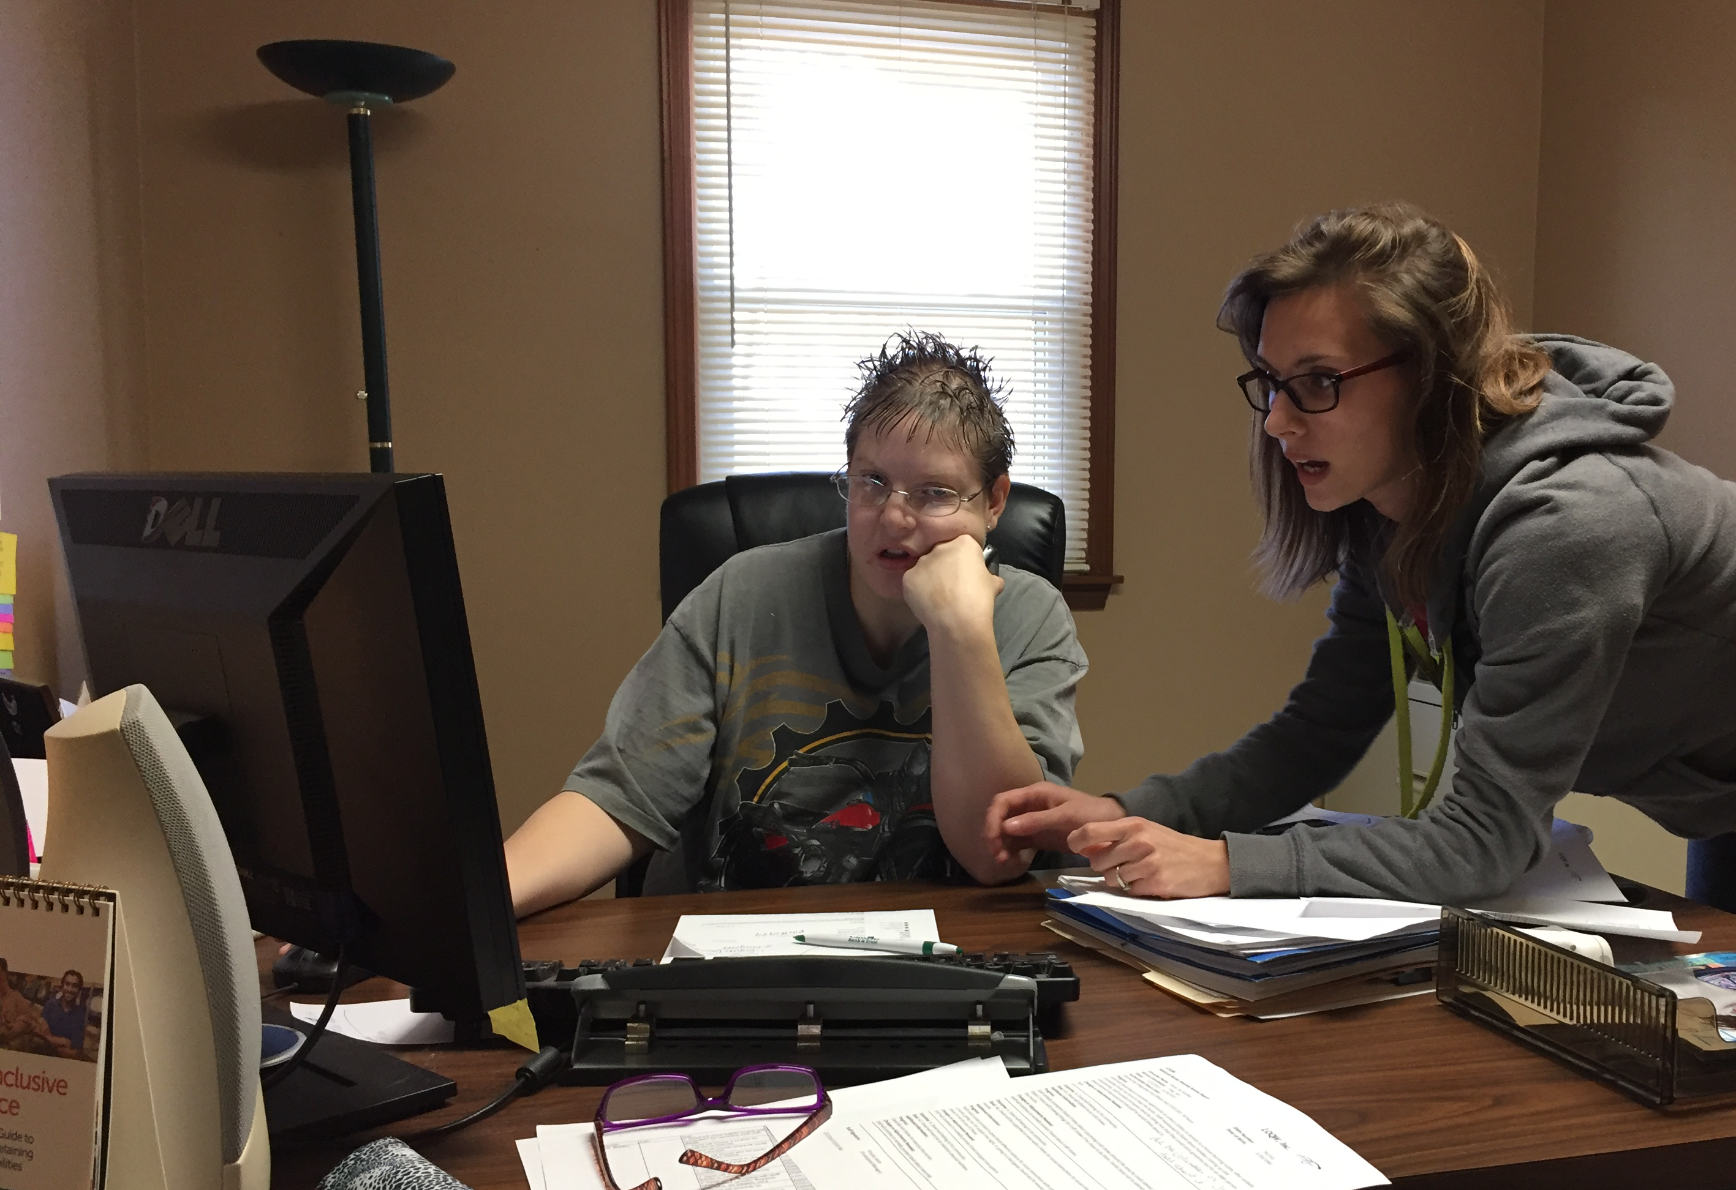
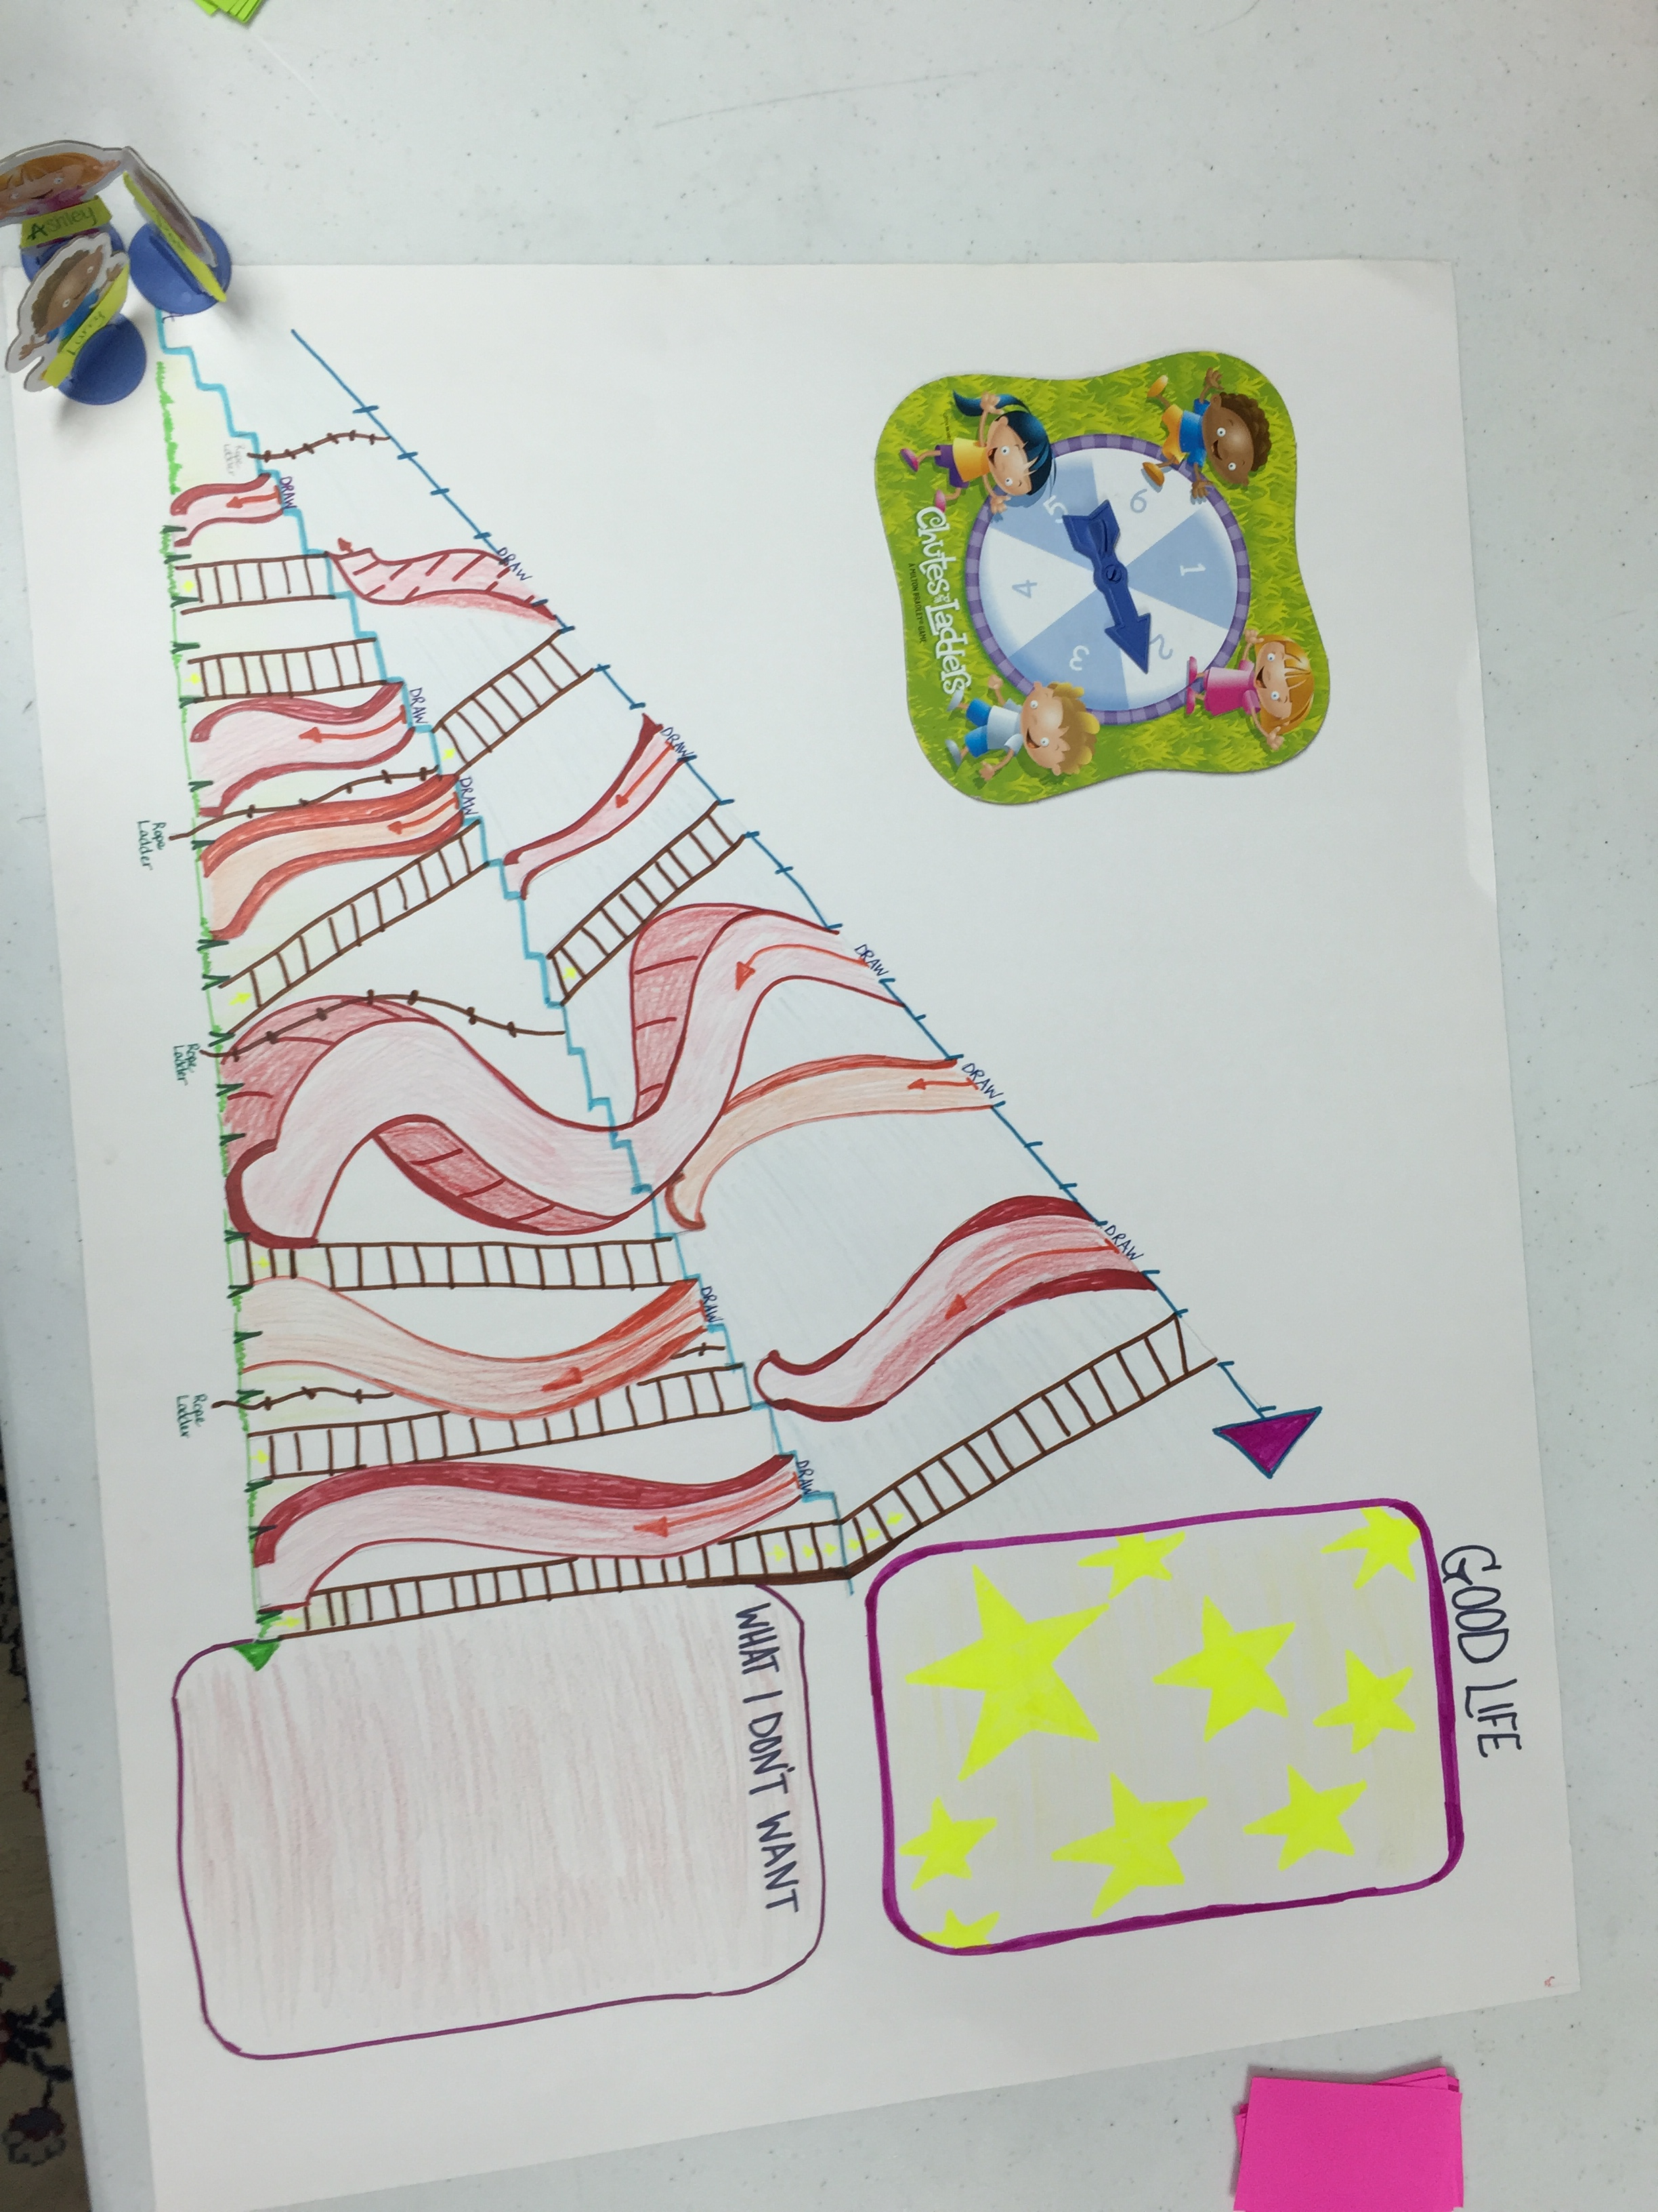
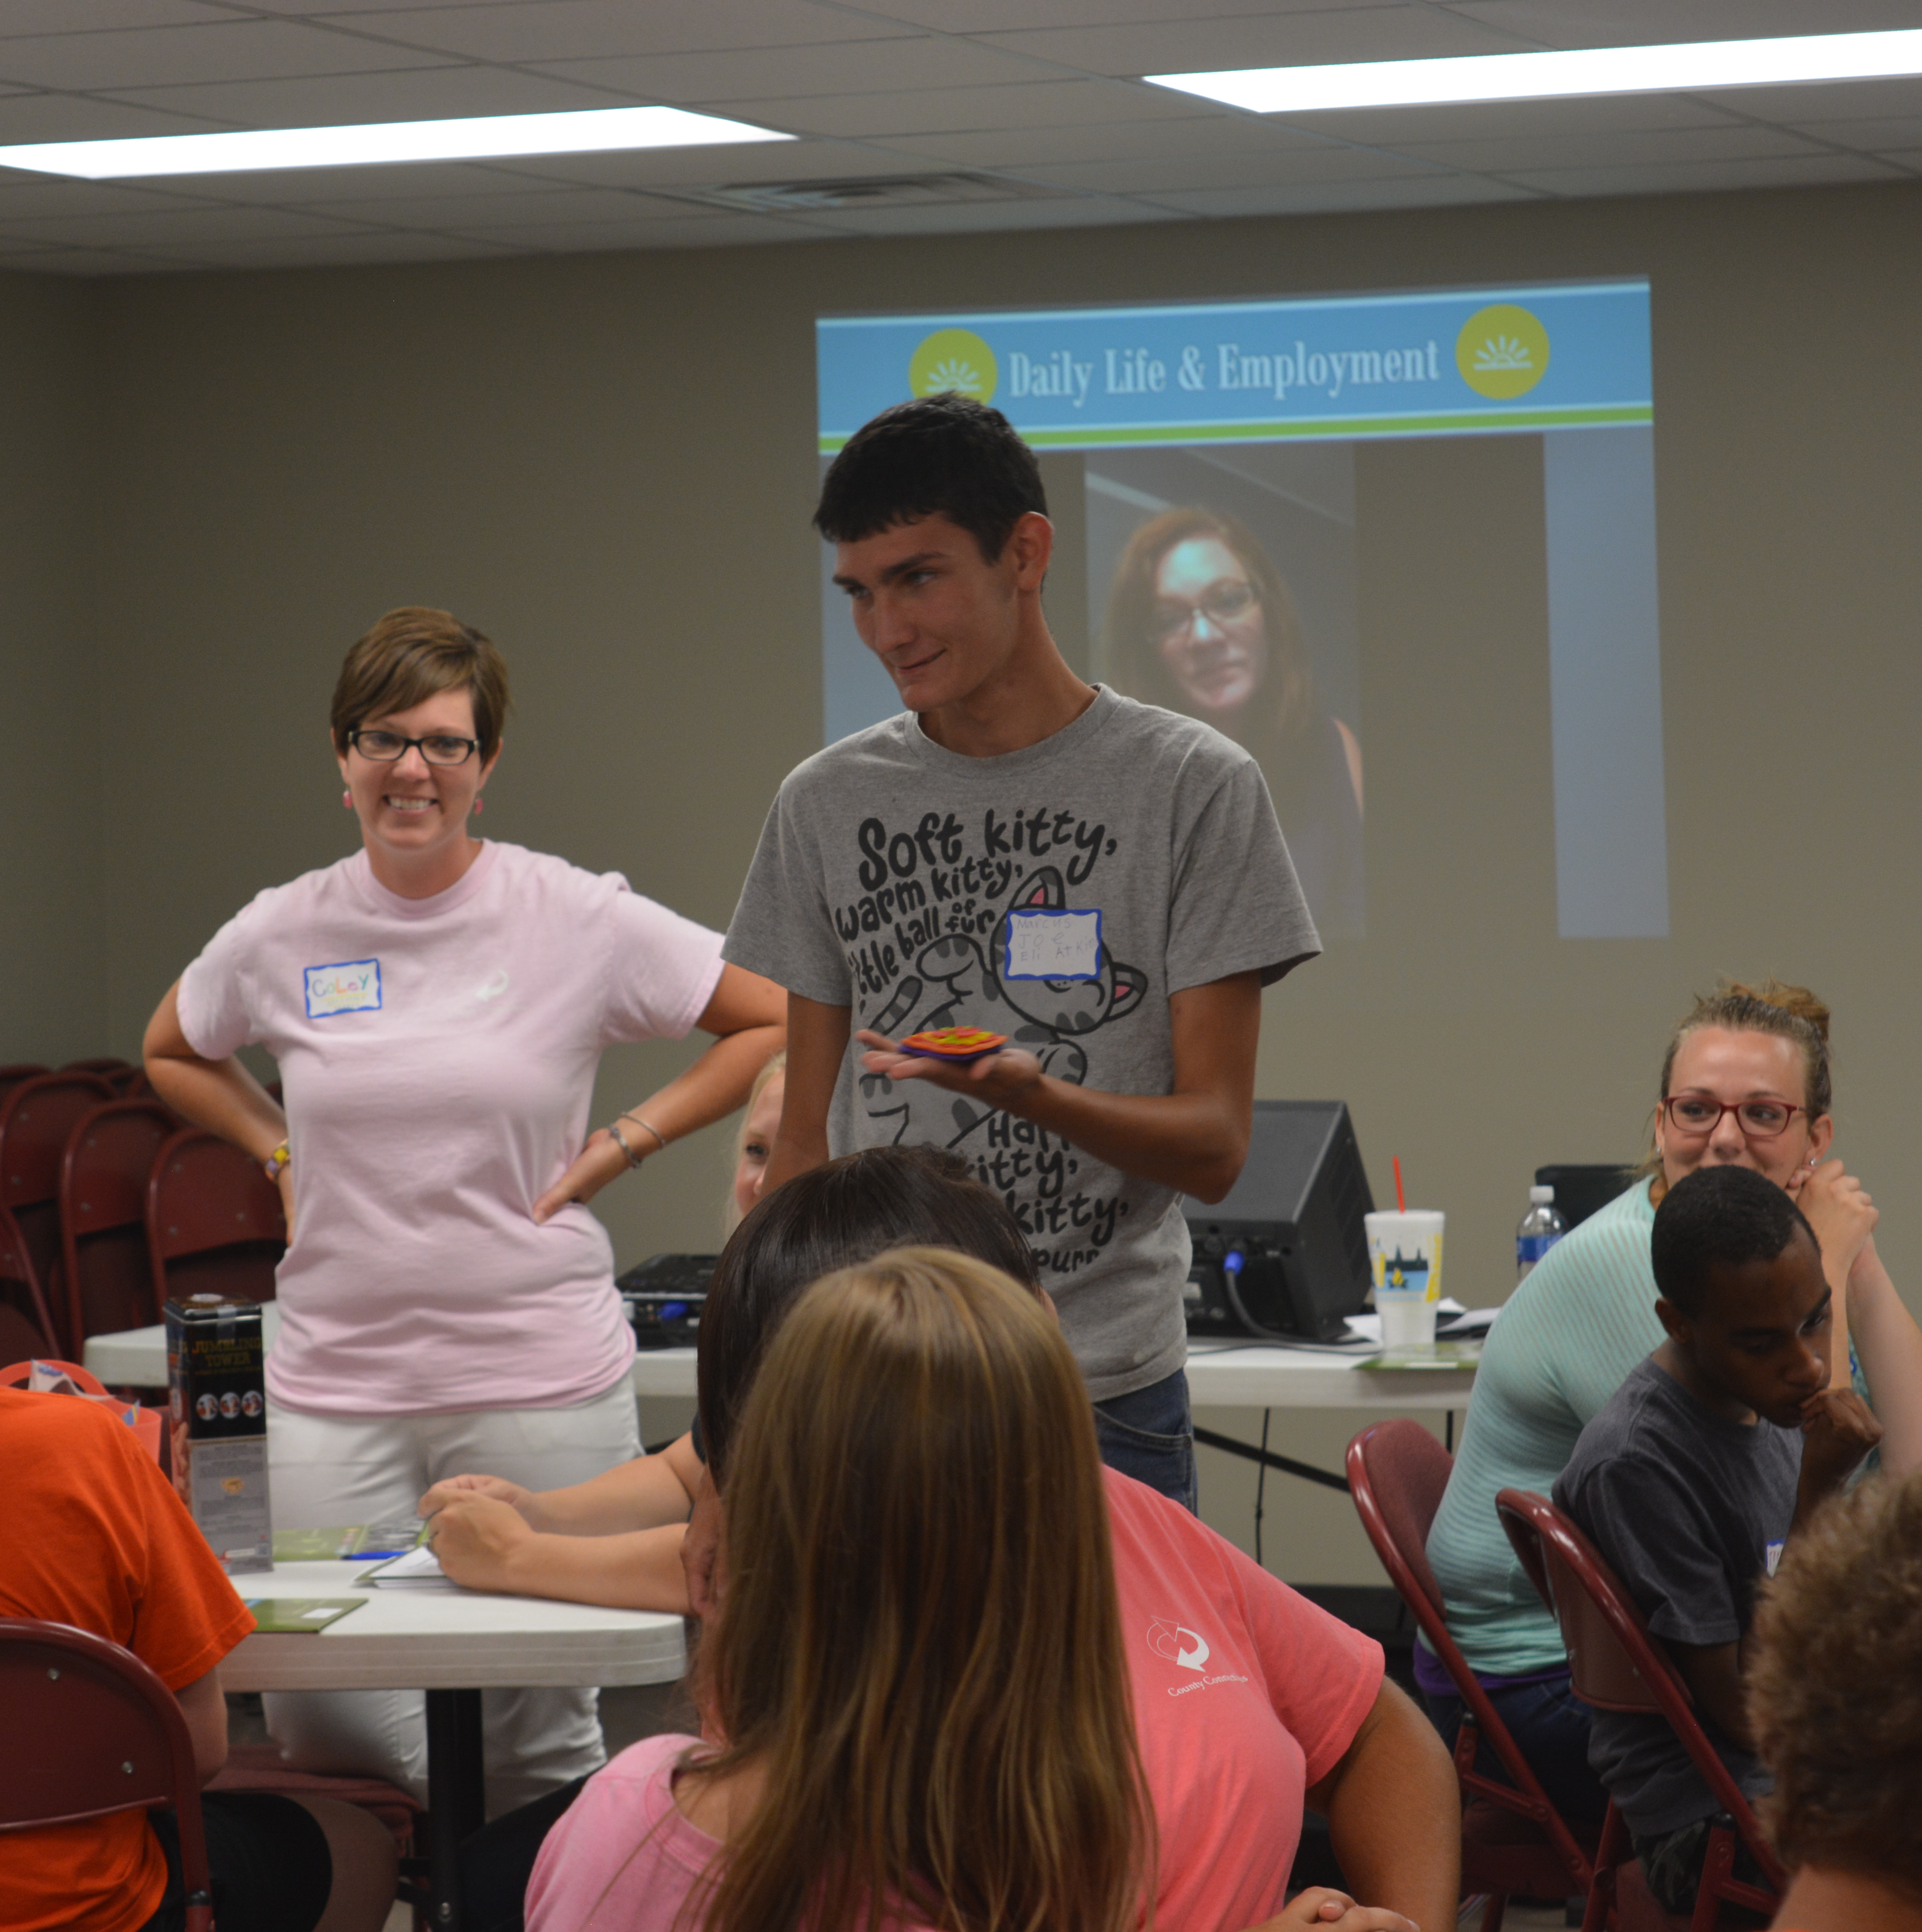
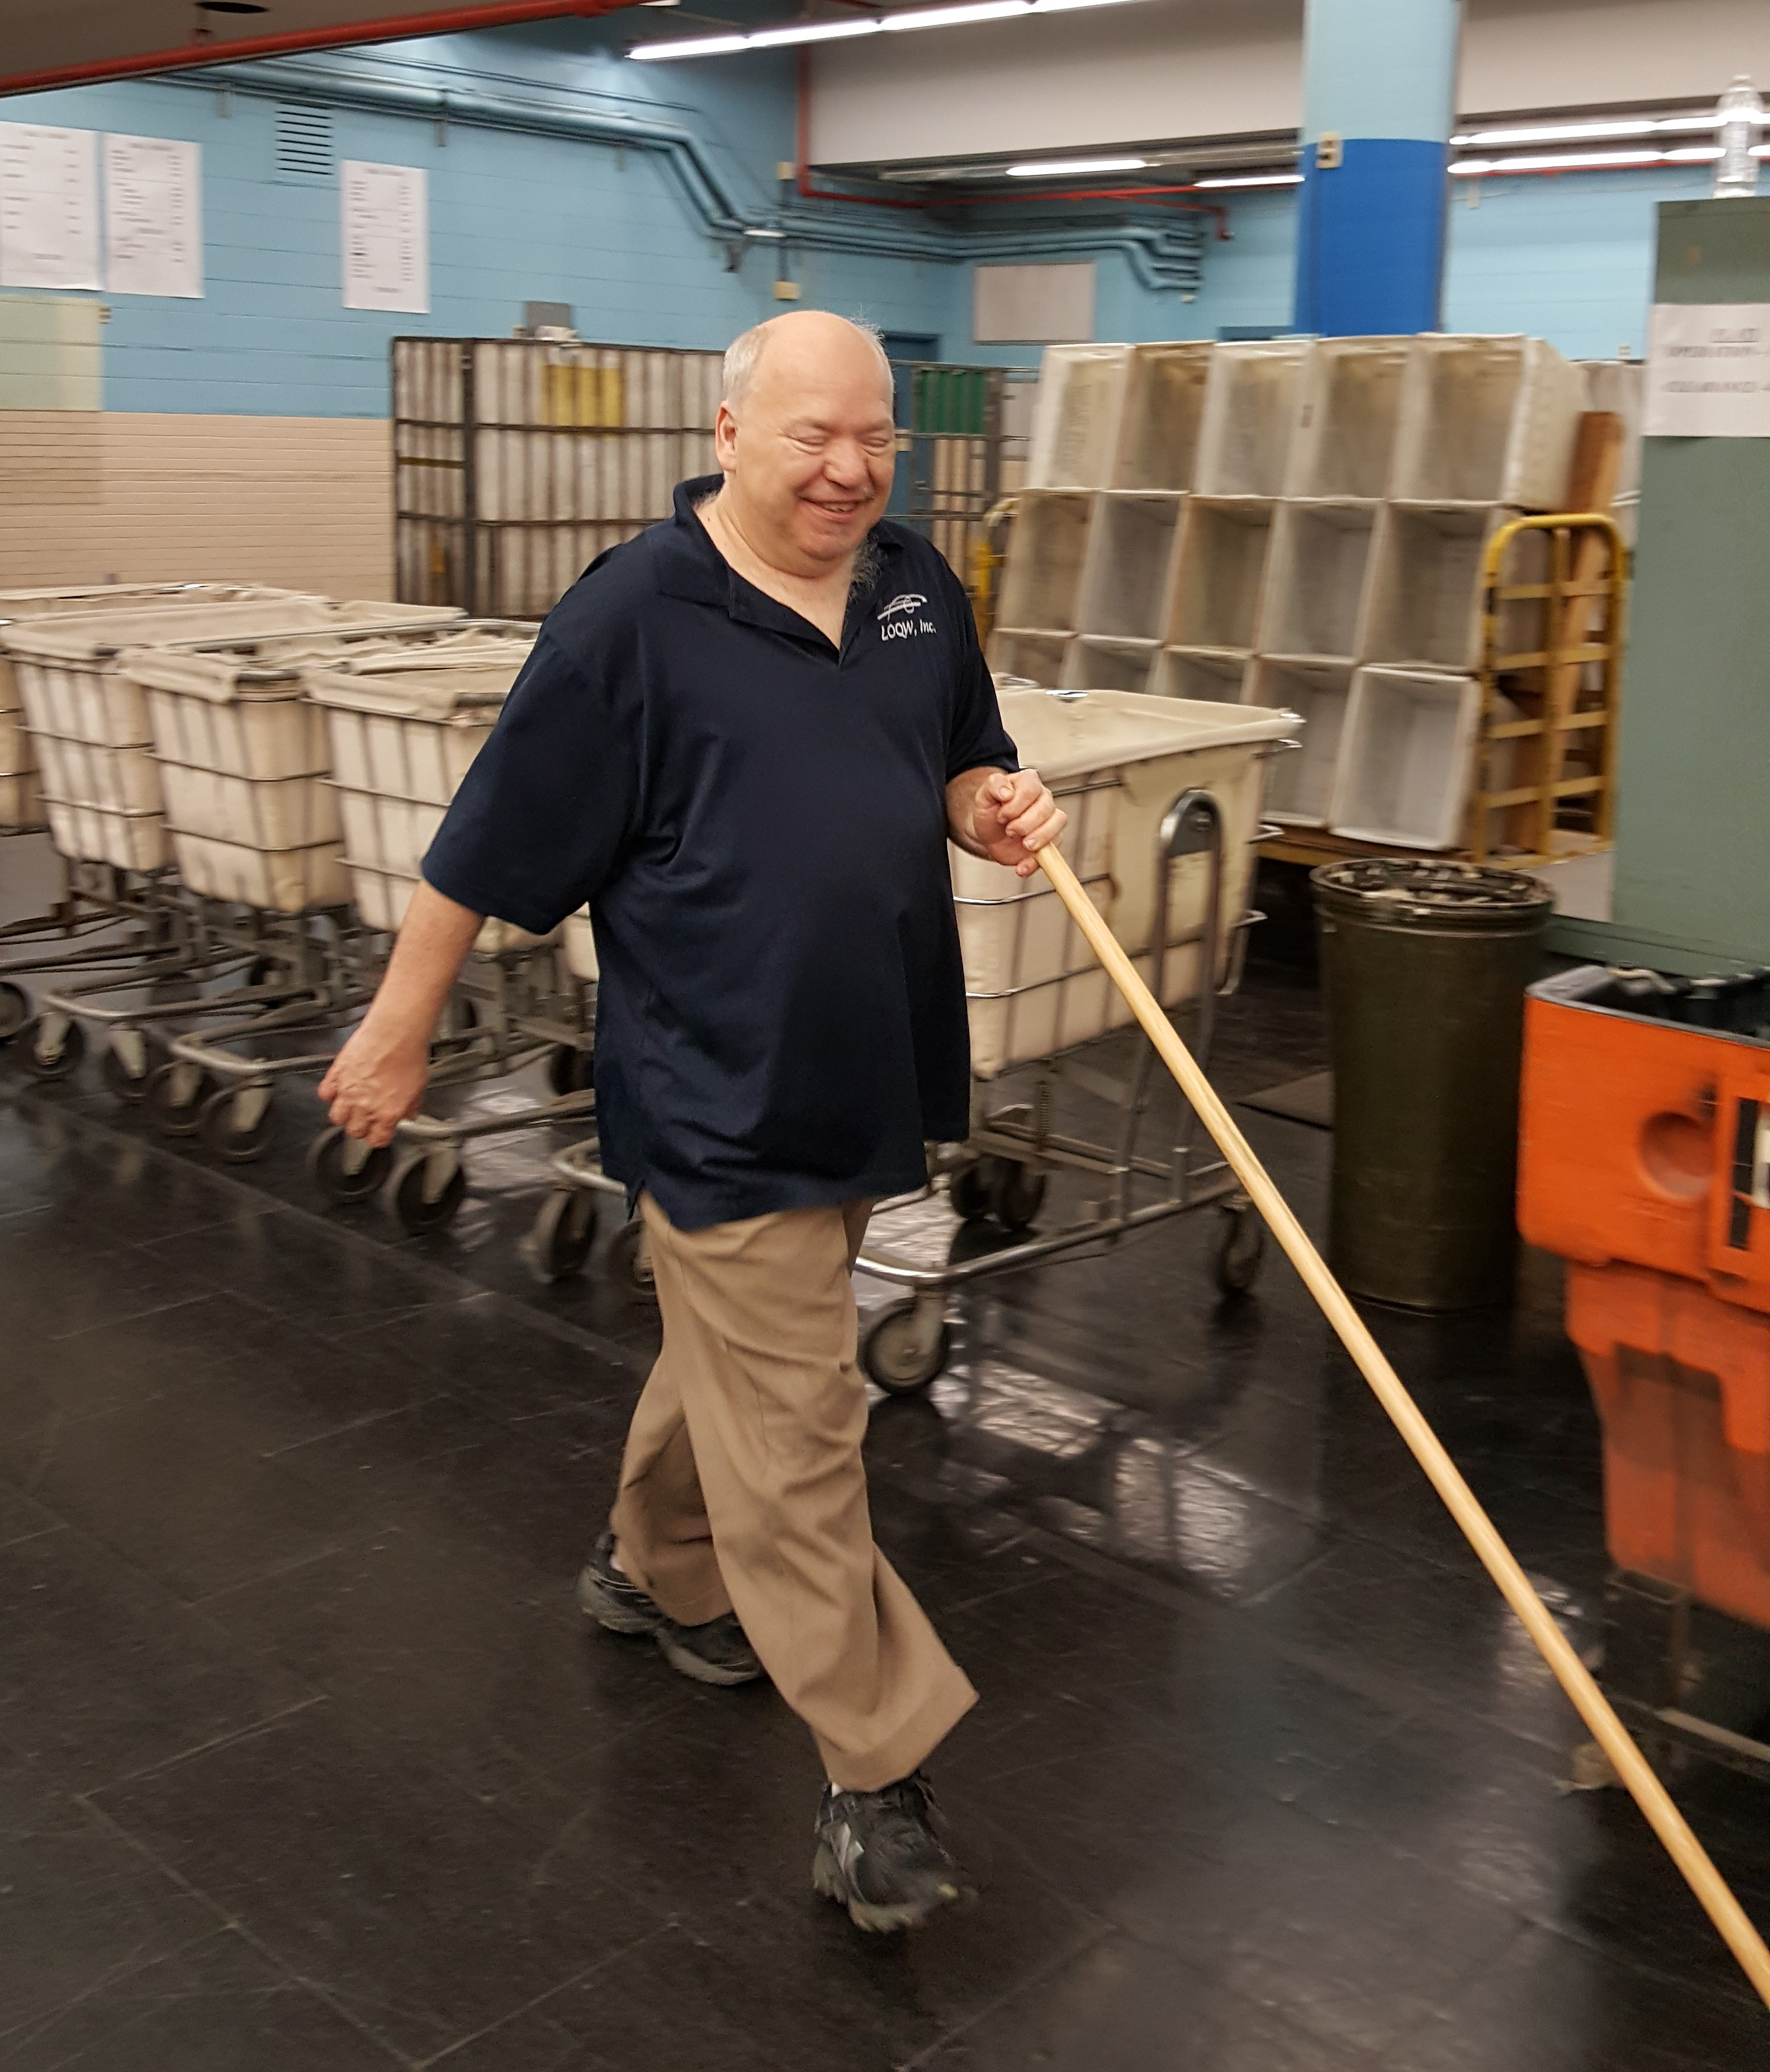
Explore…
Discover…
Express…
Pursue…
Notes:
(Molly)Tools to take home (show them Daily Life Book and Portfolio), lifecoursetools.com, contact SC’s, VR counselors

Slide 55
Questions???
Notes:
Questions?? Answers???

Slide 56
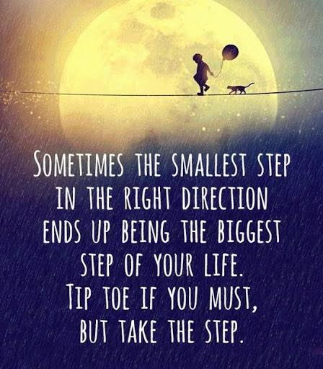
Learning Opportunities/Quality Works, Inc.
Contacts
Wendy Hays, Executive Director, LOQW whays@loqw.com | loqw.com 573.735.4282
Missy Johns, Director of Community Services, LOQW mjohns@loqw.com | loqw.com 573.735.4282
Cyndi Johns Human Resources & Skill Development cjohns@loqw.com | loqw.com 573.735.4282, ext. 114
Notes:
THANKS!!!
Feel free to contact us

