Slide 1
Supporting Every Day Lives for Persons with DD and
Their Families in Pennsylvania
September 14, 2016

Slide 2
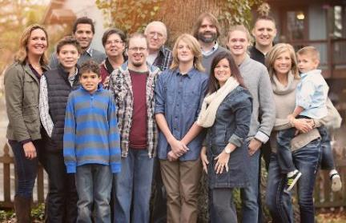
About Sheli
Sibling of three brothers, one who is 32 years old with developmental disability
Member, Presidents Committee for Persons with Intellectual Disabilities Appointed by President Obama
Director of Individual Advocacy and Family Support, UMKC UCEDD
  Supported the Self-Advocacy Movement for 12 years
  Director of Mo Family-to-Family Health Info Center
  Co-Director of National CoP on Supports to Families

Slide 3
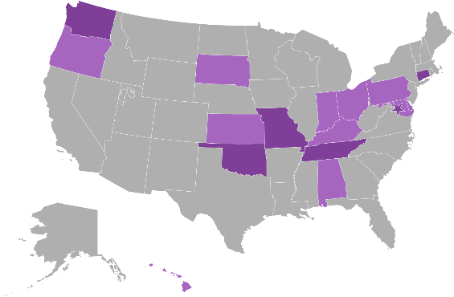
National Community of Practice for
Supporting Families
Project Goal
To build capacity through a community of practice across and within States to create policies, practices and systems to better assist and support families that include a member with I/DD across the lifespan.
Project Outcome
State and national consensus on a national framework and agenda for improving support for families with members with I/DD.
Enhanced national and state policies, practices, and sustainable systems that result in improved supports to families.
Enhanced capacity of states to replicate and sustain exemplary practices to support families and systems.
Notes:
COP charged with developing a framework for supporting families
Chose to model after the life course theory
Informed by Wingspread-Building a National Agenda for Supporting Families with a member with IDD
Framework started with Mo F2F stakeholders. Plain language, not systems jargon.

Slide 4









Funded in 2012 by
National Partners

Slide 5
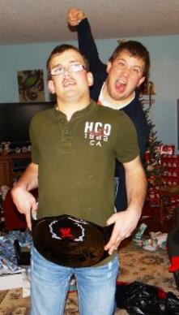
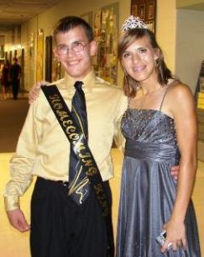
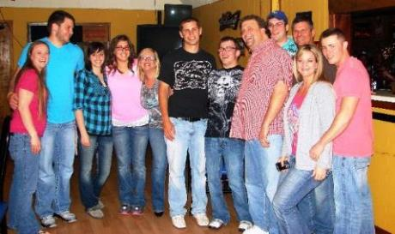

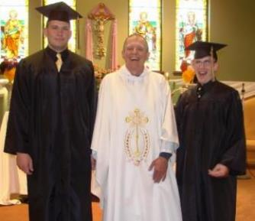
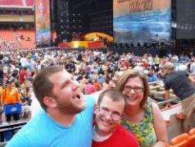
Setting the Stage

Slide 6
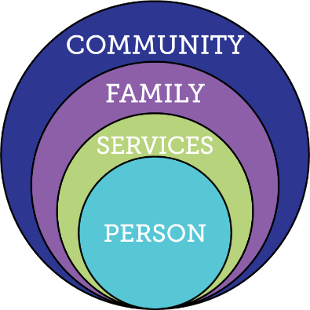
Current Reality of Services and Supports
Changing
Demographics
Demand for Services
Expectations, Values, Rights
Budgets
Capacity of
Work Force
Federal Policies
Notes:
-DEMAND for services going UP, while BUDGET is going DOWN. Workforce – females between 25 and 45, going DOWN. Elderly using $ and people resources that IDD also uses.
-Expectations of younger generation that has grown up with FULL iinclusion.
-Policy – moving away from institutional and congregate settings, and employment and community inclusion is an expectation.
-Providers expected to do MORE for less
Key Federal Policy:
Developmental Disability Act
Individuals with Disabilities Education Act
Family and Medical Leave Act
Lifespan Respite Act
Older American’s Act
HCBS rules
Key Federal Initiatives
Medicaid Money Follows the Person
SSA Ticket to Work
Aging and Disability Resource Centers
HHS Community Living Initiative
Other Key Initiatives:
National Governors Association initiative “A Better Bottom Line: Employing People with Disabilities”

Slide 7
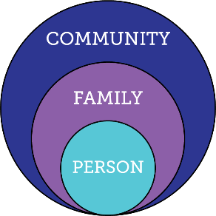
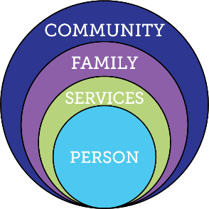
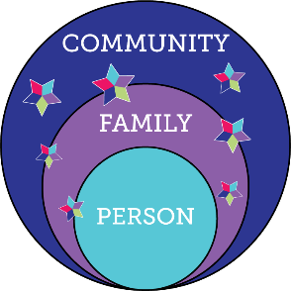
Services and Supports are Evolving
Everyone exists within the context
of family
and community
Traditional
Disability Services
Integrated Services and Supports within context of person, family and community

Slide 8
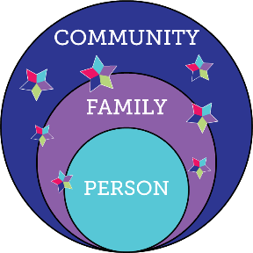
Joining Forces for a New Vision
1950s Mom------------Parent-----Family Movement
1970s Self-Advocacy and Independent Living Movements (Nothing about me, without me!)
2000s Siblings Movement
1960s Medicaid and Medicare Established
1980s Medicaid Waiver (Community Supports)
2010s Affordable Care Act
1970s Rehab Act: 504 Plans
1975s Education for All Children
1990s IDEA and ADA
2000’s Community and Society

Slide 9
History of the Role of Family
Era | Understanding of Family | Disability Services
1800s- | Moral blame assigned to parents | Removal from Society
1900s | Child damaged families | Removal from Family
1950s | Burden of Caregiving | Specialized Therapeutic Congregate Services
1980s | Families seen as system Positive Coping | Community Group Residential Supports
1990s | Families support children to remain in their home for as long as possible | Family Support programs for children living at home

Slide 10
History of the Role of Family
Era | Understanding of Family | Disability Services
2010s | Families adapt, accommodate and are resilient Recognize that there are additional emotional, physical and financial realities | -Family is a main constant in the lives of persons with disability -Families play significant role across the lifespan regardless of service provision -Families may need supports for the different roles they play in the lives of their family member

Slide 11

Moving to Supporting Families
Family Support | Supporting Families
Defined by eligibility, services or programs available, or funding | Not a program or based on eligibility, it is needs defined by the families across the lifespan regardless of service provision
Caregiver or parent | Family is defined functionally; inclusive of siblings, parents with disabilities, grandparents
Tension between self-advocacy and family support | Enhances opportunities for self-advocacy and self-determination
Crisis, immediate response | Preventative, long-term planning
Supporting caregiver in order to decrease demand on long-term services | Creates a quality of life for person with DD and their family by supporting their many roles
Notes:
Defined by professionals or service system
As a program or specific services
Tension between self-determination/self-advocacy and family support
Goal of supporting caregiver in order to decrease demand on long-term services

Slide 12
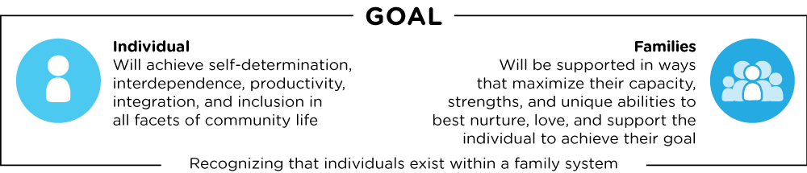
Defining Supports to Families
DISCOVERY AND NAVIGATION Knowledge & Skills | CONNECTING AND NETWORKING Mental Health & Self-Efficacy | GOODS AND SERVICES Day-to-Day & Caregiving/Supports

Slide 13
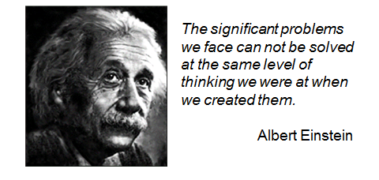
Notes:
As a field we are looking around at services, systems, support, and policies and asking how we got here and how can we think differently.

Slide 14
Type of Change that is Needed
Transitional Change
Transformation Change
“Retooling” the system and its practices to fit the new model
Mergers, consolidations, reorganizations, revising systematic payment structures,
Creating new services, processes, systems and products to replace the traditional one
Fundamental reordering of thinking, beliefs, culture, relationships, and behavior
Turns assumptions inside out and disrupts familiar rituals and structures
Rejects command and control relationships in favor of co-creative partnerships
Creating Blue Space, Hanns Meissner, 2013
Notes:
Transitional change – can’t just keep changing names and adding things on – have to think very differently.
The LifeCourse Framework is the way we can achieve Transformational Change
Have/change conversations; problem solve; navigate; educate; plan
Tools to give confidence, to start conversations, actually USE the tools

Slide 15
Adapted from Title V Maternal Child Health
Block Grants
Life Course Health Development Model
Rethinking MCH: The Life Course Model as an Organizing Framework 2010
Today’s experiences and exposures influence tomorrow’s health
Health trajectories are particularly affected during critical or sensitive periods
The broader community environment–biologic, physical, and social –strongly affects the capacity to be healthy
While genetic make-up offers both protective and risk factors for disease conditions, inequality in health reflects more than genetics and personal choice

Slide 16
Example of Life Course Health Development Model: Heart Disease
  Adult Lifestyle Model
    Change current behaviors
      Smoking
      Diet
      Exercise
      Alcohol consumption
  Life Course Perspective
    Biological and Social Factors
    Starting at pregnancy and building throughout lifespan
Kuh, D. et al (2003) Life course epidemiology.
Notes:
Environmental exposures during pregnancy have long term impact outcomes on adulthood health.
Focusing on causes occurred earlier
As opposed to focusing only on current behaviors

Slide 17
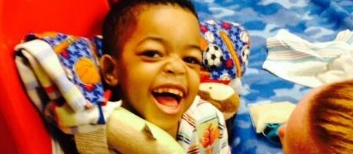
Guiding Principles of the
Supporting Families LifeCourse Framework

Slide 18
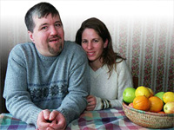
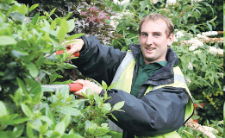

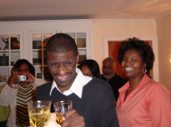
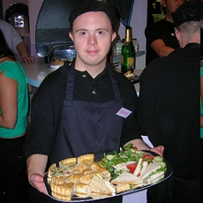
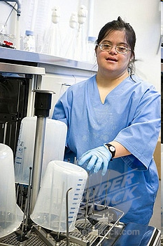
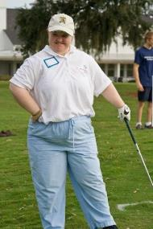
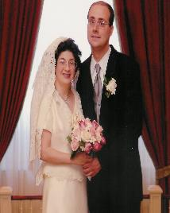
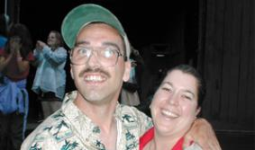
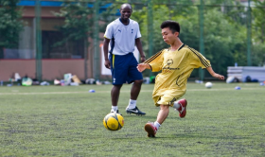
Core Belief:
All people and their families have the right to live, love, work, play
and pursue their life aspirations in their community.
Notes:
We don’t say ALL people “with disabilities” – but ALL PEOPLE. PWD are part of the ALL so we don’t need to single them out as different or special.

Slide 19
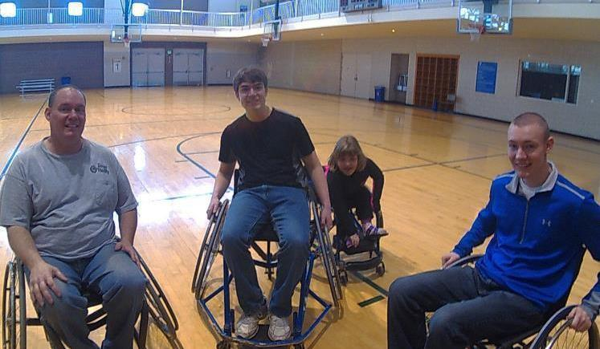
ALL People

Slide 20


1 in 4 Persons with I/DD Receive
Formal State DD Services
25%
100%
75%
4.7 Million people with developmental disabilities
National % Receiving State DD Services
** Based on national definition of developmental disability with a prevalence rate of 1.49%
Notes:
3 out of 4 are not getting and may never get paid DD services. Our job is to help the 3 get other kinds of support, and help ALL 4 figure out different ways of getting supports.

Slide 21
Pennsylvanians with DD
202,279 estimated Pennsylvanians with DD*
73%
(146,901)
6%
21%
Paid DD
Services
Support
Coordination
Not Known to
DD State System
State Support Coordination Only: 11,761
County Support Coordination Only: 3,370
Support Coordination Plus Paid DD: 40,247
SFY15-16 Total State DD: 55,378
*Based on 1.58% prevalence of PA citizens, US Census

Slide 22

Partnering with People with Disabilities and their Families
So they can Engage, Lead, and Drive
Policy and Systems Change
Notes:
How do we ensure people with disabilities and their families are involved in the process? How are they the voice of the change?

Slide 23

WHAT IS IMPORTANT TO PEOPLE
WITH DISABILITIES
CONTROL
CHOICE
FREEDOM
STABILITY
EMPLOYMENT AND
MEANINGFUL CONTRIBUTION
HEALTH AND SAFETY
INDIVIDUALITY
CONNECTED
RELATIONSHIPS
RESPONSIBILITY
PARTNERSHIP
COMMUNICATION
QUALITY
SUCCESS
ADVOCACY

Slide 24
WHAT IS IMPORTANT TO FAMILIES
THE UNIQUE ROLE OF FAMILY
CHOICE AND CONTROL
SUPPORTING FAMILIES THROUGHOUT THE LIFESPAN
HEALTH AND SAFETY
KNOWLEDGE AND RESOURCES
SIMPLICITY AND FLEXIBILITY
MENTORING
QUALITY AND STABILITY
COMMUNICATION
COLLABORATION
RESPECT AND TRUST
OPPORTUNITY
FOR INNOVATION

Slide 25
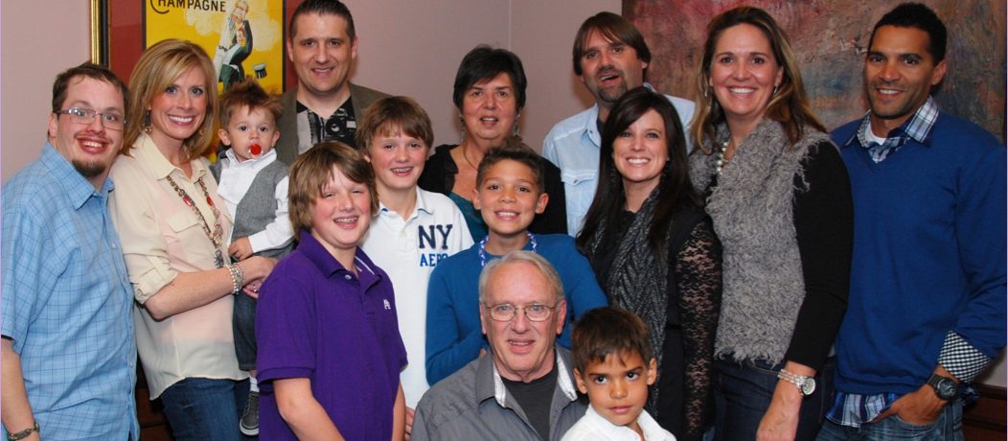
Person Within Context of Family and Community

Slide 26

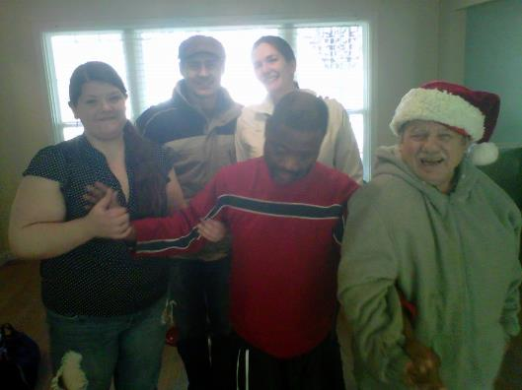
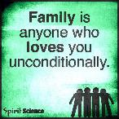
ALL Individuals Exist Within the Context of Family
Family is defined by the individual
Individuals and their family may need supports that adjust as roles and needs of all members change
Not dependent upon where the person lives
Notes:
No matter if person lives with their family (or not), talks to (or not) or if the family goes to meetings with the person
We have to be OPEN to their definition of family!

Slide 27
Where do People with I/DD Live?
89%
living in own homes
and/or are supported
by family
Anderson, L.L., Larson, S.A., Kardell, Y., Hallas-Muchow, L., Aiken, F., Hewitt, A., Agosta, J., Fay, M.L., & Sowers, M. (2015). Supporting Individuals with Intellectual or Developmental Disabilities and their Families: Status and Trends through 2013. Minneapolis: University of Minnesota, Research and Training Center on Community Living, Institute on Community Integration.
Notes:
Anderson, L.L., Larson, S.A., Kardell, Y., Hallas-Muchow, L., Aiken, F., Hewitt, A., Agosta, J., Fay, M.L., &
Sowers, M. (2015). Supporting Individuals with Intellectual or Developmental Disabilities and their Families:
Status and Trends through 2013. Minneapolis: University of Minnesota, Research and Training Center on
Community Living, Institute on Community Integration.

Slide 28

Lifelong Impact of Family on Individual
Biologically: Likes, dislikes, skills, abilities
Socially: Family and friend network, connection with community members
Environmentally: Neighborhood, socio-economic, education
Policy:
Dreams, Aspirations,
House rules, cultural rules, expectations
Notes:
Biology – are we tall or short? Do we inherit tendency for certain illness? What do I want to do or be?
Socially – impact of reputation of the family – good or bad (like in school if you had an older brother/sister attend before you); connected socially/social networks (what are those connections and reputations??)
Environmentally – the neighborhood we grow up in; our family’s education level, financial status; (Farm vs City)
Policy – house rules and expectations; important to understand expectations and norms. (everyone expected to go to college; make your bed every morning) Family CULTURE – so important – what you do on holiday, birthdays, traditions and things that are important in your family culture; how to hang stockings. WHO is going to know the family rituals???

Slide 29



Reciprocal Roles of ALL Family Members
Caring About | Affection & Self-Esteem
 | Repository of knowledge
 | Lifetime commitment
Caring For | Provider of day-to-day care
 | Material/Financial
 | Facilitator of inclusion and membership
 | Advocate for support
*Adapted from Bigby & Fyffe (2012), Dally (1988), Turnbull et all (2011)
Notes:
#1 fear of all parents/families --- what will happen when I’m GONE?
Having conversations with families (especially parents) about “Caring About” – who else can fill these roles when you are gone, and how can you start giving some of those things to others NOW while you are still around?
It doesn’t matter if you think you have all the “caring for” covered when you’re gone – what if it all falls apart? If there is no one that cares ABOUT the person to figure it out, then it’s all for naught.
AND who does the person care about? Do they send cards or call on birthdays for loved ones? Is there someone they are about that they also care FOR? (ie- interdependent relationships especially with older families)
RECIPROCAL - reciprocity

Slide 30
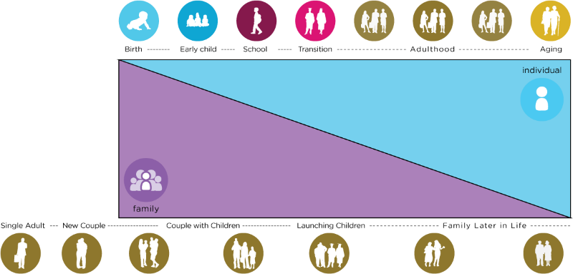
Family Life Cycle
Life Stages and Individual and Family Cycles
Individual Life Stages
Notes:
Have to consider the individual’s stage of life, but also where other family members are in their lives. Are the parents aging? Are the siblings raising their own families? Is a sibling going away to college?
Stages – what happens in early or any stage, affects the stages to come. You have them for only a very short time in their lifespan, but what happens in those years can have profound effect on future (adult) years!
*45 Year old PWD – parent is 65 or older and might be caring for their own elderly 95 year old parent!
*12 year old with autism – also has a new baby in the house.
Consider the person you support in the context of their whole family dynamic!

Slide 31
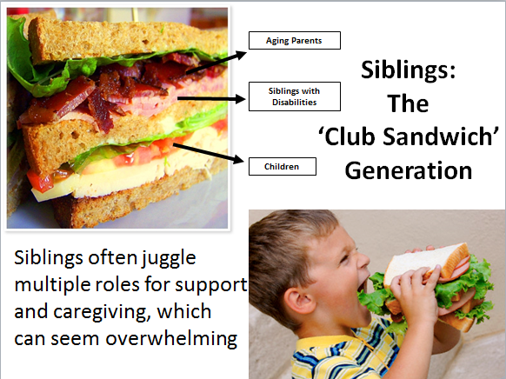
*Courtesy of National Sibling Leadership Network

Slide 32
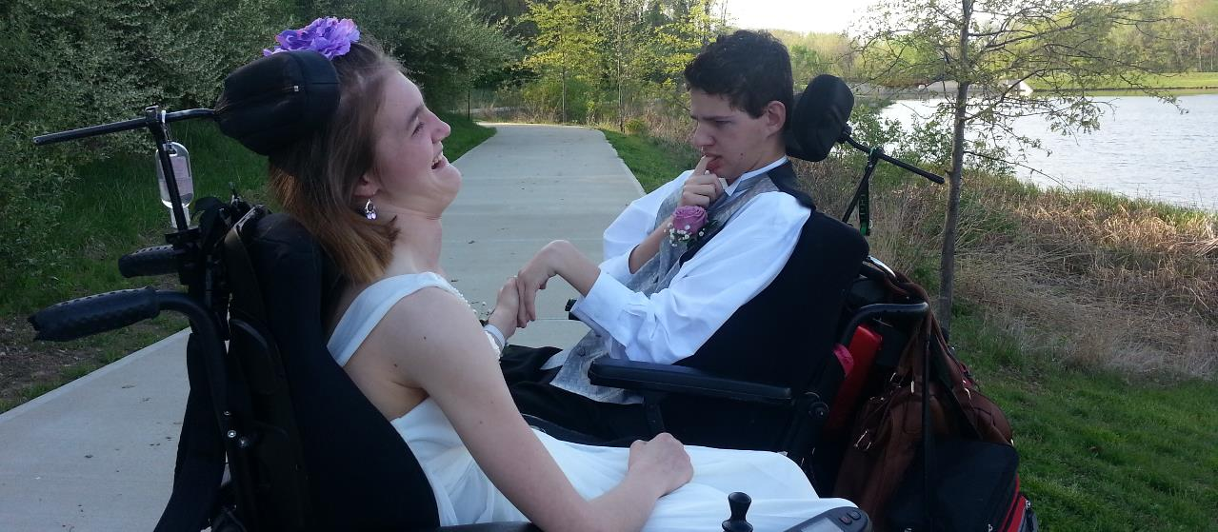
Good Life Vision, Trajectory,
Life Experiences and Life Stages

Slide 33
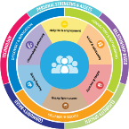
Vision for a Good Life
The future is not something we enter. The future is something that we create. And creating that future requires us to make choices and decisions that begin with a dream.
    -Leonard L. Sweet
Notes:
How can you plan with people if you don’t know their finish line?
STORY---Resource Center – we try to figure out WHY they are asking for a service – story about mom asking for DayHab because her son actually needed transportation to his job and dayhab has transportation.

Slide 34
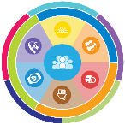
What is YOUR Vision
for a Good LIFE?
Vision of What I Want for a Quality of Life
Notes:
Ask the group Who said: Family/friends; vacations, pets, chocolate, etc
How many people said: Good Behavior Plan????
EVERYBODY “gets” what “good life” means --HCBS new rule – plan must be understood by individual and reflect their goals and preferences

Slide 35
What DON’T you want?
Vision of What I Don’t Want
Notes:
Who said: Poverty, isolation, segregation, loneliness?
Ask the group for anything else they put there that hasn’t already been said.
Family sometimes cant envision the good life – too many barriers, always a fight. But they can almost always tell you what they DON’T want!

Slide 36
Trajectory towards Good Life
Friends, family,
enough money,
job I like, home, faith, vacations, health, choice, freedom
Trajectory towards Life Outcomes
Vision of What I Don’t Want
Trajectory towards things unwanted
Notes:
What kinds of things did you say earlier for YOUR good life? PWD and families usually want those same types of things. Everybody “gets” what the good life is. We just don’t usually ask them! What kinds of things do you think PWD and families will say they DON’T want? Sometimes you need to start there – they may not know what they want (because they are thinking in disability world) but they almost always can tell you want they don’t. FAMILY should have a good life trajectory too.
TRAJECTORY is the path that will either lead you toward the good life or toward things you don’t want. Think about throwing a football – the path that the ball takes on it’s way to the receiver is the trajectory. If you shoot an arrow, or a nerf gun – the path that the arrow follows is the trajectory. CAN START at ANY AGE!!!!
Support coordinators, providers, DSP’s, VR counselors, teachers….. ALL have the power to impact someone’s trajectory, sometimes negatively, by their actions or words. We must be very careful and mindful of the impact we can have. Are we nudging person and family toward what they want or what they don’t want?? EACH interaction, think about which way it pointed their trajectory!
KINDERGARTEN story – segregated class and safer special bus
Trajectory isn’t always straight
Bumps in the road – you can get back on track
VISION and TRAJECTORY can be very broad or very specific and time limited. Might be what are we doing/what’s happening this wee

Slide 37
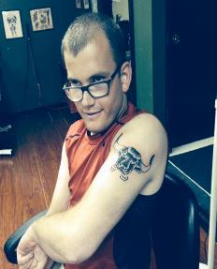
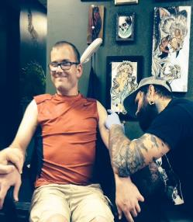
Ben’s Good Life Vision
Family Friends TATTOOS
Vacations Girlfriend
Concerts WWE Nascar
Money Job/own business
Fire Station Church
Tiger Football Royals
Good Food Pepsi Beer
Active Healthy & Fit
Poverty/No Money
Poor Health Diabetes
Heart Disease Guardian
Isolated/Segregated
Institution/group home
Treated Differently
Notes:
BEN’s

Slide 38






Trajectory Across Life Stages
Notes:
--Life experiences – are how we get ready for the next phase – having chores as a child helps prepare you for employment. Having an allowance helps you learn about money (and making mistakes with money). Learning to say NO helps the person learn to protect themselves.
--ANTICIPATORY GUIDANCE—especially at times of transition. Doctors do it all the time.
IE- we don’t start talking about Employment until age 14! But we can nudge people at age 2 or 5 or 10 – chores, summer job, volunteering, asking child what they want to be, learning about lots of options
--Show them the LC Experiences booklet – talk about how people might use it.
--SAFETY – people don’t stay safe because someone has always protected them. They need to learn skills!
--Think beyond systems transitions ONLY

Slide 39
Trajectory Across Life Transitions
Life Transitions
and
Disability
System Transitions
My parents have passed away, what do I do?
Parents Turn 65
Medicare & SSDI
Transition planning
Living Adult Life
Turning 18. Leaving school at 18 or 21
Leaving Early Childhood/ enter school
Getting New Diagnosis
Notes:
--Life experiences – are how we get ready for the next phase – having chores as a child helps prepare you for employment. Having an allowance helps you learn about money (and making mistakes with money). Learning to say NO helps the person learn to protect themselves.
--ANTICIPATORY GUIDANCE—especially at times of transition. Doctors do it all the time.
IE- we don’t start talking about Employment until age 14! But we can nudge people at age 2 or 5 or 10 – chores, summer job, volunteering, asking child what they want to be, learning about lots of options
--Show them the LC Experiences booklet – talk about how people might use it.
--SAFETY – people don’t stay safe because someone has always protected them. They need to learn skills!
--Think beyond systems transitions ONLY

Slide 40
Trajectory Across Life Experiences
Chores and allowance
Dating & Heartaches
Making Mistakes
Birthday parties with friends
Summer jobs, babysitting
Learning to say “no”
Playing sports or an instrument
Scouts, 4H, faith groups
“Anticipatory Guidance for Life Experiences”
Notes:
--Life experiences – are how we get ready for the next phase – having chores as a child helps prepare you for employment. Having an allowance helps you learn about money (and making mistakes with money). Learning to say NO helps the person learn to protect themselves.
--ANTICIPATORY GUIDANCE—especially at times of transition. Doctors do it all the time.
IE- we don’t start talking about Employment until age 14! But we can nudge people at age 2 or 5 or 10 – chores, summer job, volunteering, asking child what they want to be, learning about lots of options
--Show them the LC Experiences booklet – talk about how people might use it.
--SAFETY – people don’t stay safe because someone has always protected them. They need to learn skills!
--Think beyond systems transitions ONLY

Slide 41







Life Experiences = Life Outcomes
Experiences at age 65
What We Want
Friends, family,
enough money,
job I like, home, faith, vacations, health, choice, freedom
Experiences
at age 13
Experiences
at age 5
What We DON’T Want
Notes:
ADAPTING AND ACCOMODATING
Put an X above the pink icon –on the line – age 13
What kind of life experiences were you having at age 13? What were you doing, where were you going? Puberty, starting to separate from parents, friends,
NEXT – put an x at age 5
THEN – put an x at age 65 – what do 65 year olds do?
YOU Lived thru these same life stages (or you will). Parents lose perspective – think they need a special book for everything. Help get confidence back – they know what to do! Talk about HOW to use the booklet—SC focus on a lifestage before a meeting; ask what they are struggling with or worried about the most; work from there with the booklet. ANTICIPATORY GUIDANCE!!!

Slide 42
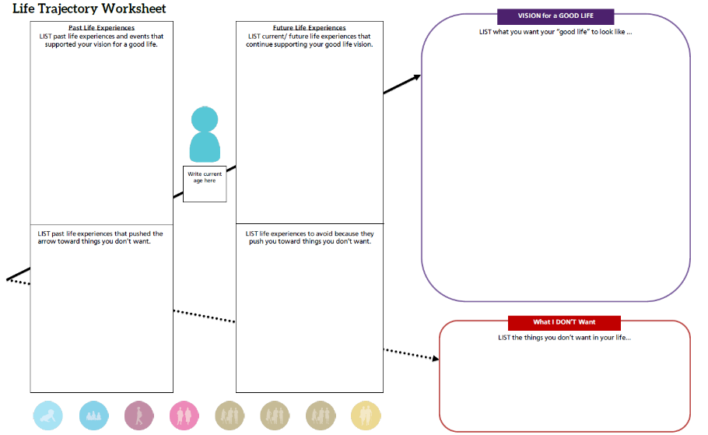
Ben’s Life Trajectory
Chores; boy scouts;
School inclusion/circle of friends;
Birthday parties;
Riding bike;
Family vacations;
Church youth group; Debit card;
Football manager; Homecoming king; Volunteering
High School diploma
Family and friends
Girlfriend
Vacations
Concerts; WWE; Nascar
Tattoos
Money; job or my own business
Volunteer at fire station
Being Tiger football manager
Church
Healthy & fit
Good food; Pepsi
Basketball
Royals baseball
Staying active
Volunteer at fire station; Find more volunteer ops; Workout regularly;
Keep in touch w/ friends; Increase alone time;
Go out with friends; Spend daytime hours out of the house;
Explore micro enterprise;
25
Special education low expectations;
Para glued to Ben’s side; Pressure to segregate; Medication side effects;
Scoliosis;
Seizures;
Physical barriers;
Sitting at home watching TV all day;
Rely on paid supports;
Gain weight;
Eat unhealthy foods or drink too much Pepsi (caffeine);
Poor health, heart disease, diabetes; Poverty/no money;
Guardianship; institution/group home; Segregation/isolation; being lonely
Being treated differently;

Slide 43
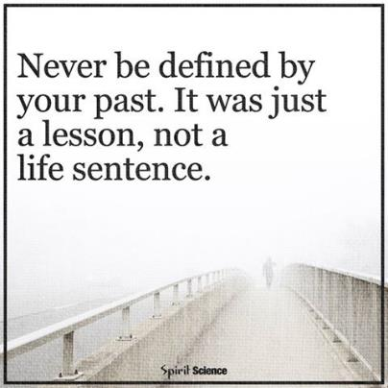
Dignity of Risk and Mistakes
Friends, family,
enough money,
job I like, home, faith, vacations, health, choice, freedom
Poverty, loneliness, segregation, restrictions, lack of choice, boredom
Notes:
-People need to be allowed to take risks and make mistakes – and not pay for it forever. We all make mistakes, have consequences, and move past it – but PWD often are labeled or restricted for life if they make even a simple mistake. “fire-starter” “sexual predator” “can’t use the internet”
-Person doesn’t learn to STAY SAFE if someone is always protecting them from everything! Learn how to stay safe by having life experiences – learning to say NO; learning who to trust or not;

Slide 44

Life Domains, Life Outcomes and Life Possibilities

Slide 45






Connected Life Domains
Daily Life and Employment
(school/education, employment, volunteering, routines, life skills)
Healthy Living
(medical, behavioral, nutrition, wellness, affordable care)
Community Living
(housing, living options, home adaptations and modifications, community access, transportation)
Safety and Security
(emergencies, well-being, legal rights and issues, guardianship options and alternatives )
Citizenship and Advocacy
(valued roles, making choices, setting goals, responsibility, leadership, peer support)
Social and Spirituality
(friends, relationships, leisure activities, personal networks, faith community)
Notes:
Explain each domain. They are all interrelated and connected. The service system tends to want to focus only on health and safety.
Cocktail party conversations…
Quality of life areas!!

Slide 46
Looking at Life Possibilities
Innovative | Very new or undiscovered
Islands of Excellence | Exists in a lot of places but not everywhere
Traditional Options | Services that have existed for a long time
Notes:
TELEPHONE analogy
Talk about their handout (Life Possibilities)

Slide 47

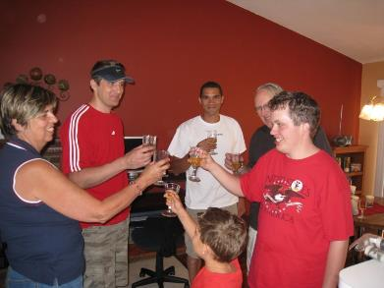
Where I Live
Housing Options
Innovative
Not Yet Discovered
Islands of Excellence
Own home Shared Living Space Co-op Environmental Adaptations Independent Supported Living
Traditional Options
Training Centers Intermediate Care Group Homes
Notes:
Settings RULE - We MUST separate where someone lives (housing) from Services. Eric’s various living arrangements – he would get “fired” from living in settings. Story about how one agency sent him to the hospital and said don’t send him back. NOW his name is on the lease. HE now has the power, the control – he can fire an agency, they can’t kick him out. The intent of the RULE is all about giving the control back to the PWD.

Slide 48

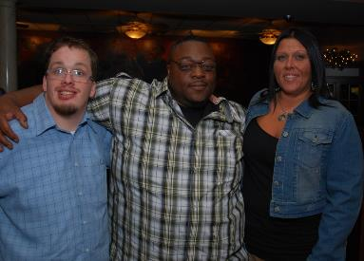
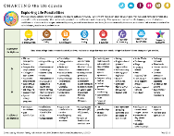
How I am Supported
Long Term Services & Supports
Innovative
A new possibility
Islands of Excellence
Remote Monitoring Assistive Technology Time banks Human-service coops Self-directed Services Respite Micro-boards Companion Model
Traditional Options
Staff hired by Provider
Notes:
Had to rethink how Eric was supported – went from 2 or 3 on 1 to living in companion model, living as a family member/friend. He’s happy and behaviors have all but disappeared.

Slide 49

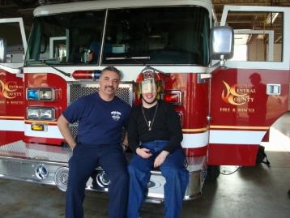
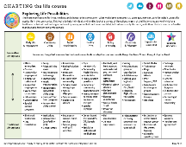
What I do During the Day
Daily Life and Employment
Innovative
A new possibility
Islands of Excellence
Micro-enterprise College/Tech Schools Career Military Supported Employment Volunteerism AmeriCorps/VISTA
Traditional Options
Sheltered Workshops Day Habilitation

Slide 50
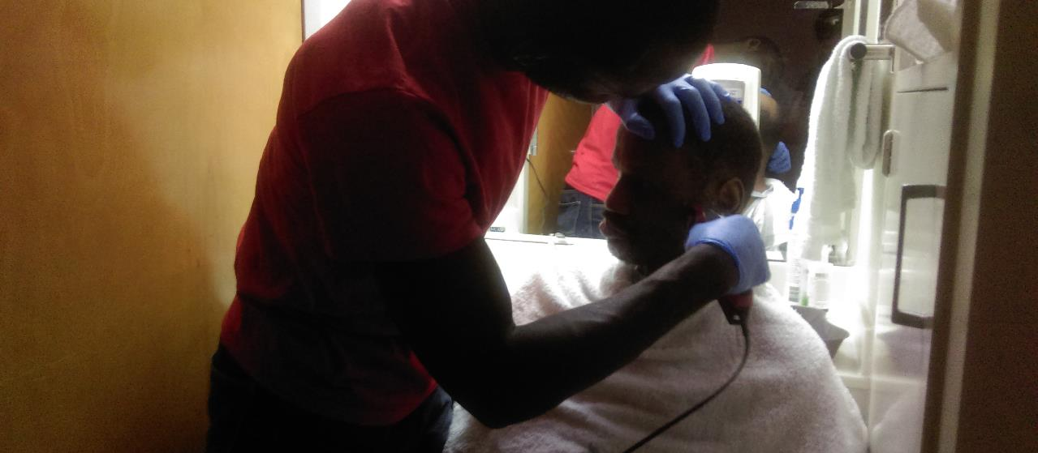
Individualized Supports to Achieve a Good Life
Notes:
Recap: Talked about
Current realities
Good life/Vision/Trajectory
Life Experiences
Domains/Life Possibilities
NOW – how do we get there???

Slide 51

Three Strategies for Supporting Families
Goods &
Services
(Day to Day, Medical, Financial Supports)
Discovery & Navigation
(Info and Training)
Connecting & Networking
(Talking to someone that has been there)
Notes:
--The 100% can have access to the 3 buckets - even if they never receive formal services
--YOU don’t have to know everything or provide it – but you can refer them to someone that does. Every state has a family to family organization, and many have parent to parent networks.
Judy Chezik and MPACT story

Slide 52

Three Strategies for Supporting Families
Discovery & Navigation Knowledge and Skills | Connecting & Networking Mental Health and Self-efficacy | Day-to-Day Services Instrumental Supports
Information on disability Knowledge about best practices and values Skills to navigate and access services Ability to advocate for services and policy change | Parent-to-Parent Support Self-Advocacy Organizations Family Organizations Sib-shops Support Groups Professional Counseling Non-disability community support | Self/Family-Directed services Transportation Respite/Childcare Adaptive equipment Home modifications Financial assistance Cash Subsidies Short/Long term planning Caregiver supports and training

Slide 53
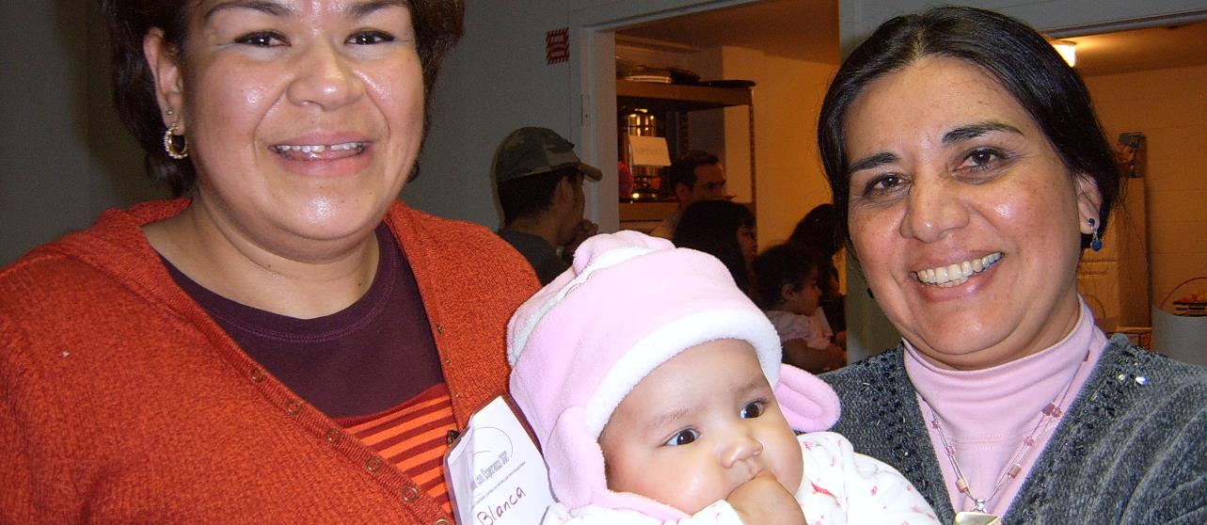
Integrated Star for Problem Solving & Exploring Options
Notes:
HOW do we get the supports needed for the GOOD LIFE???

Slide 54
Integrating Services and Supports
75%
People with I/DD not receiving formal DD services
25%
People with I/DD receiving formal DD services
100%
People with I/DD receiving integrated services and supports

Slide 55
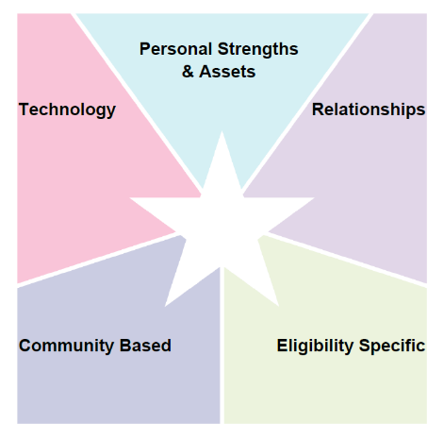


Integrated Supports STAR
resources, skills, abilities characteristics
i-pad/smart phone apps, remote monitoring, cognitive accessibility,
Adaptive
equipment
family, friends, neighbors, co-workers, church members, community members
school, businesses, church faith based, parks & rec, public transportation
SHS services, Special Ed, Medicaid, Voc Rehab, Food Stamps, Section 8
R
100%
Notes:
MAPPING
PROBLEM SOLVING
PLANNING LTSS
PLANNING ACTIVITIES
We ALL do this without even thinking about it

Slide 56
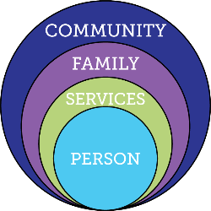

Focusing ONLY on Eligibility Supports
Friends, family, enough money,
job I like, home, faith, vacations, health, choice, freedom
Eligibility Supports
Poverty, loneliness, segregation, restrictions, lack of choice, boredom, institutions

Slide 57
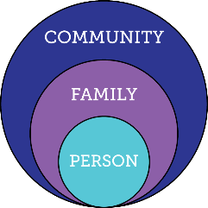

Relying ONLY on Family & Friends
Friends, family, enough money,
job I like, home, faith, vacations, health, choice, freedom
Relationships
Poverty, loneliness, segregation, restrictions, lack of choice, boredom, institutions

Slide 58
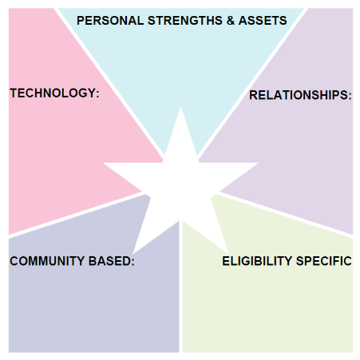
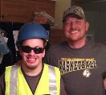
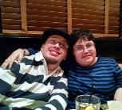


Focusing on Social and Spirituality
Happy, Funny and loving
Likes to help people
Likes to try new things
Police cars, tow trucks, fire engines and racecars
Golf Cart
I-pad
Smart Phone
See his girlfriend more
Connect with his family
Spend more time with friends
Eric
Scouts
Red Robin
Race Tracks
Companion Supports
day-to-day

Slide 59
Safety and Security
Focusing on
Supported
Decision Making

Slide 60

LifeCourse Star to Calendar

Slide 61

BEFORE: Services and Supports
Mom, Dad
Ben’s Services & Supports
DDD Self-Directed waiver PCA staff; Medicaid; Special Needs Trust

Slide 62

AFTER: Services and Supports
Able to stay home alone for up to an hour; has & can use i-pad;
i-pad when home alone; digital watch
Mom, Dad, Matt, Zac, Ali, Chad, Ericka, Roy, Carol, Nick, Spohn,
Ben’s Services & Supports
Firemen at ESFD; coaches & staff at ES high school; Omni bus;
DDD Self-Directed waiver PCA staff; Medicaid; Special Needs Trust

Slide 63

PA Community of Practice on Supporting Families

Slide 64













VALUES IN ACTION: RECOMMENDATIONS
ASSURE EFFECTIVE COMMUNICATION
SUPPORT PEOPLE WITH COMPLEX NEEDS
INCREASE COMMUNITY PARTICIPATION
    PROMOTE SELF-DIRECTION, CHOICE, AND CONTROL
    DEVELOP AND SUPPORT
    QUALIFIED STAFF
    PROVIDE COMMUNITY SERVICES TO EVERYONE
SIMPLIFY THE SYSTEM
EVALUATE FUTURE
INNOVATIONS BASED ON EVERYDAY LIVES PRINCIPLES
INCREASE EMPLOYMENT
SUPPORT FAMILIES THROUGHOUT THE LIFESPAN
IMPROVE QUALITY
PROMOTE HEALTH,
WELLNESS, AND SAFETY
EXPAND OPTIONS FOR COMMUNITY LIVING

Slide 65

ALL: Public Health Framework
Medical System
Flu Shot
Hand Washing
Anti-Bacterial Soap

Slide 66
Universal Strategies for Supporting Good Lives for ALL
LTSS Delivery Areas Focusing on Family
HCBS Waivers and State Services
Person Centered Planning and ISP
Front Door (Intake)
Paid Family Caregiver or Support Staff
Relationship-Based Models for Community Living (Shared Living)
Enhancing Provider-Family Partnerships
Notes:
P2P interacts both directions!!

Slide 67
Universal Strategies for Supporting Good Lives for ALL
DD Services
Parent to Parent/Peer Support
Family, Self-Advocacy & Sibling Networks
Inclusive education with supports
Adaptive equipment & Accommodations
Universally designed and affordable homes
Grocery carts for older kids
EMT and Police knowledgeable and supportive
Strong families and friends to share lives with
Inclusive, accepting spiritual and recreational opportunities
Notes:
P2P interacts both directions!!

Slide 68







Comprehensive, Integrated & Coordinated Systems Across
Life Domains & Stages
Pediatrician, Families and Friends,
Faith based
IDEA Part C, Parents as Teachers,
Health, Headstart
School, Special Education, Health, Recreation
Vocational Rehab, Health,
Employment, College, Military
Disability Services, Health,
Housing, College, Careers
Retirement, Aging System, Health
Notes:
Think across domains and life stages. Thinking about how we are utilizing systems and community to be the solution.

Slide 69

Project Outcome 3
Enhanced capacity of states to replicate and sustain exemplary practices to support families and systems.
Notes:
Now we can take practices and replicate them.

Slide 70






Reframing for All Stakeholders:
Developing Materials
Family to Family at Missouri UCEDD
Early Childhood, Part C
School Districts, Special Education
PNS Show Me Career Grant Pilot Sites
State Division of Developmental Disability
Special Health Care Needs
Dept. Health and Senior Services
Vocational Rehabilitation
Notes:
There are materials available on the website, we can direct you to mentors in other states and we can walk you through them. MO has put together multiple materials from front door to working with schools to leverage work around partnerships and LifeCourse

Slide 71







Reframing for All Stakeholders:
Disseminating Broadly
Tennessee
Washington
Notes:
Other states are working uniquely around outreach and with unusual partners. Washington is building technology and piloting work developed by families.

Slide 72



Reframing for All Stakeholders:
Focused Education and Training
Self-Advocates and Families
Partners in Policymaking Classes
Person Centered Planners
Teachers and School Professionals
Employment Professionals
Notes:
Different focus/uses of tools and resources

Slide 73


State Structures:
Connecting Families to Support at the Front Door
Notes:
Referrals from front door to peer-to-peer network

Slide 74





State Structures:
Support Coordinator Training
Eligibility
Services
DDS Services
Person Centered Planning
Notes:
CT has focused on support coordination training – when to use what type of training. They have taken strategies from tools and framework and fit them around the star.

Slide 75


State Structures:
Person Centered Planning and HCBS Rules
Notes:
How do you align around expectations? MO is working on aligning ISP with the LifeCourse

Slide 76




Integrating Systems and Initiatives:
Youth Transition and Employment
Statewide Employment Leadership Network (SELN)
Employment First State Leadership Mentor Program

Slide 77


Integrating Systems and Initiatives:
No Wrong Door/ADRC
No Wrong Door SYSTEM
Focus of
CoP Supports to Families and
DD System:
Support Coordination
Person Centered Thinking, Planning, and Facilitation
Family Navigation and Family Neworks
LifeCourse Framework and Tools
Responding to new CMS HCBS rule
Focusing on Front Door of DD Services
Notes:
What is it I (family) am interested in and how do I get to what I need? What does it mean from the front door.

Slide 78


State Structures:
State Waitlists
Strategies:
Strengthen Information Access
Provide Resource Navigation and Improve Inter-Agency Service Coordination
Provide family-to-family support to individuals and families who are currently on the Waiting List or who apply for Waiver Services.
Assess needs of families currently on the Waiting List.
Build capacity of services and supports outside of those provided through DDS waivers.

Slide 79


State Structures:
Medicaid State Plans and Waivers
Employment and Community First CHOICES Waiver
for Tennesseans with I/DD (Amendment 2)
  Family Caregiver Education and Training
  Community Support Development, Organization and Navigation
  Peer–to-Peer Self-Direction, Employment and Community Support and Navigation

Slide 80

What does K Plan: Community First Choice change about our current system?
Current:
Future:
Entitlements (State Plan)
Other Medicaid
Entitlements (State Plan)
Other Medicaid
Institutional
Home and Community-Based
Home and Community-Based
Institutional
Home and Community-Based
Home and Community-Based
Nursing Facilities or
ICF/ID
Nursing Facilities or
ICF/ID
Medicaid Personal Care:
Personal Care
Waivers:
Personal Care
PERS
Equipment
Assistive Technology
Home Modifications
Respite
Therapies
Habilitation
Employment Support
Other
New - Community First Choice:
Personal Care
Required CFCO Services
Optional CFCO Services?
More Flexibility?
Improved outcomes
Waivers:
Will look different in some cases
May become more of a wrap-around service to CFCO?
New: A client is potentially eligible for both
Current: client is eligible for one or the other
Notes:
Washington – balance entitlements to come in with the big world rather than just service world in mind

Slide 81

Systems Drivers for Implementing Change
Notes:
Barb went over some of the innovations in the CoP. Once you identify the key areas we work with you to think about how to do it. For example, if you want to change the front door you need to think about what values and practices guide the front door, who in leadership supports and buys in, what structures are in place to support change. Are there policies that need to be written? What goals need to be written? How to sustain change? How are we using data to understand innovation and impact and for quality assurance? Consider the key partnerships.

Slide 82






Notes:
First show the person,
Then show the family,
then bring up the domains
And then the buckets
And then the outer layers
All these things work together to make a good life.

