Slide 1
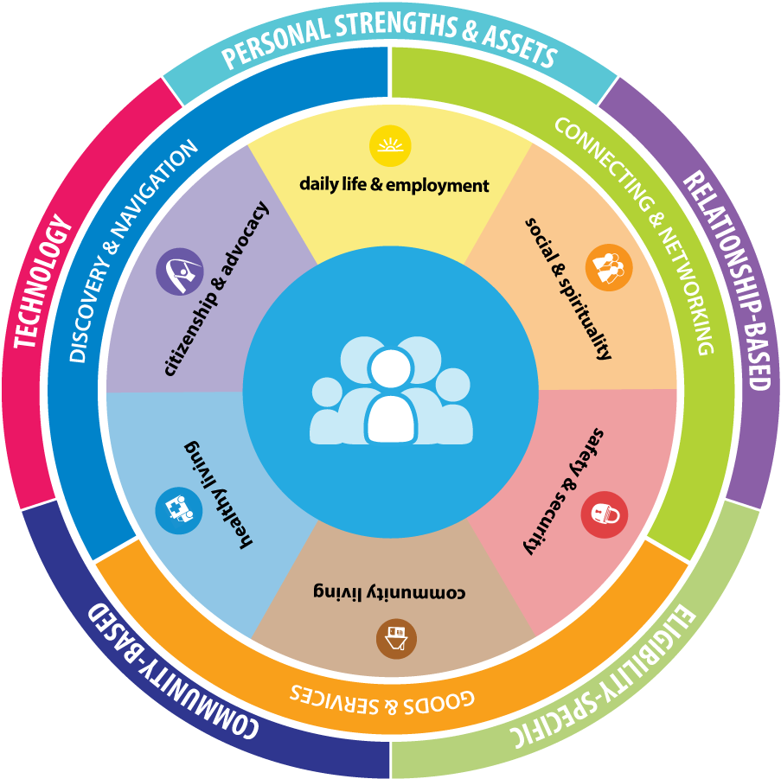
Personal Outcomes
Across the Life Course

Slide 2
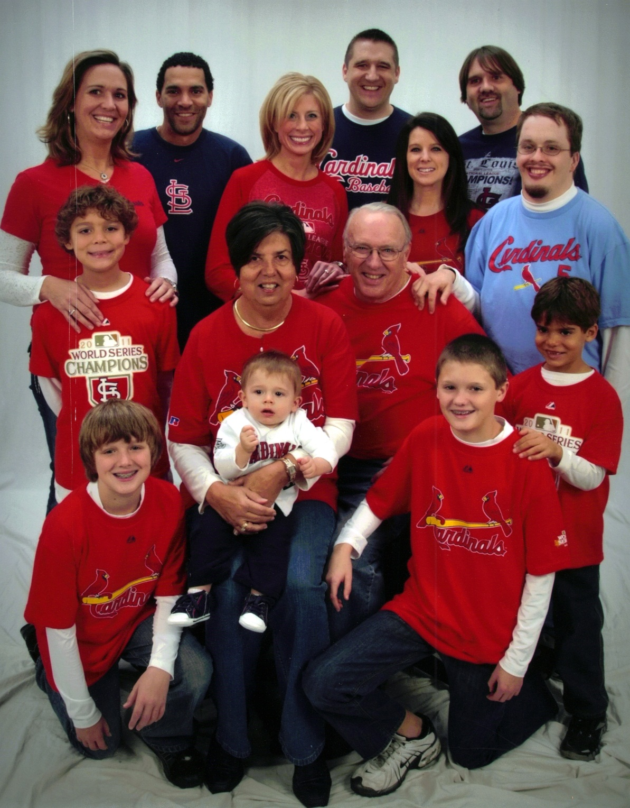
About me…
Sibling of three brothers, one who is 32 year old with developmental disability
Director of Individual Advocacy and Family Support, UMKC UCEDD
  Supported the Self-Advocacy Movement for 12 years
  Director of Mo Family-to- Family Health Info Center
  Co-Director of National CoP on Supports to Families

Slide 3

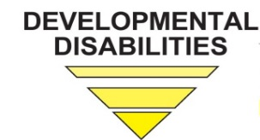



About UMKC-IHD
UCEDD/LEND has longstanding focus on Family Support, Self-Advocacy and Self-Determination
State and National Systems and Policy Change
Statewide Family Resource Center, Family-to-Family HIC, for over 25 years with evolving and on-going statewide partnership

Slide 4








Project Goal
To build capacity through a community of practice across and within States to create policies, practices and systems to better assist and support families than include a member with intellectual and developmental disability across the lifespan.
CT
DC
MO
OK
TN
WA

Slide 5








Funded by
National Partners

Slide 6
Outcomes for Today
Overview of the LifeCourse framework guiding the work of the National Community of Practice on Supports to Families
Connections between Personal Outcomes and LifeCourse principles
Introduction to LifeCourse tools and resources with concrete examples for how to use

Slide 7
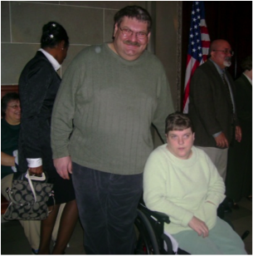
Setting the Stage

Slide 8
What we know about current realities?
Community
Family
Social Services
Person with Disability
Demand for Services
Expectations, Values, Culture
Federal Budget
Capacity of
Work Force
Federal Policy
Notes:
Key Federal Policy:
Developmental Disability Act
Individuals with Disabilities Education Act
Family and Medical Leave Act
Lifespan Respite Act
Older American’s Act
Key Federal Initiatives
Medicaid Money Follows the Person
SSA Ticket to Work
Aging and Disability Resource Centers
HHS Community Living Initiative
Other Key Initiatives:
National Governors Association initiative “A Better Bottom Line: Employing People with Disabilities”
Key Federal Policy:
Developmental Disability Act
Individuals with Disabilities Education Act
Family and Medical Leave Act
Lifespan Respite Act
Older American’s Act
Key Federal Initiatives
Medicaid Money Follows the Person
SSA Ticket to Work
Aging and Disability Resource Centers
HHS Community Living Initiative
Other Key Initiatives:
National Governors Association initiative “A Better Bottom Line: Employing People with Disabilities”

Slide 9
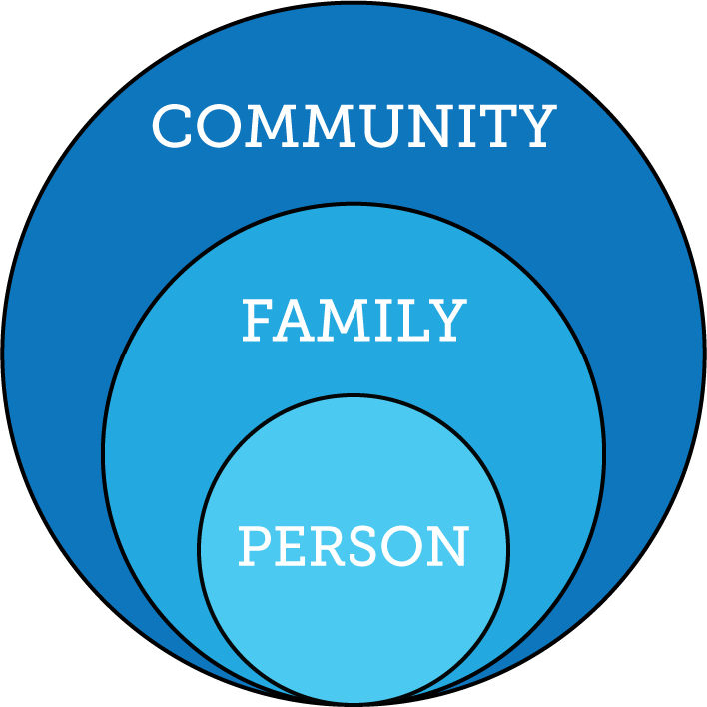
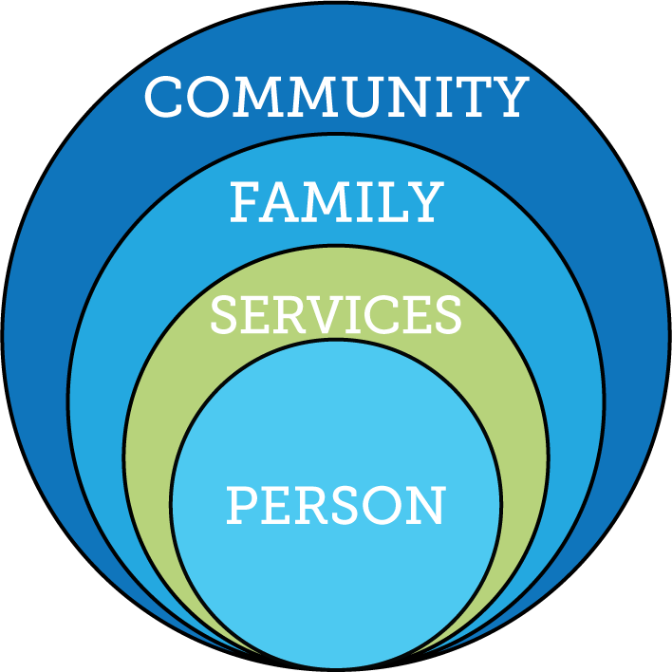
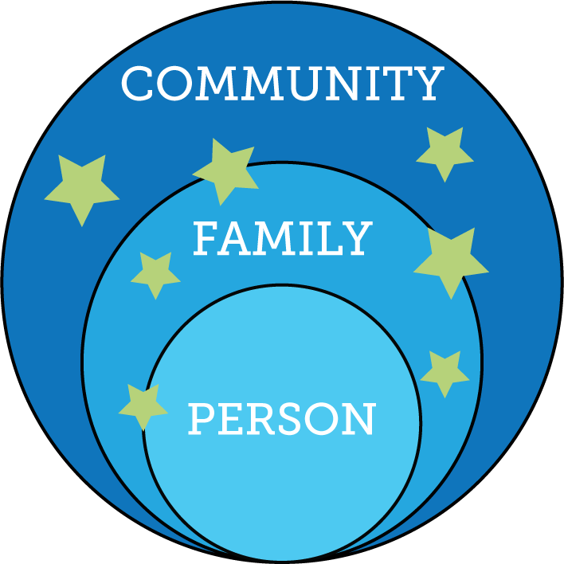
Services and Supports are Evolving

Slide 10
Type of Change that is Needed
Transitional CHange
Transformation Change
“Retooling” the system and its practices to fit the new model
Mergers, consolidations, reorganizations, revising systematic payment structures,
creating new services, processes, systems and products to replace the traditional one
Fundamental reordering of thinking, beliefs, culture, relationships, and behavior
Turns assumptions inside out and disrupts familiar rituals and structures
Rejects command and control relationships in favor of co-creative partnerships
Creating Blue Space, Hanns Meissner, 2013

Slide 11
ALL: Public Health Framework
Medical System
Flu Shot
Hand Washing
Anti-Bacterial Soap

Slide 12
Universal Strategies for Change
Eligibility Based Supports
-Parent to Parent/Peer Support
-Family, Self-Advocacy & Sibling Networks
-Inclusive education with supports
-Adaptive equipment & Accommodations
-Universally designed and affordable homes
-Grocery carts for older kids
-EMT and Police knowledgeable and supportive
-Strong families and friends to share lives with
-Inclusive and accepting spiritual and recreational opportunities
Notes:
P2P interacts both directions!!

Slide 13
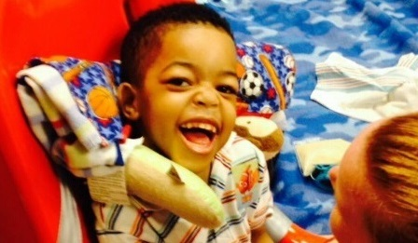
LifeCourse
Framework and TOOLS

Slide 14
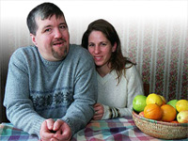
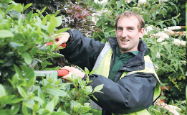
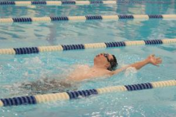
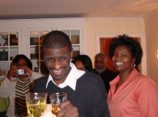
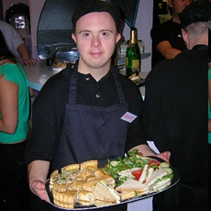
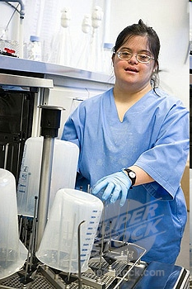
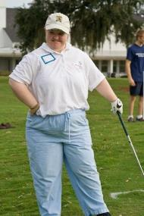
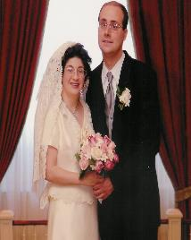
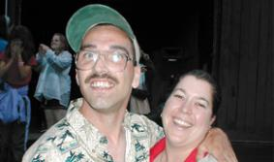
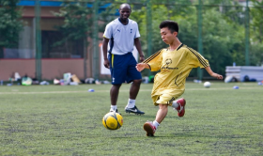
Core Belief:
All people and their families have the right to live, love, work, play
and pursue their life aspirations in their community.

Slide 15



“Good Life for All ”
The Individual will achieve self-determination, interdependence, productivity, integration, and inclusion in all facets of community life
Families will be supported in ways that maximize their capacity, strengths, and unique abilities to best nurture, love, and support all individual members to achieve their goals

Slide 16
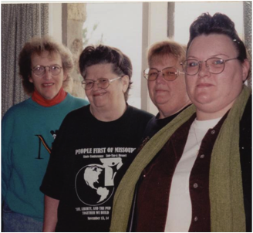
ALL People

Slide 17
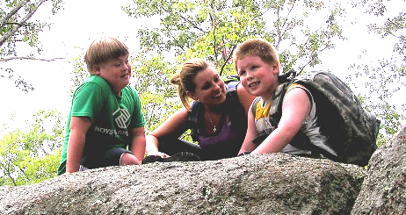
Focus on “ALL”
100%
ALL individuals (including those with
intellectual and developmental disabilities or special health care needs) and their families are considered in our values and vision.
(Family is defined by the Individual)

Slide 18
Focusing on ALL
ALL 4.9 Million people with developmental disabilities
25%
75%
National % Receiving State DD Services
Individuals who:
Unaware of disability specific services
Do not want disability specific services
Have a diagnosis but don’t meet “eligibility criteria”

Slide 19
Missourians with Disabilities
95,498 estimated Missourians with Developmental Disabilities
13%
3%
65%
(62,498)
19%
ICF/DD
Enrolled HCBS DD Services
State DD Services
Targeted Case Management
Based on 1.49% prevalence of MO citizens, US Census

Slide 20
Oklahomans with I/DD
60,277 estimated Oklahomans with Developmental Disabilities
15%
73%
(44,002)
12%
Enrolled State DD Services
Waiting for State DD Services
Based on 1.49% prevalence of OK citizens, US Census

Slide 21
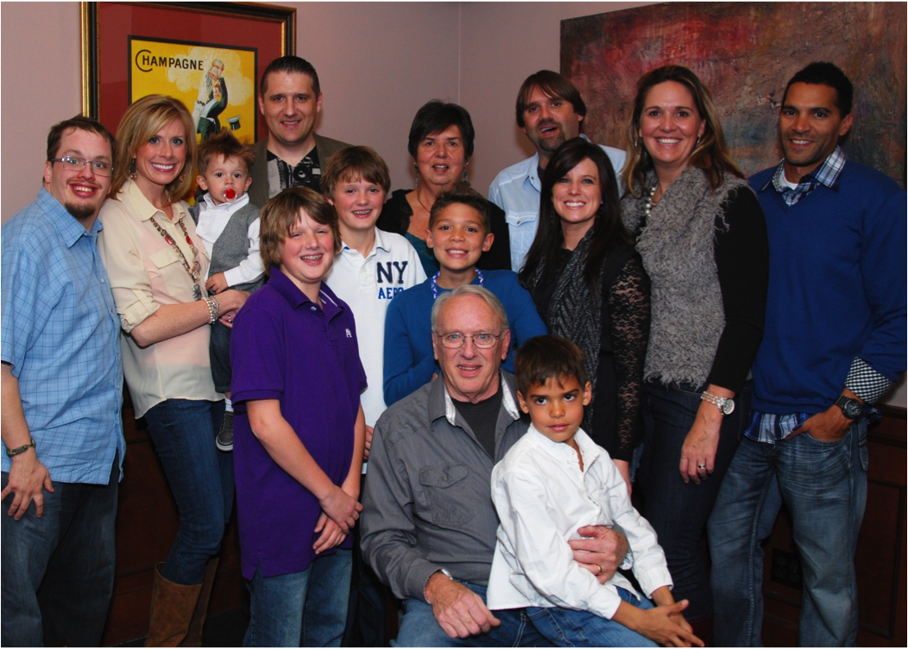
Person Within Context of Family & Community

Slide 22

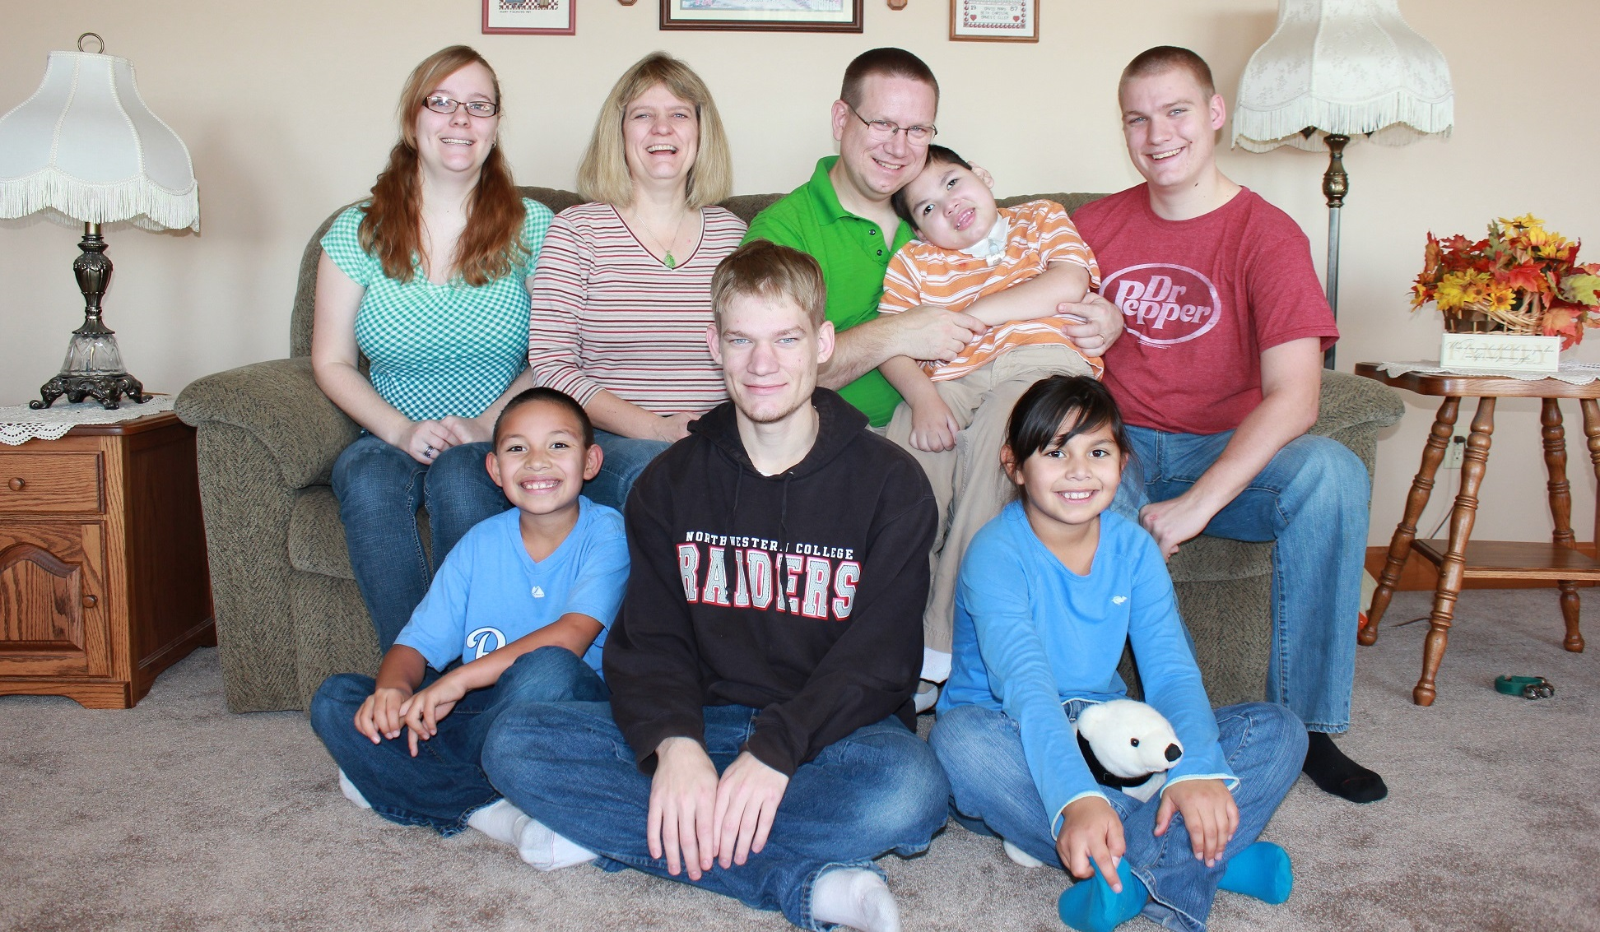
All individuals exist within the context of family
Individuals and their family, as a whole, may need supports that address different facets of life and that adjust as roles and needs of all members change through both the life cycle and the family cycle.
(Regardless of where a person lives)

Slide 23
Where Do People with Disabilities
LIVE and Receive Services?
89% of People I/DD receiving services are Supported by Family
Larson, S. A., Lakin, K. C., Anderson, L., Kwak, N., Lee, J. H., & Anderson, D. (2000).

Slide 24
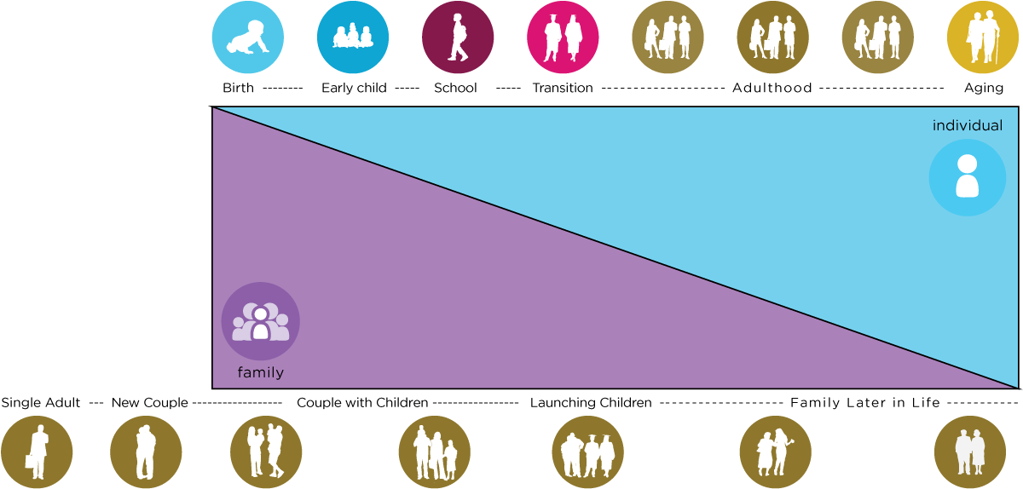
Family Life Cycle
Recognition of Individual
and Family Cycles
Individual Life Cycle

Slide 25
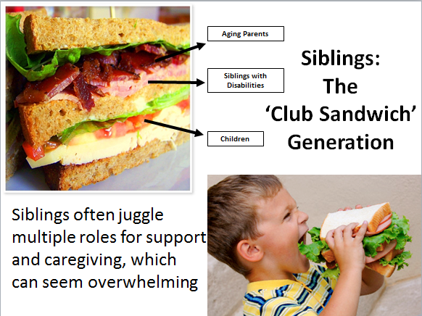

Slide 26


Reciprocal Roles between
All Family Members
Caring About | Affection & Self-Esteem
 | Repository of knowledge
 | Lifetime commitment
Caring For | Provider of day-to-day care
 | Material/Financial
 | Facilitator of inclusion and membership
 | Advocate for support
*Adapted from Bigby & Fyffe (2012), Dally (1988), Turnbull et all (2011)

Slide 27

Lifelong Impact of Family on Individual
Biologically: Likes, dislikes, skills, abilities
Socially: Family and friend network, connection with community members
Environmentally: Neighborhood, socio-economic, education
Policy:
Dreams, Aspirations,
House rules, cultural rules, expectations

Slide 28
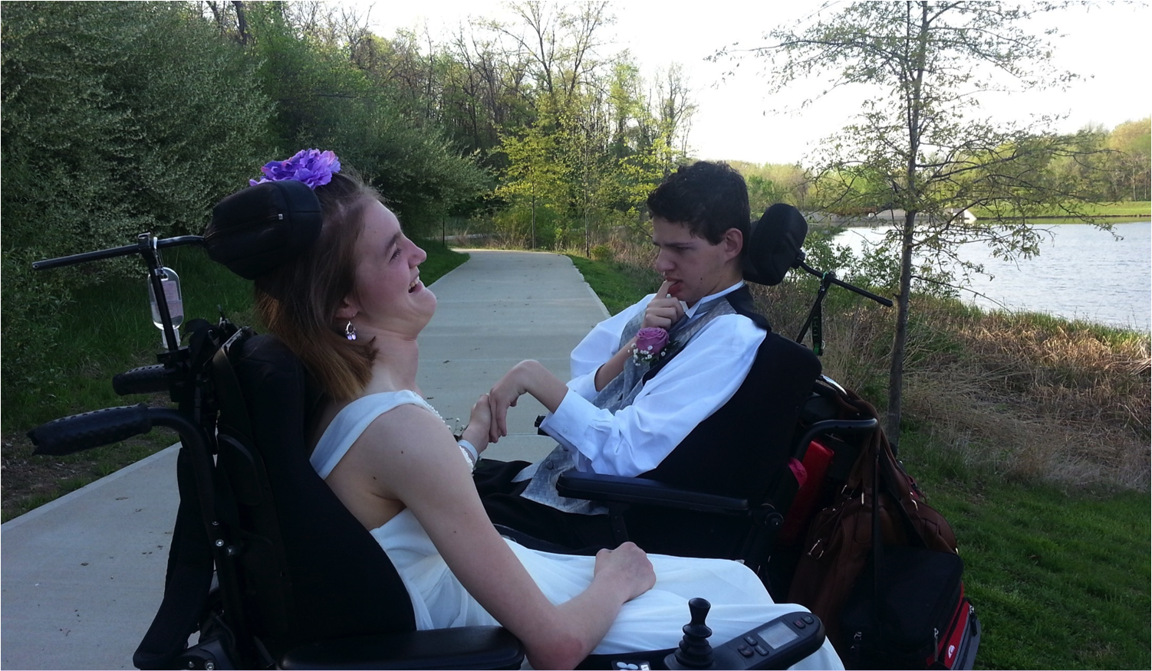
Life Trajectory, Experiences and Life Stages

Slide 29

Vision for a Good Life
The future is not something we enter. The future is something that we create. And creating that future requires us to make choices and decisions that begin with a dream.
    -Leonard L. Sweet

Slide 30
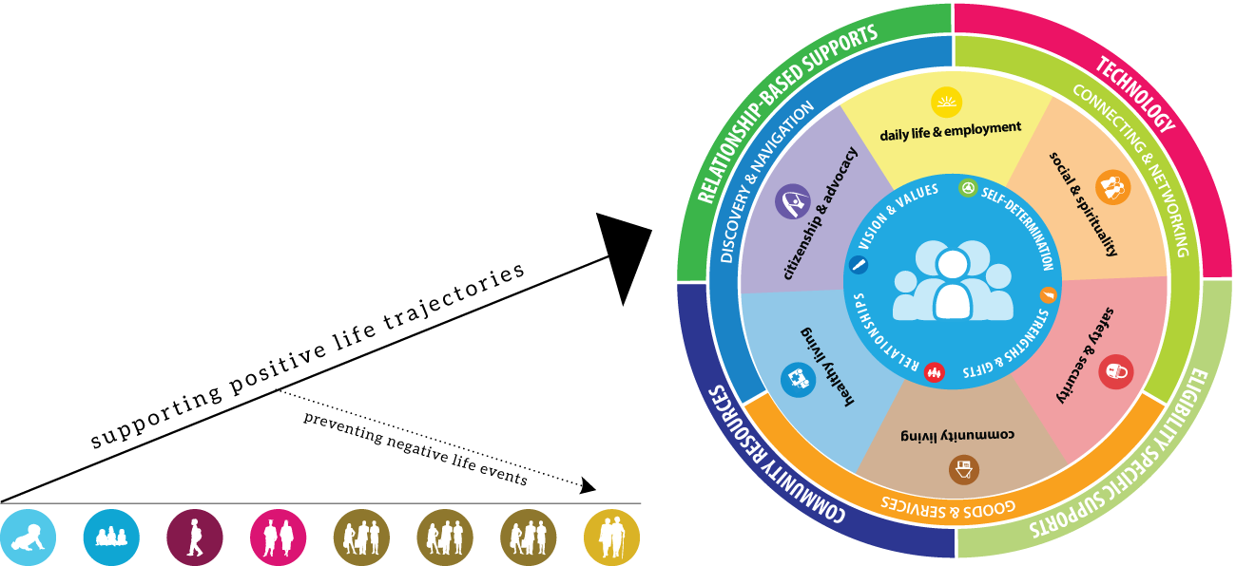
Vision and Trajectory
Notes:
FIX!!

Slide 31






Focusing on Life Experiences
“Volunteering at church”
“Making mistakes”
Learning to say “no”
“Birthday parties with friends”
“Playing sports or an instrument”
“Chores and allowance”
Birth-----Early Child----School----Transition---Adulthood-------Aging
“Anticipatory Guidance for Life Experiences”

Slide 32
Life Stages: Think Across Generations
Age | 0-5 | 6-18 | 19-64 | 65
Total MO Population | 362,650 (6%) | 1,045,641 (17.3%) | 3,747,386 (62%) | 888,537 (14.7%)
Approx. DD (1.58%) | 5729 | 16,521 | 59,209 | 14,038
Notes:
Where are people the longest?

Slide 33
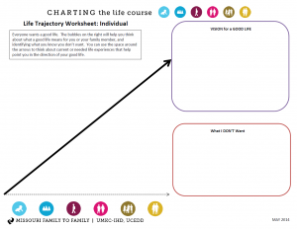
ACTIVITY:
Charting Life Experiences
Family &Friends
Education
Career
Job of Choice
Economic Sufficiency
$ for Home & Fun
Poverty
Isolation/Loneliness
No opportunities
Sheltered Employment
Dependence on Govt

Slide 34


a
Life
Medical spend down
Trajectory toward life
Adulthood
Guardianship
SSI
School
LABELED
WORLD
Poverty
Special programs
Depend upon public funding
Isolation – even segregation
Birth
Human Service Path
Disability path
Washington Community of Practice Adapted from National CoP Supports to Families, 2015

Slide 35
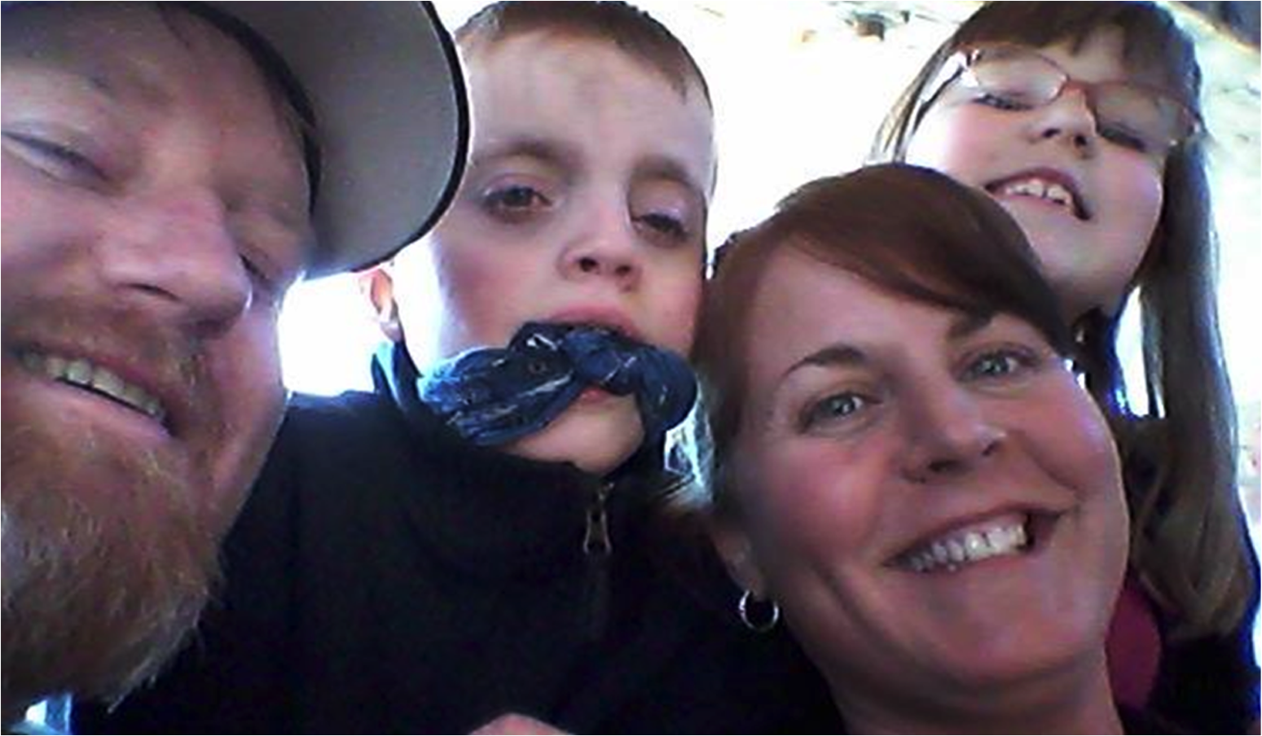
Life Domains and Outcomes

Slide 36






Thinking Across All Life Domains
Daily Life and Employment
(school/education, employment, volunteering, routines, life skills)
Healthy Living
(medical, behavioral, nutrition, wellness, affordable care)
Community Living
(housing, living options, home adaptations and modifications, community access, transportation)
Safety and Security
(emergencies, well-being, legal rights & issues, guardianship options & alternatives )
Social and Spirituality
(friends, relationships, leisure activities, personal networks, faith community)
Citizenship and Advocacy
(valued roles, making choices, setting goals, responsibility, leadership, peer support)

Slide 37
Trajectory toward
Positive
Life Outcomes
Friends, family,
self-determination, community living,
social capital and economic sufficiency
Trajectory towards Outcomes
Vision of What I Don’t Want
Trajectory towards things unwanted
Across the Lifespan

Slide 38
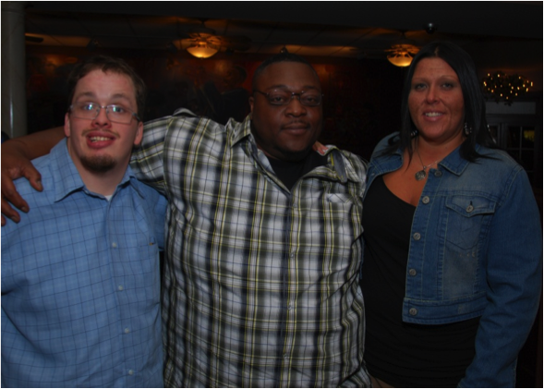
Individualized Supports to Achieve a Good Life

Slide 39
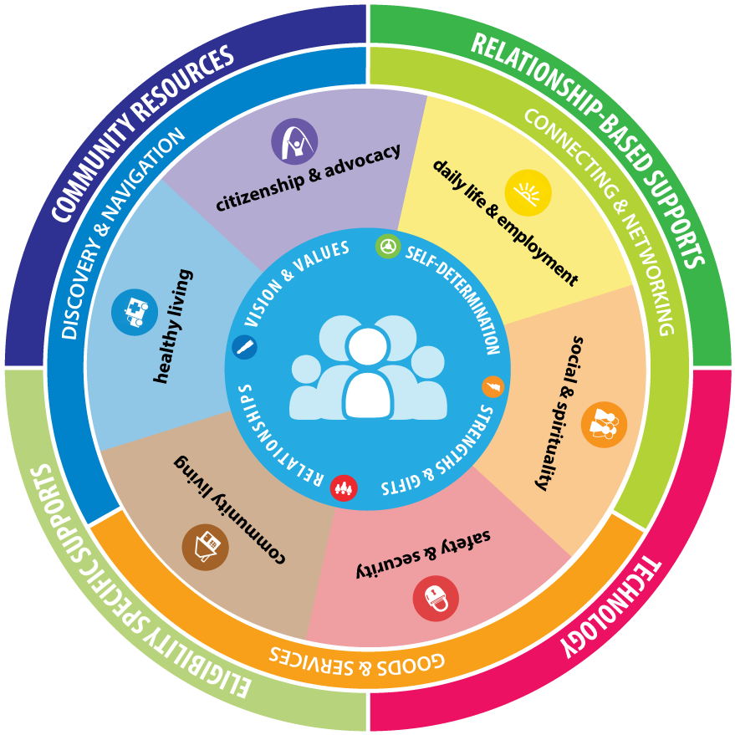
What People Need to be Supported
People with disabilities and their families…
have access to resources and supports, that are person and family centered and directed, that enhance individual lives and maintain the family well-being.
Life Course
Notes:
vision for real lives
-real life experiences
-recognzies person within context of their family

Slide 40

Three Types of Supports
Goods &
Services
(Day to Day, Medical, Financial Supports)
Discovery & Navigation
(Info and Training)
Connecting & Networking
(Talking to Someone that has been there)

Slide 41
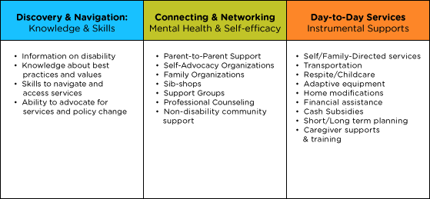
Types of Supports

Slide 42
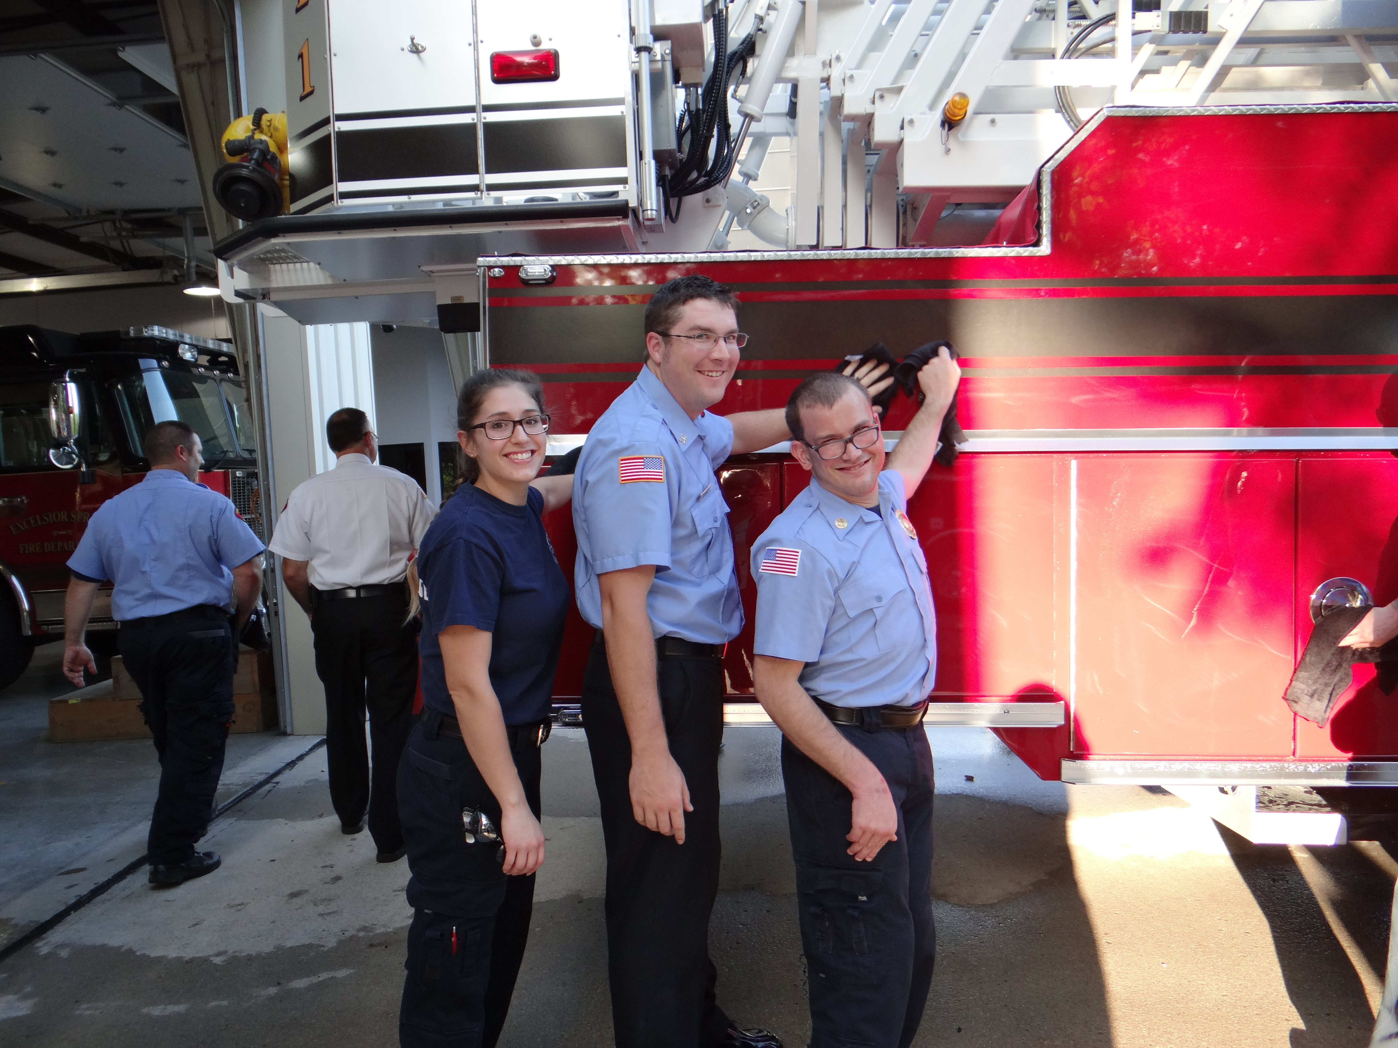
Integrated Star for Problem Solving & Exploring Options

Slide 43
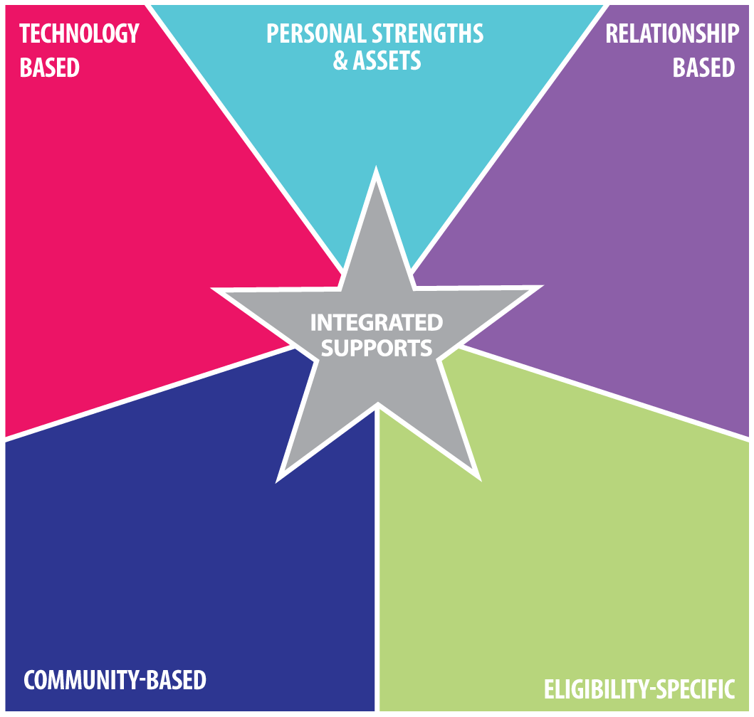
Identifying, Developing and Integrating
Supports & Services
i-pad/smart phone
apps, remote monitoring,
cognitive accessibility,
adaptive equipment
person or family resources, abilities, strengths, characteristics
family, friends, neighbors, co-workers, community members, church members
SHS services,
Special Ed,
Medicaid,
section 8,
Food Stamps,
Vocational Rehab (VR)
school, businesses,
church/faith based,
public transportation,
parks and recreation

Slide 44
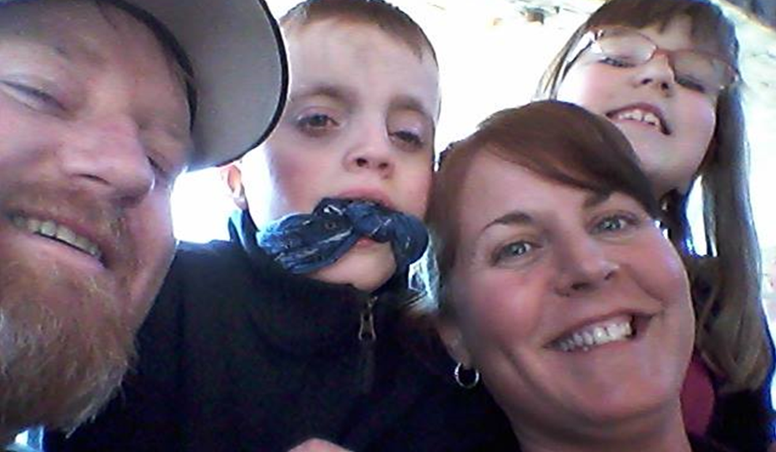
LifeCourse Framework and Tools in Action

Slide 45
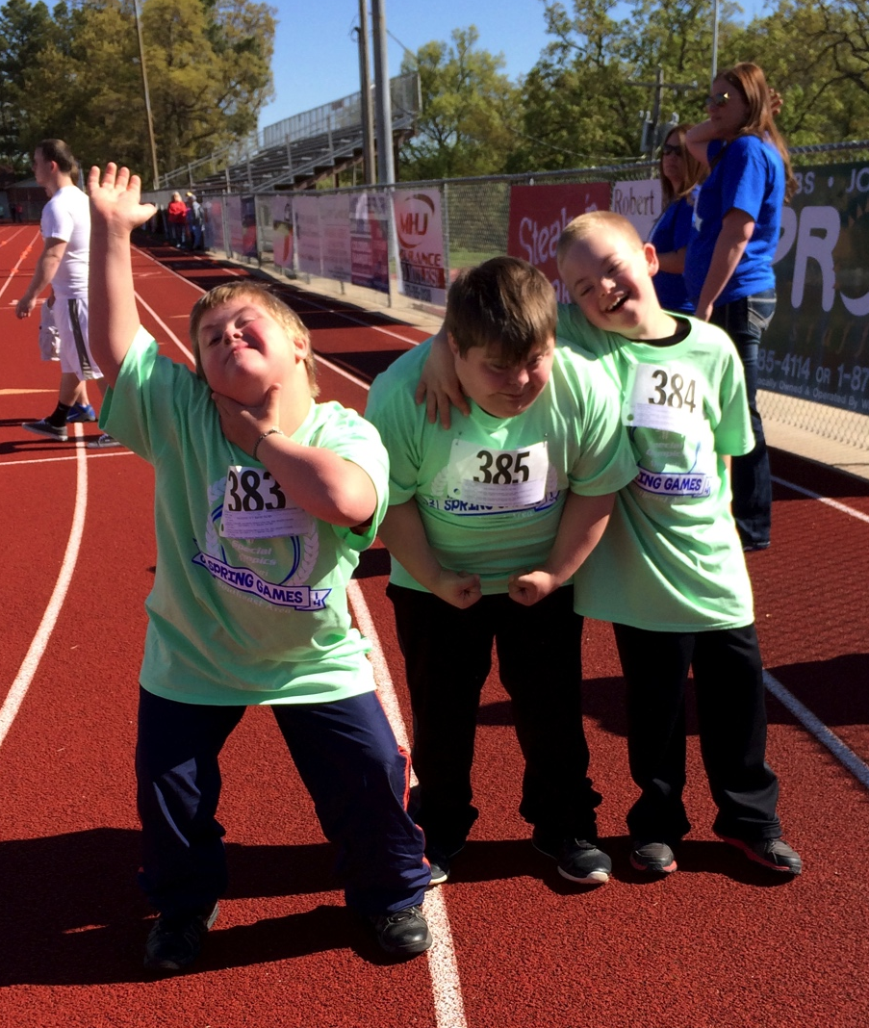
Peyton’s Plan for Inclusion in
School
Using the LifeCourse Tools to Transform the Way the School Thinks about Inclusion for Peyton
Notes:
How the Story Began: Peyton
Family wants Peyton to attend the neighborhood school with his brother and his school age peers
School believes that Peyton will be best supported in a next year in a segregated setting, in a different building which does not have students his age
During the IEP meeting, the school and parent became grid-locked on a what more inclusive day could look like for Peyton (he was not included in homeroom, lunch, specials or other general education class)
Two weeks later, Mom brought Peyton’s trajectory, integrated star and weekly schedule to the follow-up IEP. The school better understood what she wanted and have made more concrete strides at meeting his inclusion needs.

Slide 46
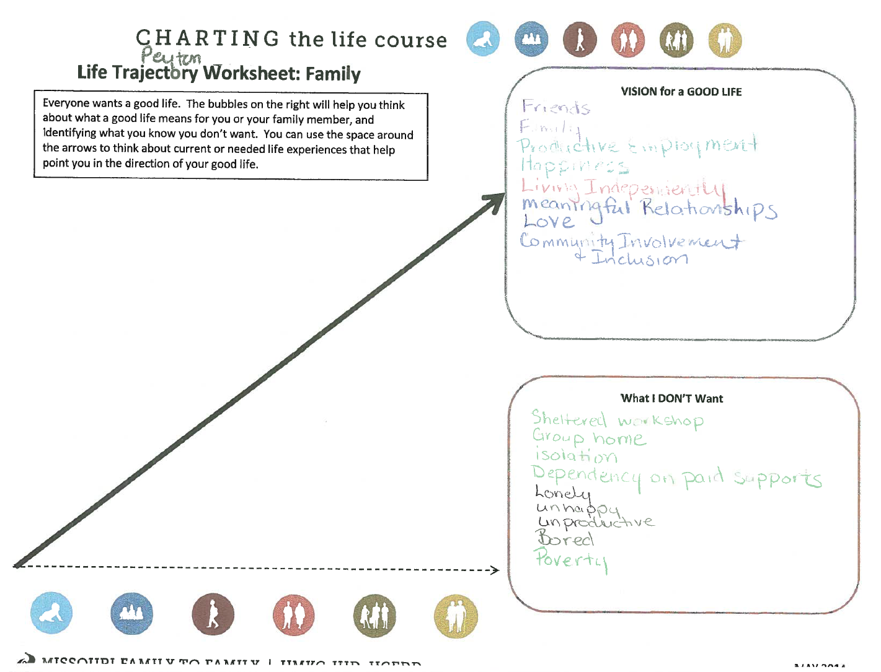
Peyton’s Good Life

Slide 47
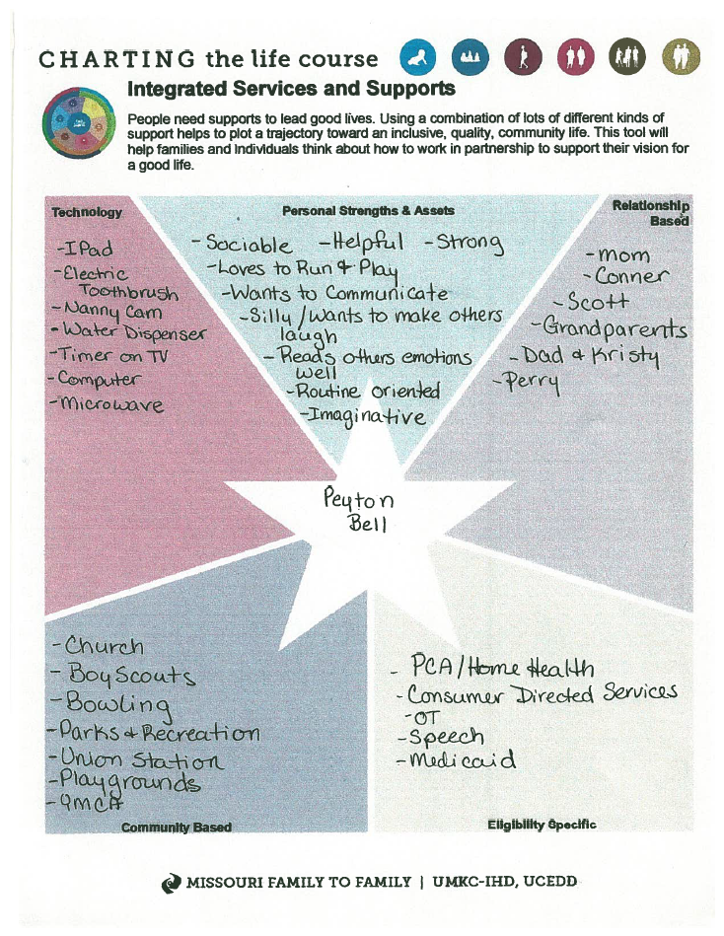
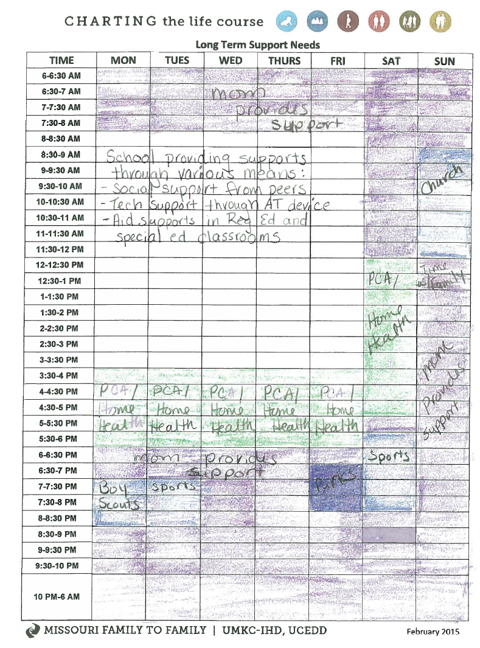
Peyton’s Integrated Good Life

Slide 48
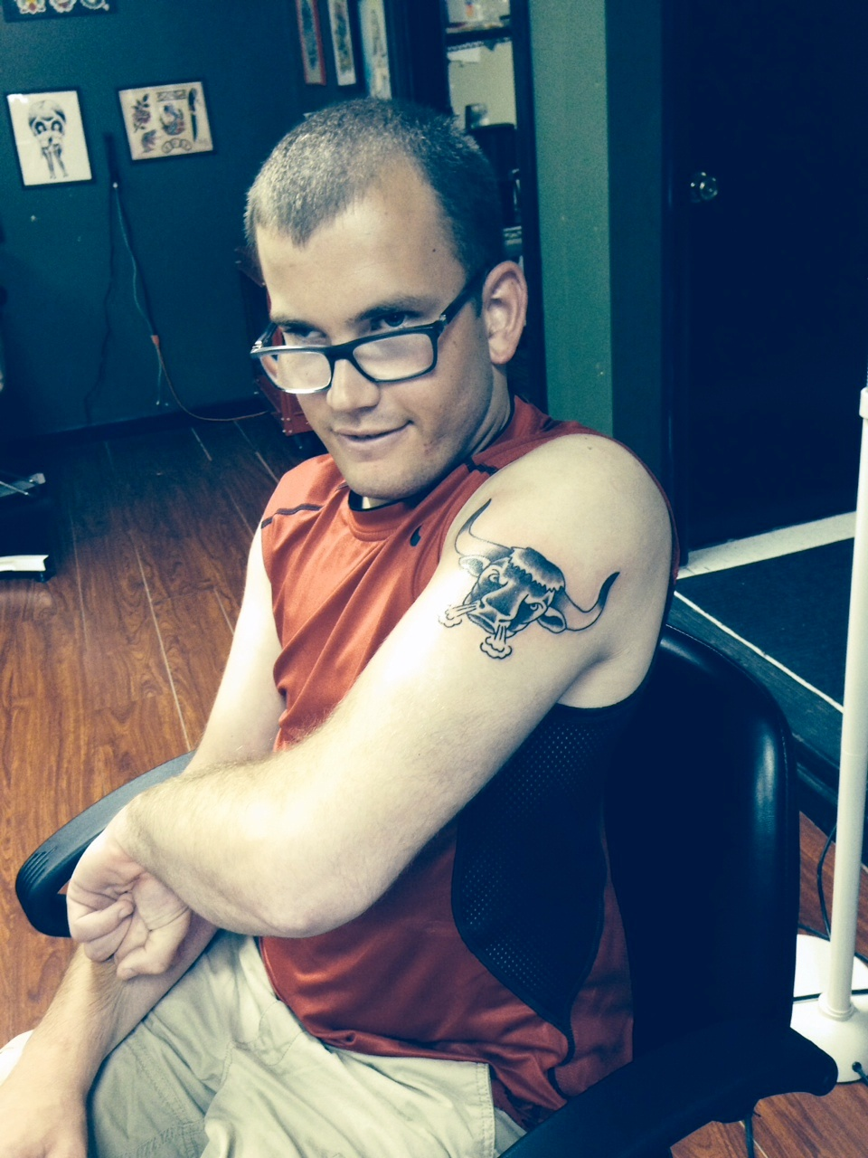
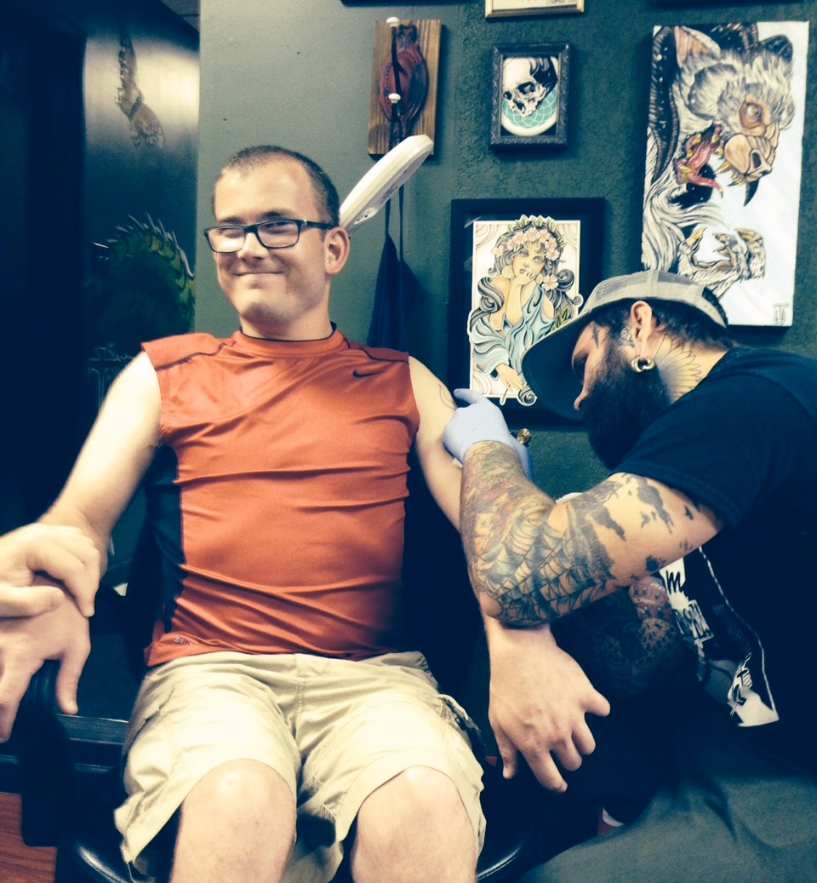
Ben’s GOOD LIFE

Slide 49
Tools Used for Planning and Day-to-Day Supports for DMH
Division of DD
(Ben’s One Page Profile)

Slide 50
Ben’s Life Trajectory

Slide 51
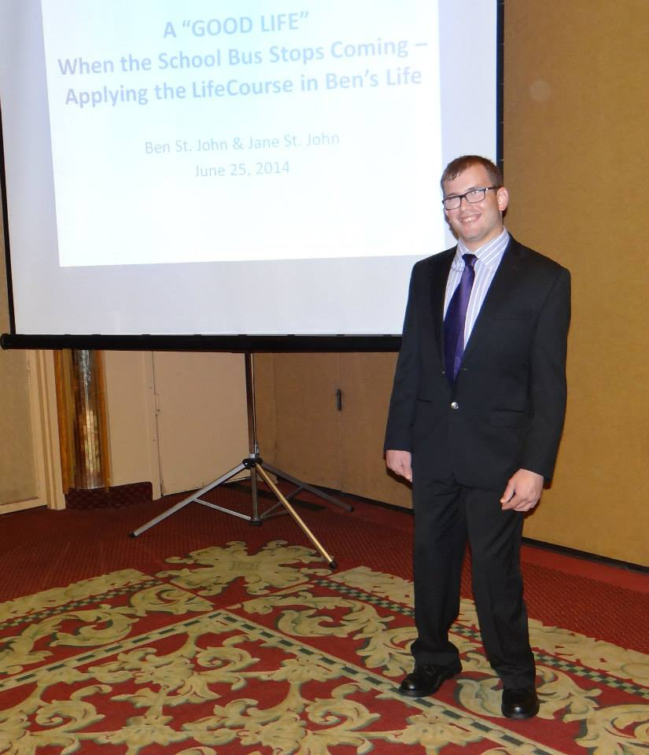
Ben’s Integrated Services and Supports Star
Outgoing personality, friendly, Eagle Scout,
can ride city bus
Dad, Mom, Matt, Zac, Ali, Chad, Ericka, Sheli,
Firemen friends,
Ange, Pam, Wally, Josh B., Matt S.,
Mike, Nick,
Scouting friends
I-pad, apps, Facebook,
Facetime,
Digital watch,
Vibrating toothbrush,
Glasses
Ben’s
Omni bus, Walmart,
24 Hour Fitness,
library, Price Chopper, Dr. T.,
St. Ann’s church, ES Fire Dept,
joint bank account, direct deposit, Power of attorney
PCA –DDD, self-
directed supports
Social Security,
Medicaid, Special
Needs Trust

Slide 52
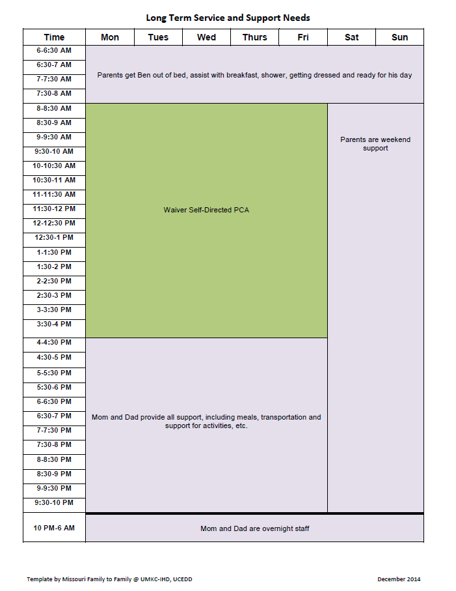
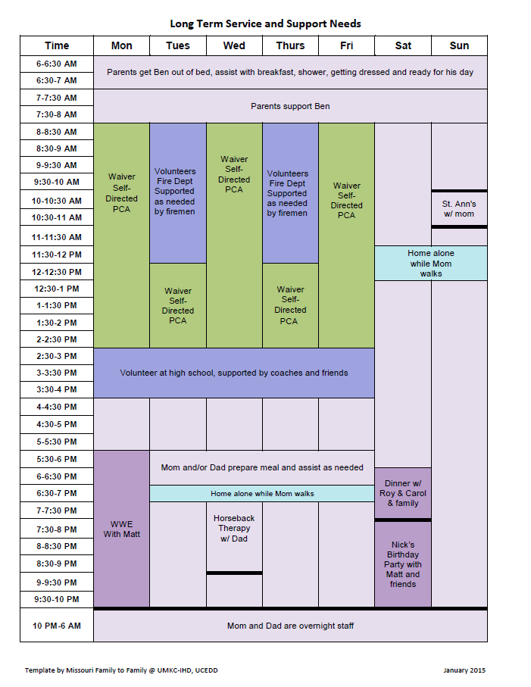
Integrating Supports into Real Life

Slide 53
Ben’s Integrated Activities

Slide 54
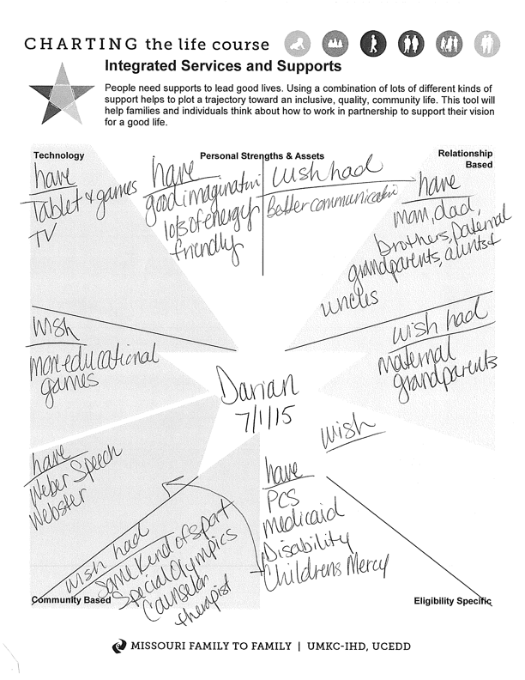
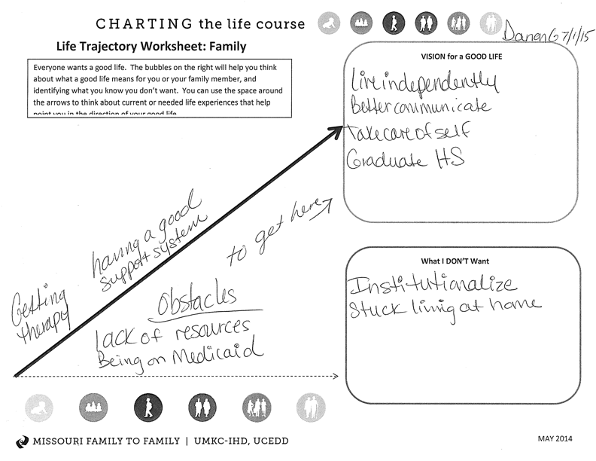
Darien – age 3

Slide 55
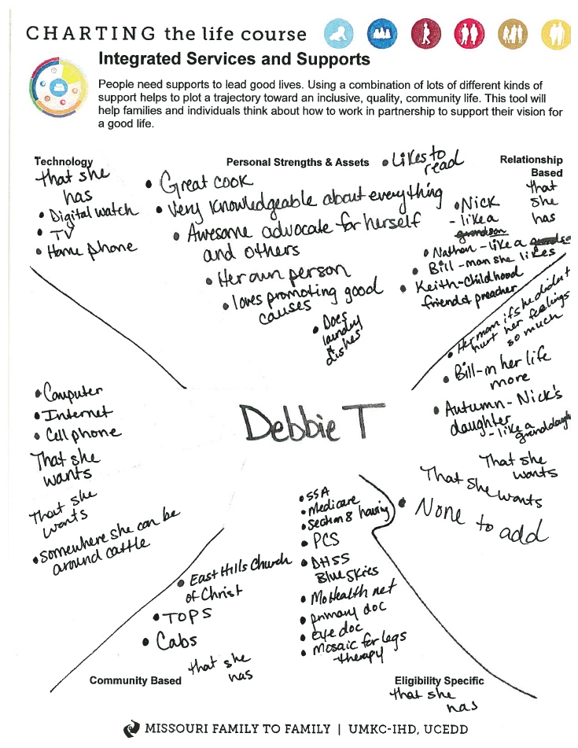
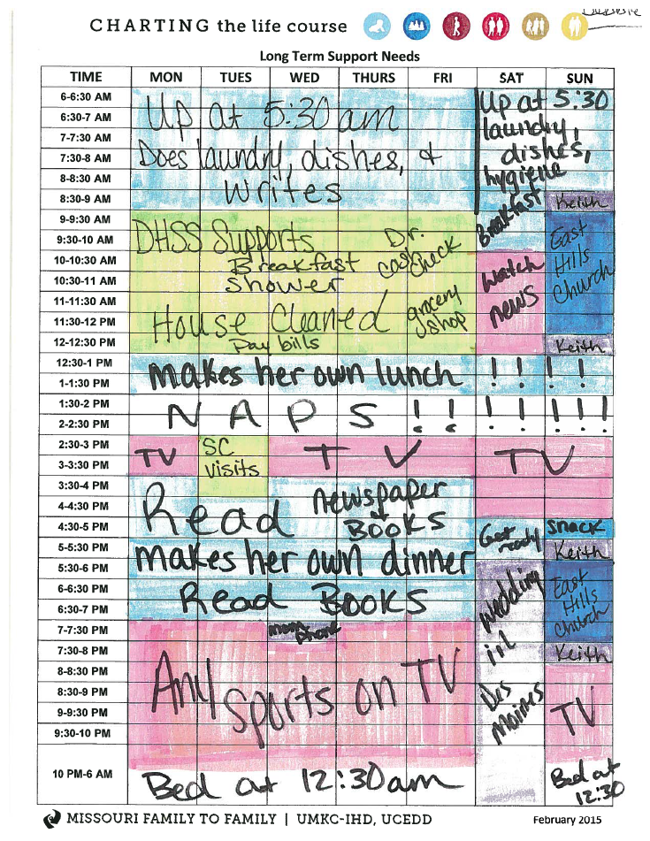

Slide 56
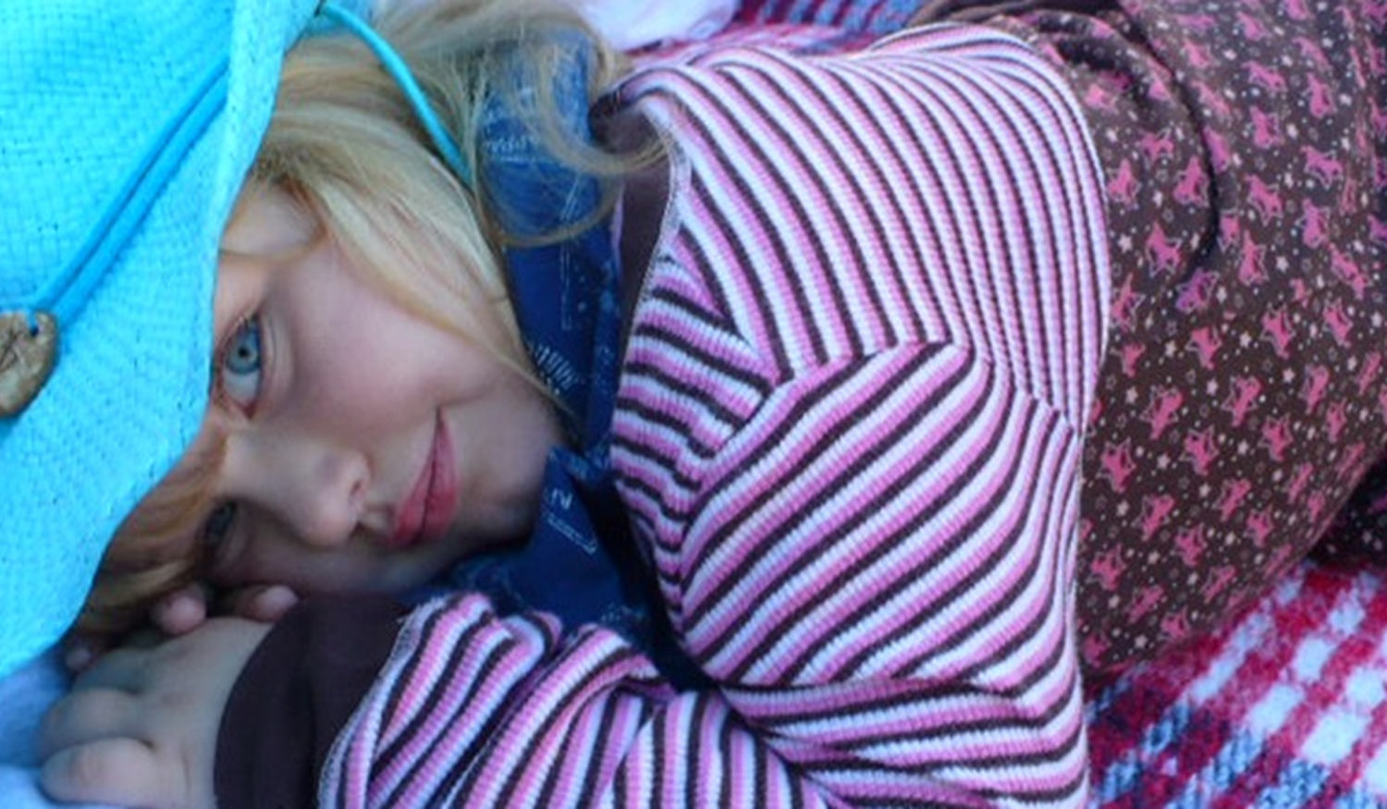

Elizabeth’s
Health and Wellness Trajectory
Self determination
Choice
Privacy
VISION for a GOOD LIFE
Uncharted trajectory self-cath
Peer Support/Research/Advocacy
Unnecessary medications
Unnecessary procedures
Limiting choices
Limiting self-determination
What I DON’T Want
Peer Support / Research /Advocacy
Charted trajectory ditropan
Charted trajectory stoma
5 Months…………….1 year…………………2 years

Slide 57
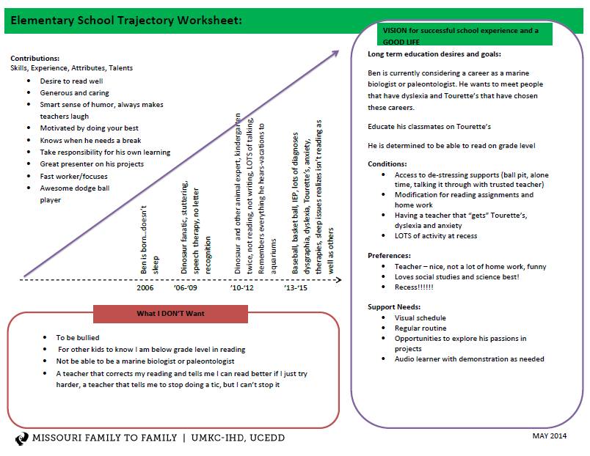
Elementary School Trajectory
Notes:
This is a trajectory made by a mom after interviewing her 9 year old son about school.
Point out some of the cool concepts that come to mind

Slide 58
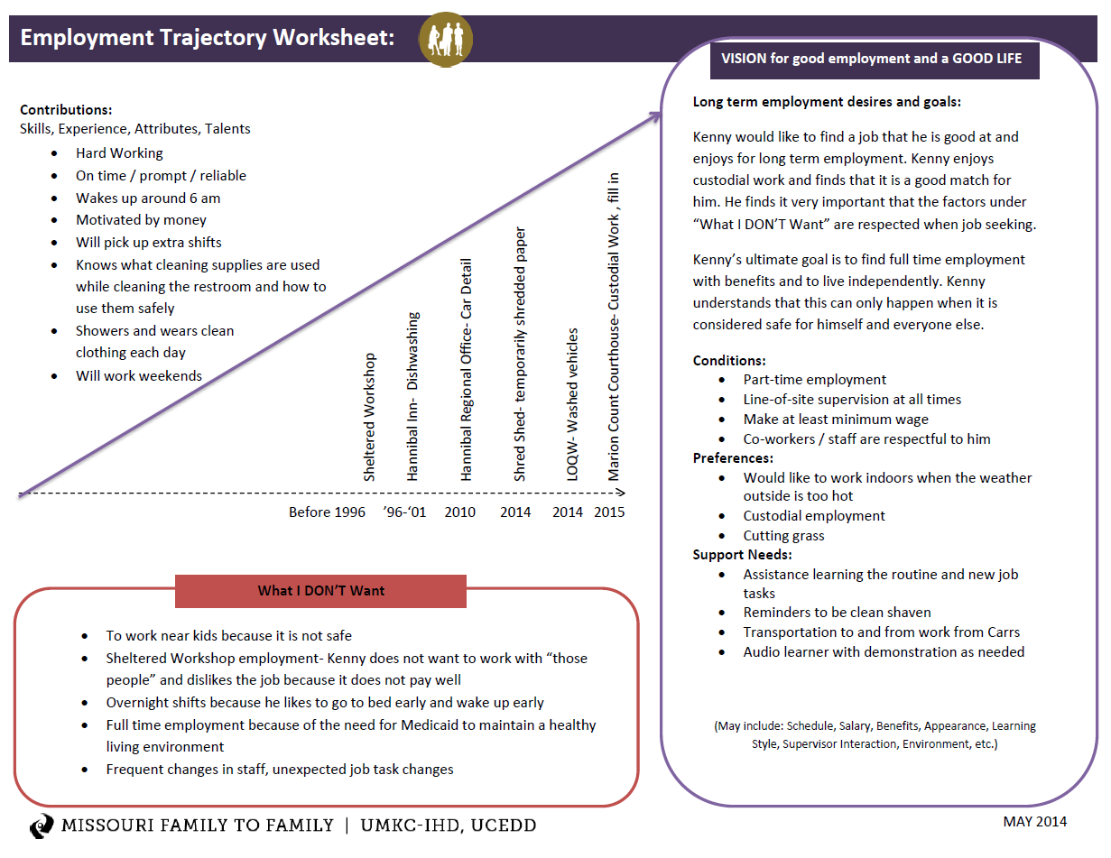
Adult Employment Trajectory

Slide 59
Domain Specific
Safety and Security:
Focusing on Supports Beyond
Legal Guardianship

Slide 60





Eric’s Focus on Social and Spiritual
Happy, Funny and loving
Likes to help people
Likes to try new things
Police cars, tow trucks, fire engines and racecars
Golf Cart
See his girlfriend more
Connect with his family
Spend more time with friends
Scouts
Red Robin
Race Tracks
Companion Supports
day-to-day
I-pad
Smart Phone

Slide 61

Community & Person/Family
Centered & Driven Policy & Systems

Slide 62
Comprehensive, Integrated & Coordinated Systems Across Life Domains & Stages
Pediatrician, Families and Friends, Faith based
IDEA Part C, Parents as Teachers, Health, Headstart
School, Special Education, Health, Recreation
Vocational Rehab, Health Employment, College, Military
Disability Services, Health, Housing, College, Careers
Retirement, Aging System, Health
Notes:
Parent to Parent/Peer Support flows across all the stages of life

Slide 63

Partnering with People with Disabilities and their Families so they can
Engage, Lead, and Drive
Policy and Systems Change

Slide 64
Putting the Framework Together!

Slide 65
Questions, Reflections and Discussion

Slide 66
Contact Information
Sheli Reynolds
816-235-1759
reynoldsmc@umkc.edu

